Slide 1
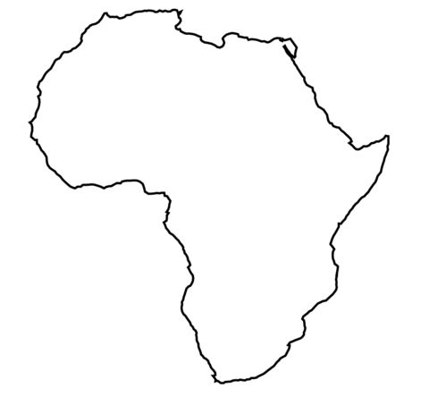
Stone age foraging
Late Stone Age Pastoralism
Agriculture
a)
b)
c)
San (Kx’a & Tuu)
Khoe-Kwadi
Bantu
Notes:
Three population strata in southern Africa, two introductions of food producing strategies (pastoralism=Khoe-Kwadi), agriculture+agro-pastoralism=Bantu

Slide 2
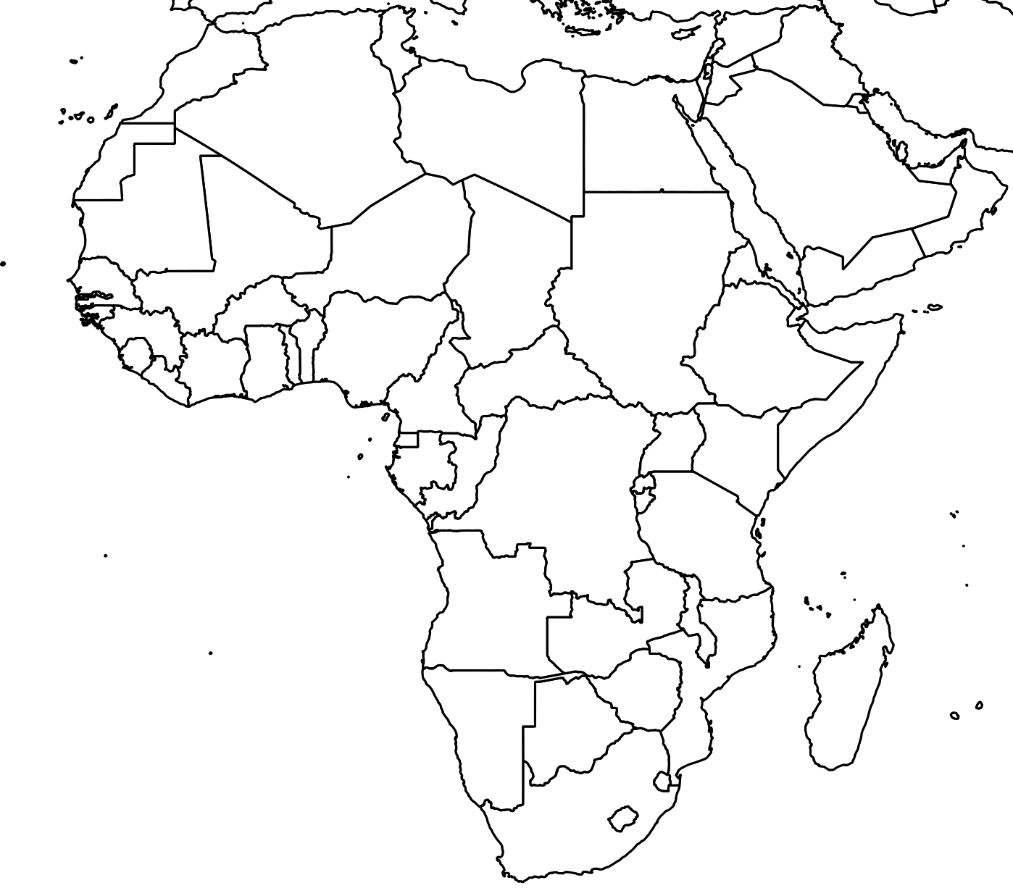



Hypothetical Khoe-Kwadi migration into southern Africa
Proto Khoe-Kwadi
Khoe
Kwadi
Khoekhoe
Kalahari
Khoe
?
Tom Güldemann (2008): A Linguist’s View
Notes:
Hypothetical encroachment of the Khoe-Kwadi into southern Africa, along with the domesticates they introduced

Slide 3
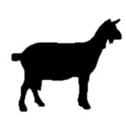

The Bantu expansion
SW-Bantu
East-Bantu
Notes:
ca. 2000 BP: Arrival of Bantu-speakers from the east and west, introduction of cattle, goats, dogs and crops; livestock presumably only from the east

Slide 4
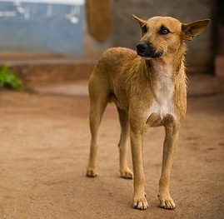
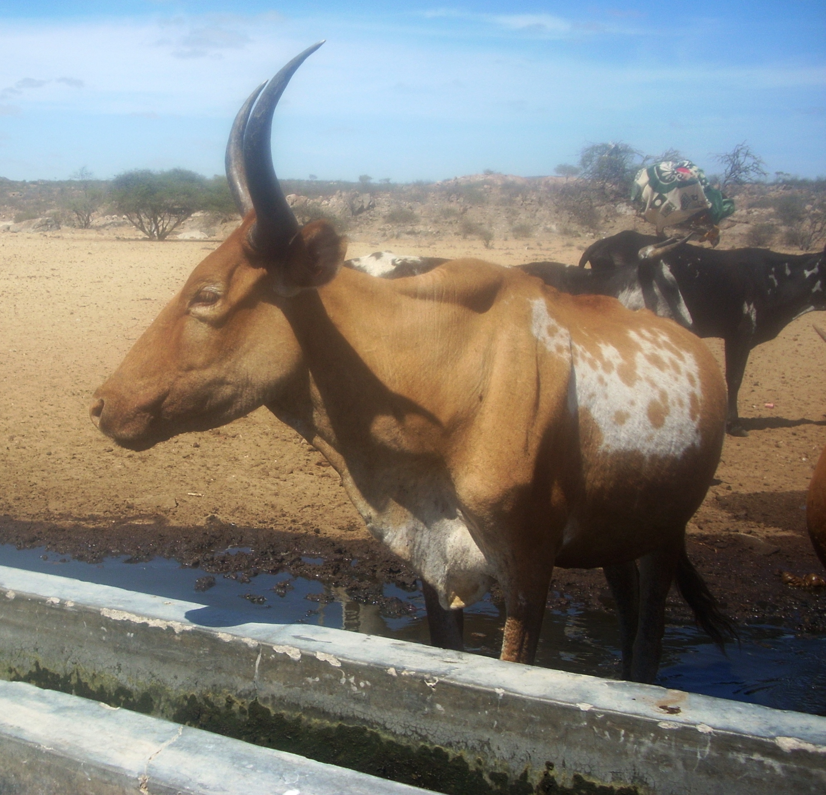
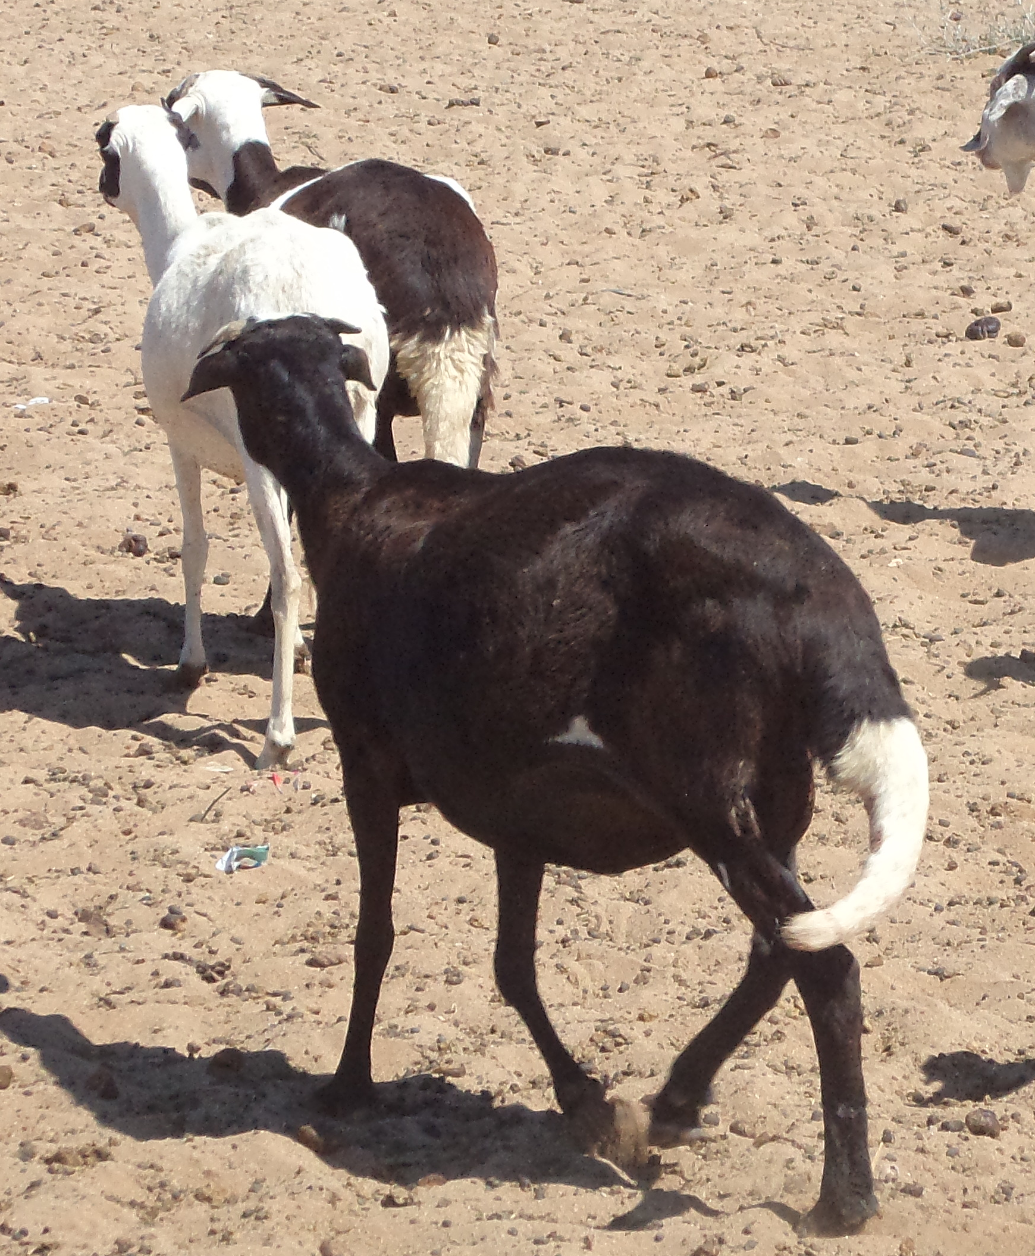
Domesticates

Slide 5
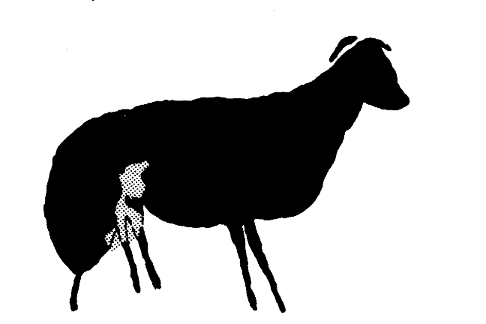
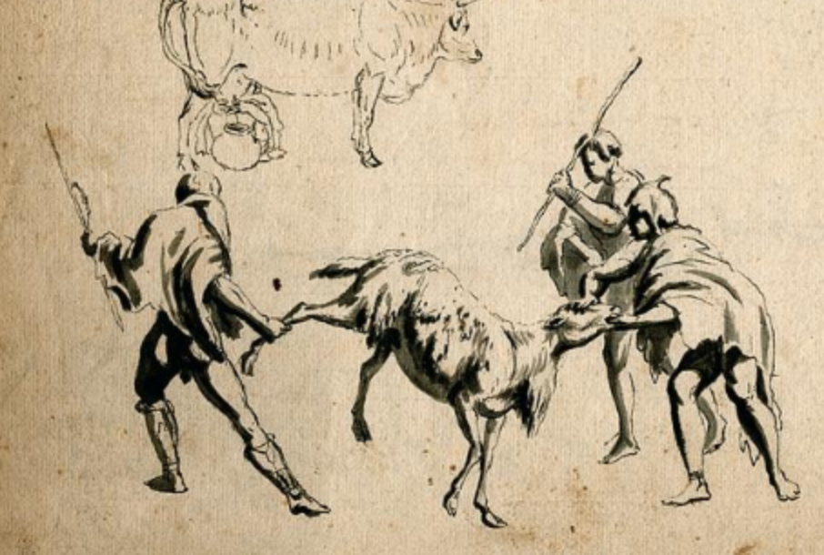
‘Fat-tailed sheep’
> first attested domesticate to reach southern Africa
Falls rockshelter (Namibia, 2200 BP)
Toteng (Botswana, 2200 BP)
Blombos (South Africa, 1900 BP)
Spoegriver (South Africa, 1850 BP)
Rock art of fat-tailed sheep in
Mazowe, Zimbabwe
Historical sketch of Khoekhoe herders with sheep
Fat-tailed sheep in SW-Angola
(cf. Blench 2010, https://www.wdl.org/en/item/11266/ )
Notes:
Evidence for early presence of sheep in southern Africa

Slide 6
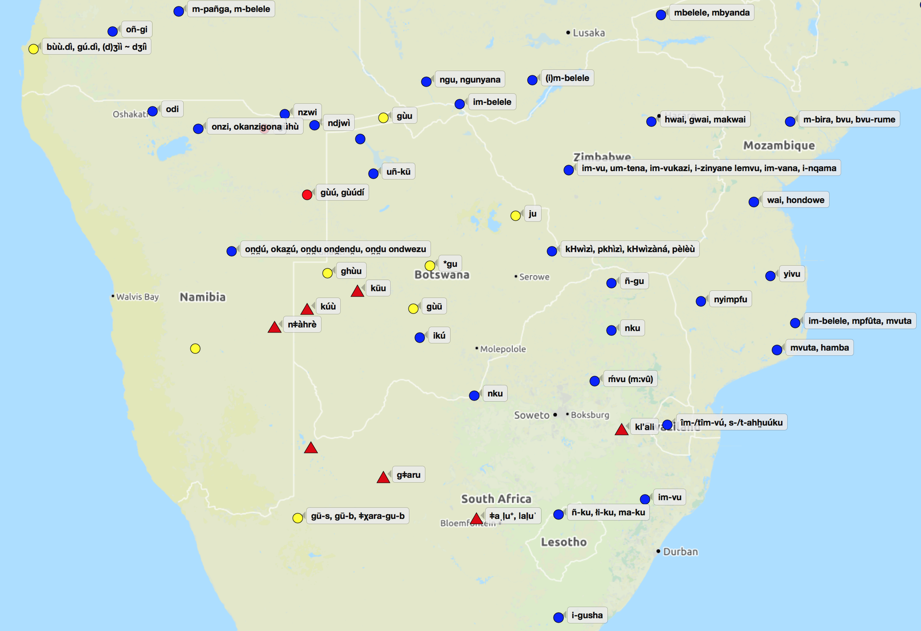
‘Sheep’
P-Khoe-Kwadi
*guu
Map courtesy of http://www.tsammalex.clld.org/
Notes:
Distribution of the root *guu ‘sheep’ across four language families in southern Africa

Slide 7
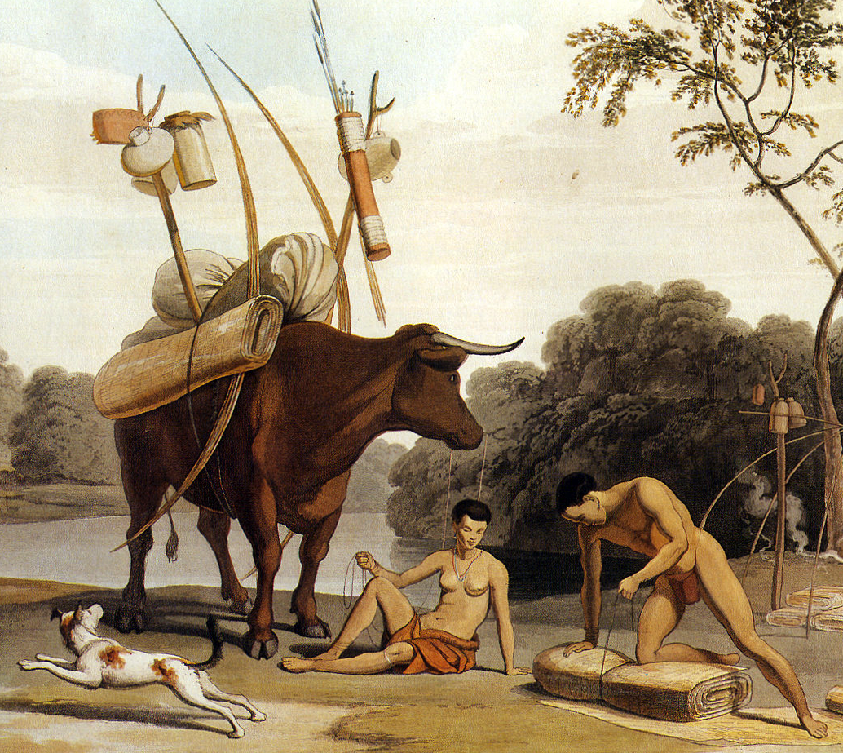
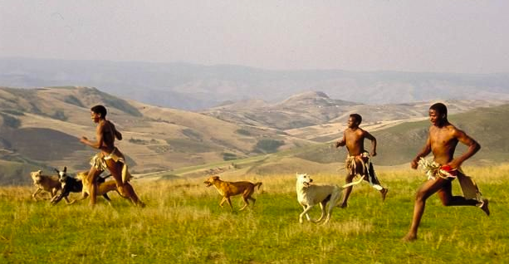
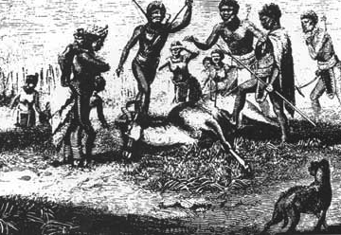
‘Dog’
remains hard to distinguish from jackal and
African wild dog
Diamant (Limpopo, South Africa, 1400 BP)
Basutswe (Botswana, 1300 BP)
Western Cape (South Africa, ca. 1000 BP)
no representation in rock art
(cf. Mitchell 2015)
Notes:
Evidence for early presence of dogs in southern Africa

Slide 8
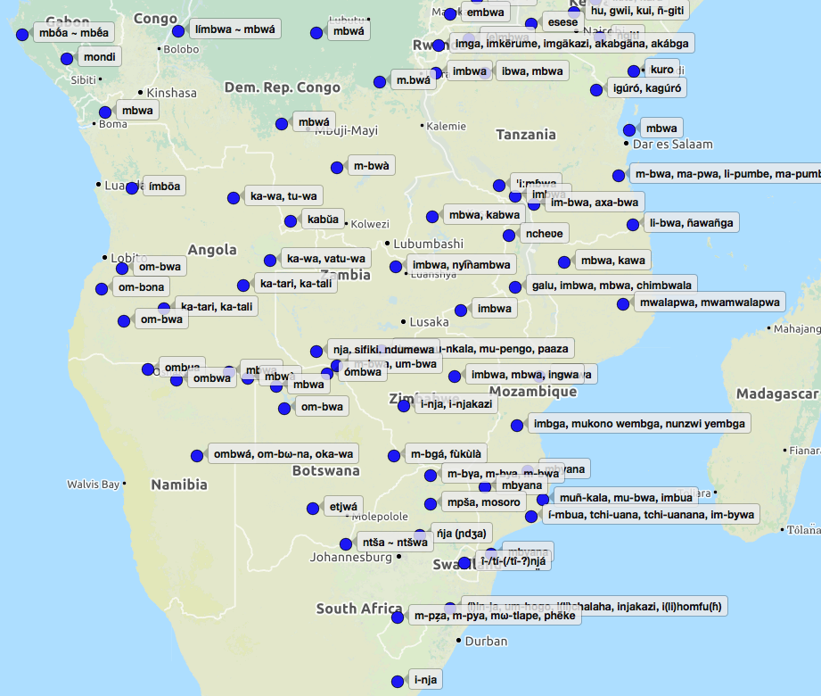
‘Dog’
Bantu
P-Bantu
*-bʊ́à
*kuro <
P-West Rift Southern Cushitic *gwihhira?
Map courtesy of http://www.tsammalex.clld.org/
Notes:
Bantu forms for ‘dog’

Slide 9
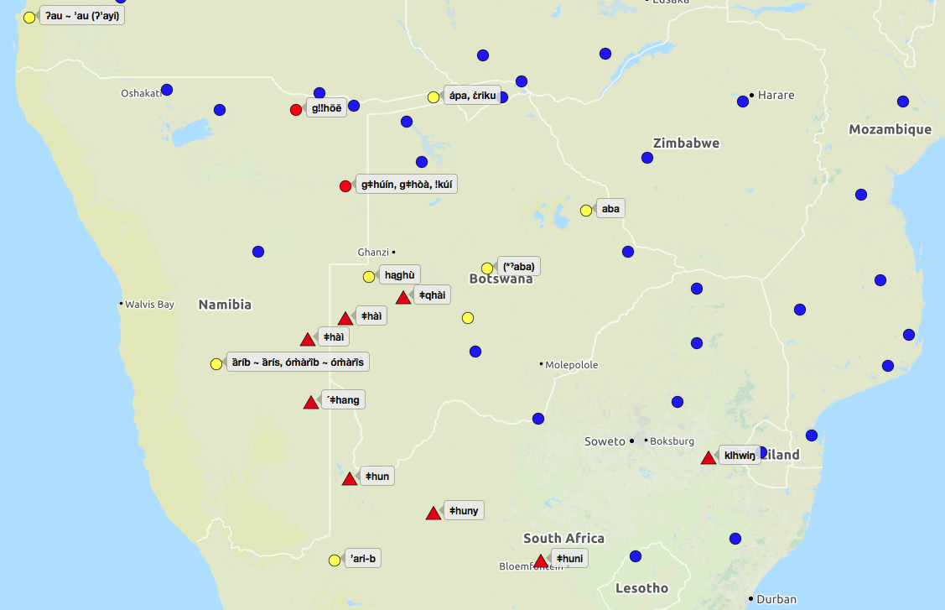
‘Dog’
Khoe-Kwadi
*ʔari(-gu) >
*ʔa(r)u(-gu) >
*ha(r)u(-gu)
P-Kalahari Khoe
*ʔaba ~ ʔapa
Kx’a
*gǂhui
Tuu
*ǂk(h)uni
Map courtesy of http://www.tsammalex.clld.org/
*ǂhaM
Notes:
SAK forms for ‘dog’

Slide 10
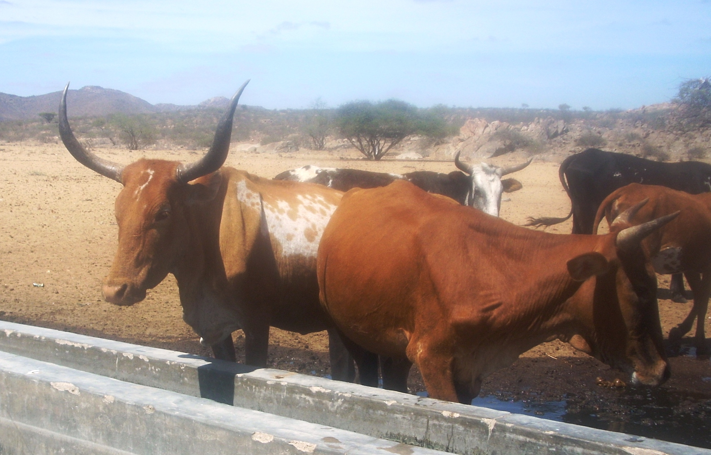
‘Cattle’
> rare before Later Iron Age (ca. 1000 BP)
Toteng (Botswana, 2000 BP)
Byneskranskop (Western Cape, 2100 BP)
Kasteelberg A (Western Cape, 1860 BP)
Knersvlakte (Western Cape, 1600 BP)
Khoekhoe cattle, 18th century
“Sanga” cattle, SW-Angola
Rock art of cattle, drawn over eland
(cf. Blench 2010, Smith 2015)
Notes:
Evidence for an early, possibly pre-Bantu, introduction of cattle in southern Africa

Slide 11
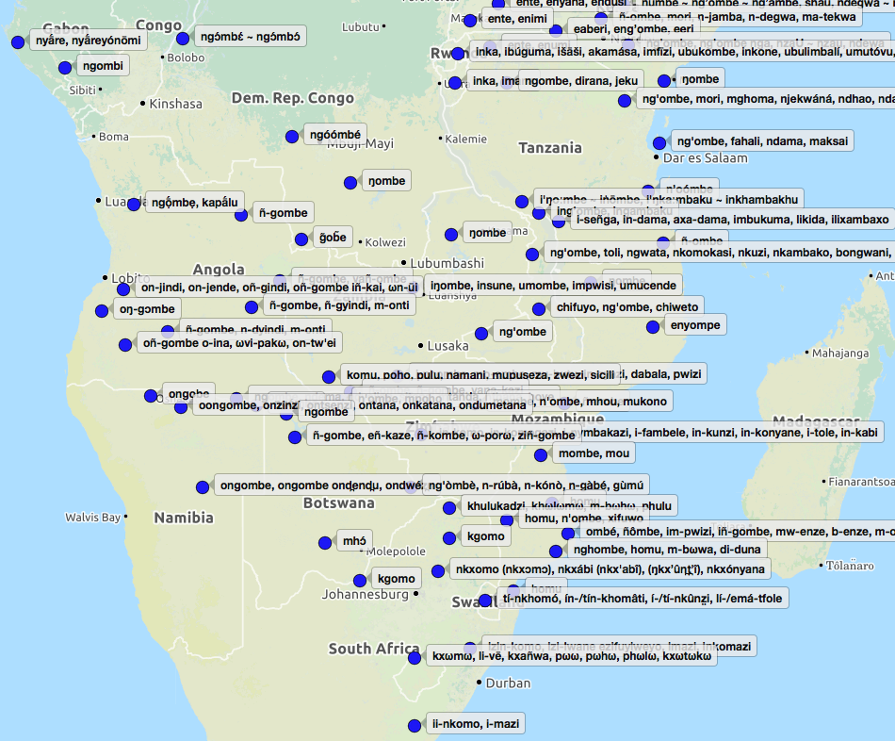
‘Cattle’
Bantu
P-Bantu
*-gòmbè
*-khomo
Map courtesy of http://www.tsammalex.clld.org/
Notes:
Bantu forms for ‘cattle’

Slide 12
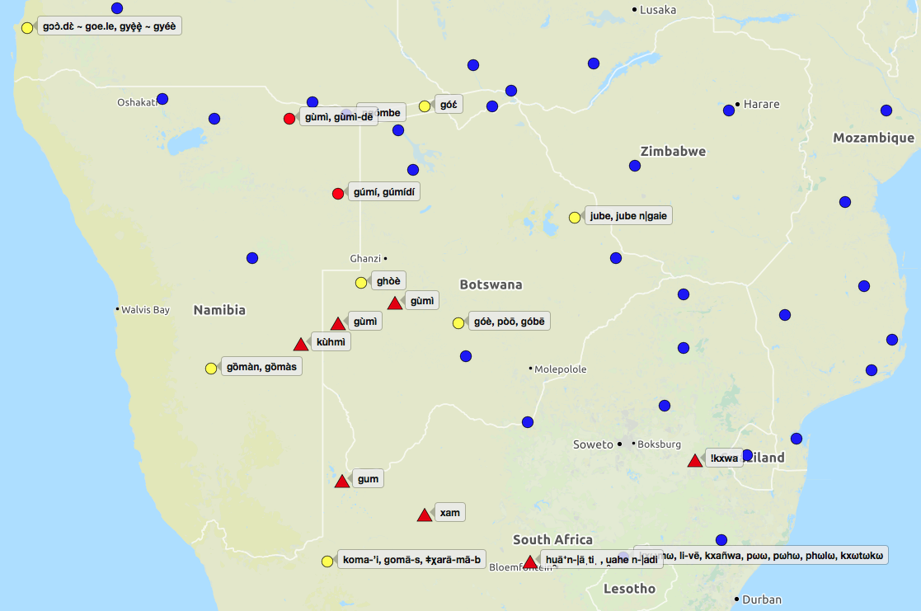
‘Cattle’
Khoe-Kwadi
< Bantu *-gombe?
P-Khoekhoe
*goma
Kwadi+Kalahari West
*goe
Kalahari East
*gobe > *ɟube > *bee
Kx’a
< Bantu *-gombe
Tuu
Map courtesy of http://www.tsammalex.clld.org/
< Bantu *-gombe
Notes:
SAK forms for ‘cattle’, discuss possible borrowing from Bantu ‘gombe’ vs. possibility of a Proto Khoe-Kwadi form *goe

Slide 13
‘Goat’
not attested before Later Iron Age (ca. 1000 BP)
connected to Bantu expansion into southern Africa
‘Goat people’ as term used among Khoe-Kwadi speakers to
refer to the Tswana
(cf. Smith 2015)
Notes:
Relatively late arrival of goats to southern Africa, prob. introduced by Bantu from the East; close link between Tswana and goats

Slide 14
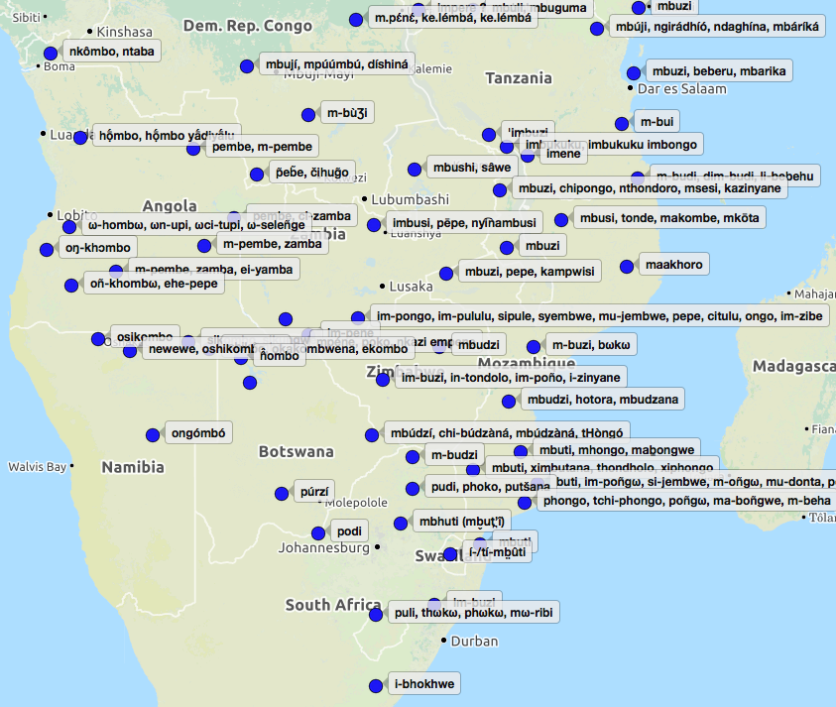
‘Goat’
Bantu
P-Bantu
*-bʊ́dì
*-khombo
*-pene
(~*-pembe?)
Map courtesy of http://www.tsammalex.clld.org/
Notes:
Bantu forms for ‘goat’ (broad West vs. East distribution)

Slide 15
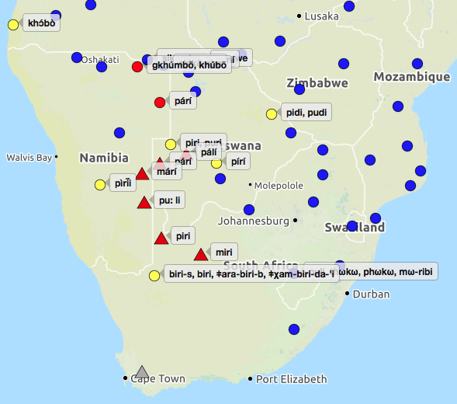
‘Goat’
Khoe-Kwadi
< Tswana pódi
< SW-Bantu
*-khombo
< Yeyi impèné
Kx’a
< Tswana pódi
< SW-Bantu
*-khombo
Tuu
< Tswana pódi
Map courtesy of http://www.tsammalex.clld.org/
Notes:
Bantu-borrowings for ‘goat’ into SAK

Slide 16
Summary
distribution of the root *guu for ‘sheep’ in the languages of southern Africa supports introduction of this domesticate before the arrival of the Bantu
likely introduction of dogs with the earliest herders, i.e., speakers of Khoe-Kwadi, but no borrowing of Khoe-Kwadi forms by Non-Khoe “Khoisan” or Bantu speakers
possible pre-Bantu introduction of cattle, but multiple forms in Khoe-Kwadi, plus possibility of deriving them from Bantu *gombe
introduction of goats clearly linked to Bantu, widespread borrowing of the Bantu root *bʊdi into southern African “Khoisan” languages

Slide 17
Khoe-Kwadi reconstructions related to herding
CATTLE | P | *goe
DOG | P | *ʔarigu
SHEEP | P | *guu
KRAAL | K | *!hhara
TO CASTRATE | K | *tVbi
TO CHURN (SHAKE) | K | *nǁubu
TO FENCE IN | K | *ǁaun
TO HERD | K | *guude
TO MILK INTO VESSEL | K | *ǀqx’ao
BULL | KK | *ǁoo
CALF | KK | *nǀaun
CATTLE_2 | KK | *goma
DOG_2 | KalK | *ʔaba
TO MILK INTO MOUTH | KalK | *tsxom
< Juǀ’hoan: ǁàùn ‘to cover with
branches’ (Di 329)
< East !Xoon: gǁxàùn ‘to make a bush fence
with hookthorn; cover something with
bushes (to hide it)’ (T 112)
< Juǀ’hoan: nǁàbù ‘to shake’ (Di 255)
< East !Xoon: nǁṵhbu sV ‘to shake (of liquids)
in a container to clean it out’ (T 125)
< East !Xoon: tshxòm ‘to wring moisture out’
(T 166)
P=Proto-Khoe-Kwadi; K=Proto-Khoe; KK=Proto-Khoekhoe; KalK=Proto-Kalahari Khoe
Notes:
Herding vocabulary reconstructed for different stages of Khoe-Kwadi + possibly Non-Khoe sources via semantic narrowing

Slide 18
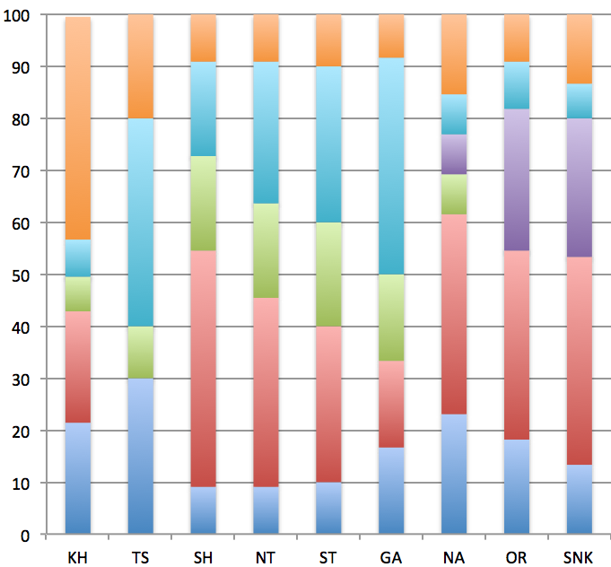
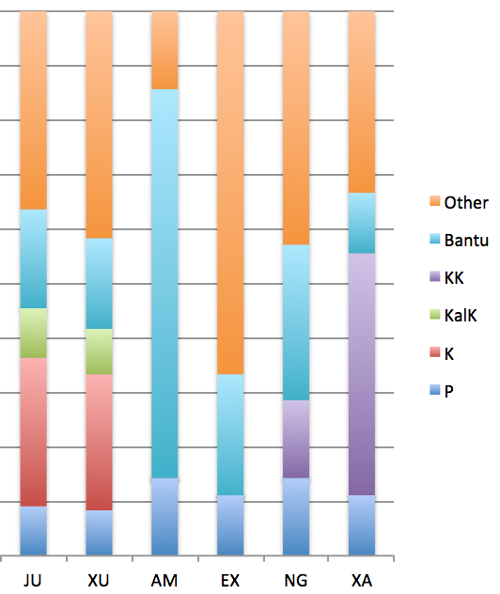
Khoe forms related to herding across Southern African “Khoisan”
Khoe
Kx’a
Tuu
40-50%
60-70%
50%
80%
40%
10%
30-55%
Other
Khoe
Okavango
Basin
East
Kalahari
Central
Kalahari
Southwest
Kalahari
North
Central
South
Notes:
Retention of Proto-Forms in individual Khoe languages + borrowing into Non-Khoe (in a sample of 12 meanings as given in the slide before)

Slide 19
Notes:
Retention of reconstructed herding vocabulary: low in the Okavango + Central Kalahari; moderately high in the Eastern Kalahari basin fringe; high in the southwest + borrowing into !Ui

Slide 20
Summary
multiple herding-related terms can be reconstructed for the Proto-Khoe stage, and, to a lesser extent, for its daughter branches Proto-Khoekhoe and Proto-Kalahari Khoe
reconstructed terms can sometimes be linked to Non-Khoe roots with a broader meaning (shake > churn, cover with branches > fence)
borrowing into Non-Khoe “Khoisan” languages, but not into Bantu
loss of inherited herding vocabulary in the Khoe languages of the Okavango and the Central Kalahari, retention in the southwest, in particular by and in contact with Khoekhoe pastoralists

Slide 21
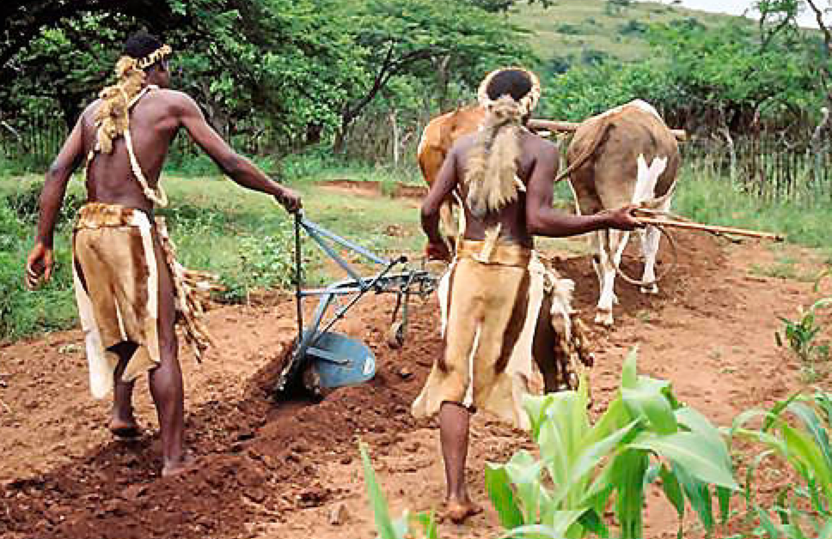
Agriculture

Slide 22
Khoe reconstructions related to agriculture
> no Proto-Khoe-Kwadi or Proto-Khoe reconstructions!
CORN | KK | *!hhoro
FIELD, GARDEN; TO PLANT (vt) | KK | *!hhana
TO CULTIVATE | KK | *ǂaa
FIELD, GARDEN; TO CULTIVATE | KalK | *ǁha(d)a
FIELD, GARDEN, MILLET; TO CULTIVATE | KalK | *khoba
HOE; TO CULTIVATE | KalK | *ǁhao
TO HARVEST | KalK | *khuan
FIELD, GARDEN | KHWE | *tsara
TO CULTIVATE | KHWE | *tshaan
Notes:
Agriculture-related vocabulary that can be reconstructed for KK and KalK + exclusive forms from the Khwe group which arguably practice a mixed subsistence strategy (small-scale gardening + foraging)

Slide 23
*ǁhao ‘HOE’
*ǁha(d)a ‘FIELD,
GARDEN; CULTIVATE’
*khoba ‘FIELD,
GARDEN; CULTIVATE’
*tsara ‘FIELD, GARDEN’
*tshaan ‘TO CULTIVATE’
Notes:
Areal distribution of agriculture-related vocabulary from Kalahari Khoe: *ǁhao all over, including Ju; *ǁha(d)a in the center, including Ju; *khoba on the northeastern fringe, also in NW-!Xun; *tsara+tshaan exclusively in the KHWE group

Slide 24
Summary
no Proto-Khoe vocabulary related to agriculture
probable introduction by Bantu only after split between Khoekhoe and Kalahari Khoe branches
no extensive vocabulary related to gardening and crop farming
possible exception: Khwe foragers of the Okavango who practice a mixed subsistence strategy (gardening+foraging)

Slide 25
Conclusion
pre-Bantu introduction of pastoralism in southern Africa, probably sheep-centered; lexical influence on Non-Khoe “Khoisan” languages
introduction of crop farming and agro-pastoralism by Bantu speakers; development of a limited agriculture-related vocabulary in the Khoe languages; partial overlap with Non-Khoe “Khoisan”, direction of borrowing not always clear
loss of pastoral subsistence pattern by all Khoe speakers, except the Khoekhoe
no adoption of crop farming, with small-scale gardening only found among the Khwe of the Okavango

