Slide 1
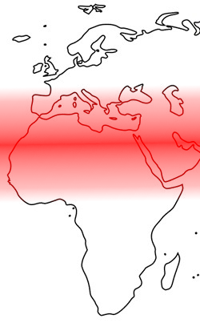
Frederik Hartmann
U Konstanz
Johanna Nichols
UC Berkeley, HSE University Moscow
The greater Sahara
in the historical linguistic geography of Africa
Westermann workshop
Berlin November 4-6, 2021
For conference participants only. Please do not circulate.

Slide 2
Introduction
Project: Map out geolinguistic distribution of complexity worldwide
Findings include: Striking systematic unconformity in North Africa and nearby
Interpretation clearly bears on areal history and typology of North Africa and the Circum-Mediterranean zone
Implication: more ancient areal patterns than usually detected
Goal: get reactions, insights, perspective

Slide 3
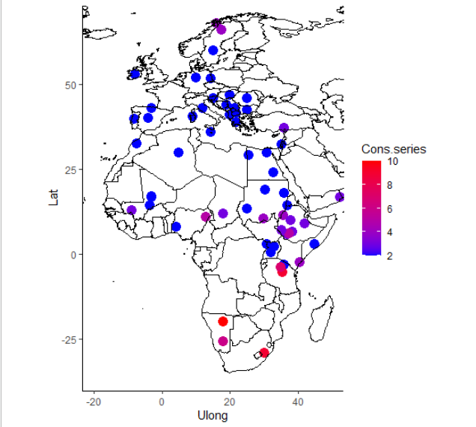
Dataset
Dataset of 257 languages
Mix of configured and unconfigured measures
Complexity measures:
  Syllable complexity
  Tonal complexity
  Consonantal complexity
  Vocalic complexity
Number of consonantal series (place)
Series = airstream manners of articulation, for obstruents

Slide 4
Complexity distributions in context
Bayesian linear and nonlinear models
Control variable: language family
Complexity in context: global distributions
West/East divide
Africa and Europe: strongest variation of consonantal series complexity
Number of consonantal series

Slide 5
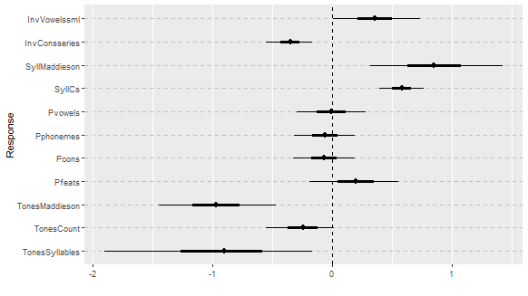
Linear trends
Linear models outline trends
Highlight differences between macroareas – here: Europe – Africa
Differences esp. in consonantal, tone, and syllable complexity
Linear models fail to capture all existing patterns

Slide 6
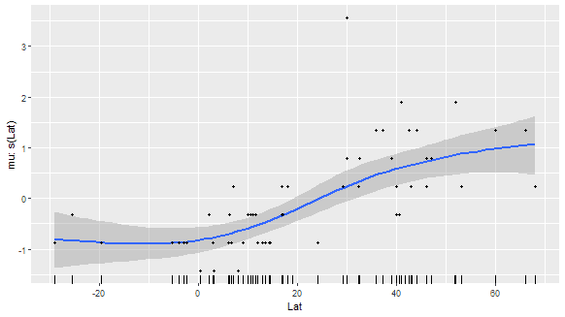
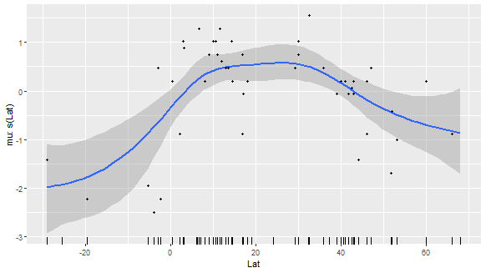
Nonlinear patterns
Consonants in maximum syllable
Number of distinctive features

Slide 7
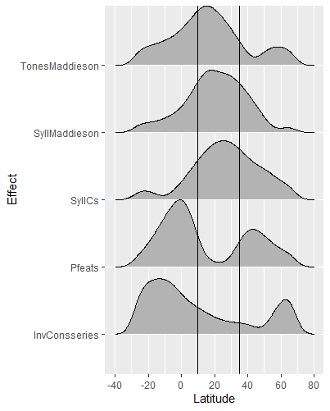
Effect gradients
The region between 10 and 35 degree North either
  contain a gradient maximum
  are enclosed by gradient maxima

Slide 8
Eurafrican Transition Zone
Zone characterized by gradual transition between two complexity levels

Slide 9
North African prehistory: Broad overview
Glacial onset to ~10,000 BP: Arid. Rain forest smaller, fragmented.
10,000-7500 BP: Monsoon belt moves north; Sahara grassland
7500 BP > present: Sudden desiccation, gradually increasing to present time.
Population overall small, sparse.
Except along major rivers (Nile, Niger)
(And: Atlas Mts., upper Nile mts., some of coast, rainforest and nearby. All must have favored linguistic diversity and density.)
Humans move into greater Sahara from all directions.
Midway: livestock domestication
Fallback to rivers and mountains.
Language extinction. Afroasiatic monoculture. Beginnings of Egyptian civilization.

Slide 10
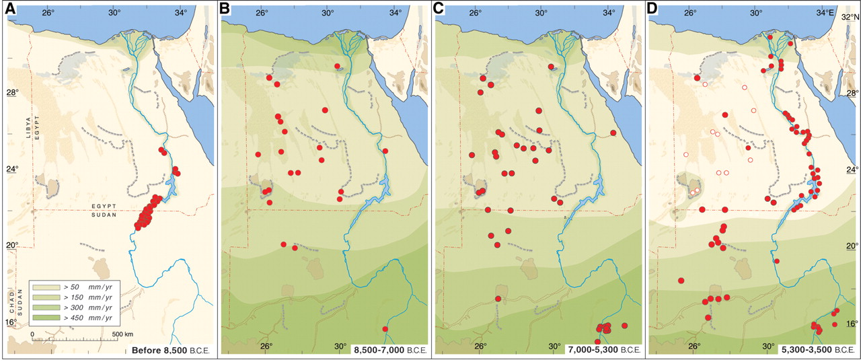

Fig. 3. Climate-controlled occupation in the Eastern Sahara during the main phases of the Holocene.
R Kuper, S Kröpelin Science 2006;313:803-807
Published by AAAS
Notes:
Climate-controlled occupation in the Eastern Sahara during the main phases of the Holocene. Red dots indicate major occupation areas; white dots indicate isolated settlements in ecological refuges and episodic transhumance. Rainfall zones are delimited by best estimate isohyets on the basis of geological, archaeozoological, and archaeobotanical data. (A) During the Last Glacial Maximum and the terminal Pleistocene (20,000 to 8500 B.C.E.), the Saharan desert was void of any settlement outside of the Nile valley and extended about 400 km farther south than it does today. (B) With the abrupt arrival of monsoon rains at 8500 B.C.E., the hyper-arid desert was replaced by savannah-like environments and swiftly inhabited by prehistoric settlers. During the early Holocene humid optimum, the southern Sahara and the Nile valley apparently were too moist and hazardous for appreciable human occupation. (C) After 7000 B.C.E., human settlement became well established all over the Eastern Sahara, fostering the development of cattle pastoralism. (D) Retreating monsoonal rains caused the onset of desiccation of the Egyptian Sahara at 5300 B.C.E. Prehistoric populations were forced to the Nile valley or ecological refuges and forced to exodus into the Sudanese Sahara where rainfall and surface water were still sufficient. The return of full desert conditions all over Egypt at about 3500 B.C.E. coincided with the initial stages of pharaonic civilization in the Nile valley.

Slide 11
How did the ETZ form? Some possibilities
(1) Boundary between Africa and Europe, stretched out with desiccation.
(2) Spread zone. The footprint of the Afroasiatic spread, plus the Afroasiatic sphere of influence.
A previously unrecognized linguistic area with its own grammatical profile.
(4) No-man's-land between African and European populations, separate until the Bronze Age.
Syncretic area, endpoint of diffusion and influence trajectories from Mesopotamia, Levant, Nile Valley, Ethiopia, Maghreb.
(6) Mix, result of many fallbacks and recolonizations as environmental conditions fluctuated.

Slide 12
How did the ETZ form? Some possibilities
(1) Boundary between Africa and Europe, stretched out with desiccation.
(2) Spread zone. The footprint of the Afroasiatic spread, plus the Afroasiatic sphere of influence.
A previously unrecognized linguistic area with its own grammatical profile.
(4) No-man's-land between African and European populations, separate until the Bronze Age.
Syncretic area, endpoint of diffusion and influence trajectories from Mesopotamia, Levant, Nile Valley, Ethiopia, Maghreb.
Mix, result of many fallbacks and recolonizations as environmental conditions fluctuated.
But … Do these explain the complexity profiles ?

Slide 13
African macroareas (Güldemann 2008)
III = Macro-Sudan Belt
Brackets = ETZ
Hammarström & Güldemann 2014v

Slide 14
Result: shadow or periphery of the MSB
Geolinguistic trends:
• General east-west predominance in Africa
• Southward retreat of the northern edge of the MSB
Any one of the above six scenarios, plus east-west predominance, would account for the shape and southern extent of the ETZ.
But – the linguistic profile? the northern reach?
Hammarström & Güldemann 2014, Comrie & Cysouw 2009

Slide 15
More possibilities
The ETZ extends N-S about 2000 km.
-- Within the range where languages resemble sisters E-W, and there is variation N-S.
Translation for us: structural resemblances are stable E-W; variation N-S.
Hammarström & Güldemann 2014

Slide 16
More possibilities, cont.
Suppose: During the Sahara Greening, hunters and then herders followed animals north into the grassland during the wet season, south to the Sahel in the dry season.
Local contact and diffusion along migration trajectories, not between them
Result: divergence between the trajectories.
Post-Greening, the start and end points moved south, stretching the ETZ southward.
(Probably the Mediterranean climate zone moved north, stretching it northward.)
Result:
Major language spreads run E-W (Berber, Arabic)
Steep profiles (variation) run N-S.
ETZ: Not a transition zone but an ecotone, stretched N-S.

Slide 17
Conclusion
Bayesian regression modelling can highlight linear and nonlinear complexity patterns across geographical spaces
Unexpected unique pattern between 10 and 35 degree North.
Explanation does not obviously follow from modern or historical economic and sociolinguistic situations
We trace it back to the time of the Sahara Greening and the desiccation afterwards

Slide 18
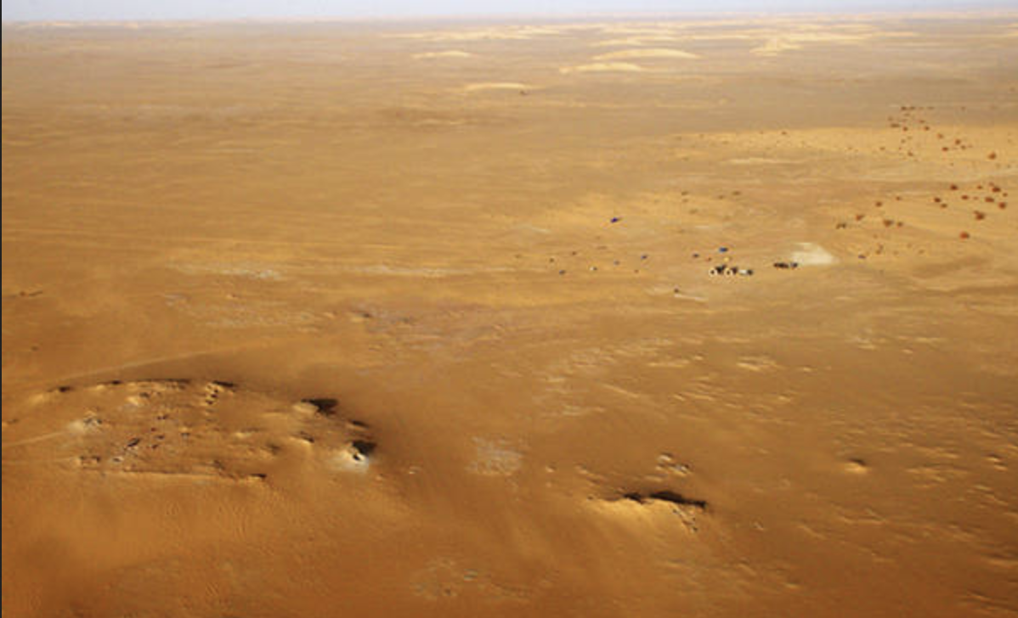
Thanks!

Slide 19
Acknowledgments
Words Bones Genes Tools (U. Tübingen)
HSE University Basic Research Program
Deutsche Forschungsgemeinschaft (grant no. 429663384, `Germanic dispersion beyond trees and waves‘)
Studienstiftung des deutschen Volkes

Slide 20
Extra slides

Slide 21
ETZ languages in sample
Glottocode | Stock | Language | Comment
beja1238 | Beja (isolate?) | Beja | Or Cushitic?
cent2194 | AA: Berber | Tamazight (Ayt Ndhir)
jams1239 | Dogon | Jamsay
kuna1268 | Kunama (isolate) | Kunama
nubi1251 | Nubian | Nubian (Dongolese)
egyp1253 | AA: Semitic | Arabic (Egyptian)
koyr1240 | Songhai | Koyra Chiini Songhay
west2369 | IE | Persian
mode1248 | IE | Greek (modern)
kenu1243 | AA: Nubian | Kenuzi (Kunuz)
tama1365 | AA: Berber | Tamashek
siwi1239 | AA: Berber | Siwi
moro1292 | AA: Semitic | Moroccan Arabic
malt1254 | AA: Semitic | Maltese
mehr1241 | AA: Semitic | Mehri
midd1367 | AA: Semitic | Samaritan Aramaic | LatePalestinianAramaic
kili1262 | IE: Armenian | Cilician Armenian
logu1236 | IE: Romance | Sardinian (Nuorese dial.)
port1283 | IE: Romance | Portuguese
adam1253 | Atlantic | Fula | ETZ ?
furr1244 | Fur (isolate) | Fur | ETZ ?

Slide 22
Sampling
Sampling method used overall: approximately Genus-Macroarea variety sample (Miestamo et al. 2016)
Genus-based stratified sampling of macroareas
Adjusted to guarantee good coverage of the Mediterranean-Sahara region and nearby
Result: confidence in accurate description of ETZ and its difference from areas to the north and south (Europe, sub-Saharan Africa)
Miestamo, Matti, Dik Bakker, and Antti Arppe. 2016. Sampling for variety. Linguistic Typology 20:2.233–296.

