Slide 1
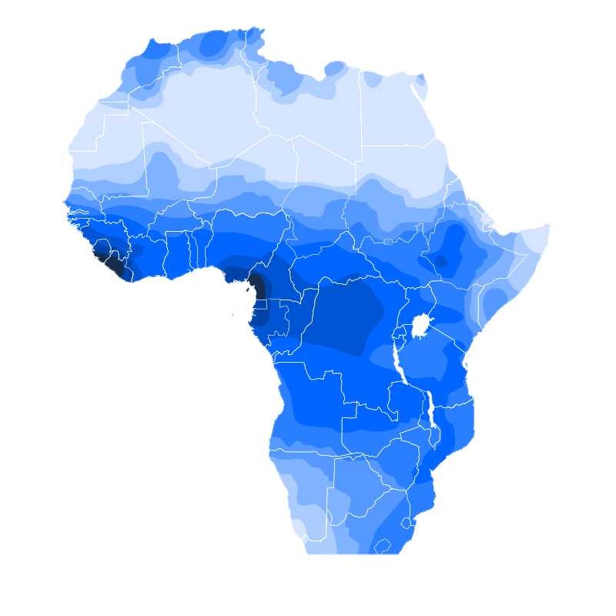
Plural words in the Macro-Sudan Belt
Jakob Lesage
jakob.lesage@gmail.com
Humboldt Universität Berlin
Westermann Workshop Berlin
HU Berlin
04/11/2021

Slide 2
Plural marking in the world’s languages
Majority of languages grammatically encode nominal plural (70%-90%)
Dryer 2013: two main strategies
Mark the noun phrase
bay hay máakar
three PL chief
‘three chiefs’
(Mofu-Gudur, Chadic)
Mark the noun
one dog → many dogs
Barreteau 1988; Dryer 2013; Skirgård et al. in prep.

Slide 3
Plural marking in the world’s languages
74%
26%
Mark the noun phrase
bay hay máakar
three PL chief
‘three chiefs’
(Mofu-Gudur, Chadic)
Mark the noun
one dog → many dogs
Barreteau 1988; Dryer 2013; Skirgård et al. in prep.

Slide 4
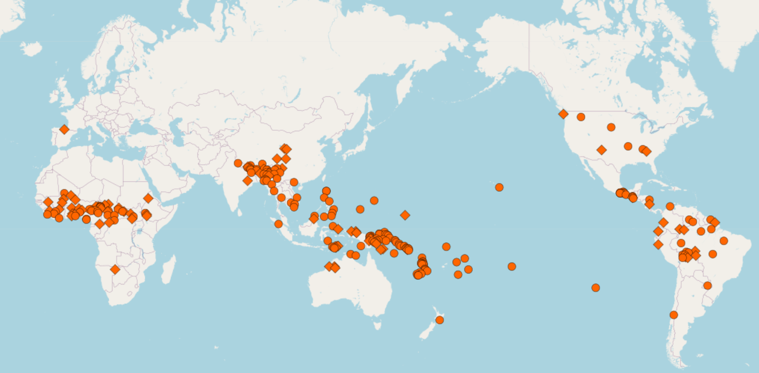
Plural words in the world’s languages
26%
Mark the noun phrase
bay hay máakar
three PL chief
‘three chiefs’
(Mofu-Gudur, Chadic)
Barreteau 1988; Dryer 2013

Slide 5
What is a plural word?
Different definitions
  Segmentally invariable (no phonological allomorphy)
  Can occur on its own (not bound)
  Marks the noun phrase, not the individual NP constituents (no agreement)
  Syntactically promiscuous (not an affix)
  Written separately in a grammar
Cf. Bloomfield 1933; Dryer 1989; Dryer 2013; Skirgård et al. in prep.

Slide 6
My understanding of some terms
Always occurs with the same root class
Jumps across root classes
Phonologically ‘welded’
Affix
Clitic
| Word?
Phonologically ‘free’
Word?
Word?
Cf. Haspelmath 2021 on ‘welded’ forms
Notes:
An affix is a grammatical marker that always occurs with the same root class and that is ‘phonologically welded’ together with its host.
A clitic is a grammatical marker that jumps across root classes and that is ‘phonologically welded’ with its host.
Some authors see this ‘jumping across root classes’ as the main ingredient of a ‘word’ and see clitics as a type of word.
But all authors appear to think a lack of phonological interaction with the host is also a central property of ‘words’.
This leaves us with three clearly distinct concepts that are all lumped together as ‘word’ in the typological literature.

Slide 7
My understanding of some terms
Always occurs with the same root class
Jumps across root classes
Phonologically ‘welded’
Affix
Clitic
| Word?
Phonologically ‘free’
Word?
Word?
Cf. Haspelmath 2021 on ‘welded’ forms
Notes:
To complete the picture, some authors see clitics as a type of affix because they’re welded.
But it’s quite rare that typologists explicitly recognize that a phonologically free marker can also be very similar to an affix if it always occurs with the same word class.
Still, as we will see, there are quite a few grammars where welding isn’t used as a criterion to judge whether something is an affix or a separate word. As typologists, we should be aware of this, and of the impact this can have on our conclusions.

Slide 8
Main questions
What are the characteristics of the ‘plural words’ authors have identified in the Macro-Sudan belt?
Are there better procedures than looking at orthography?
Do different definitions lead to different conclusions?
How can we compare plural words with plural affixes?

Slide 9
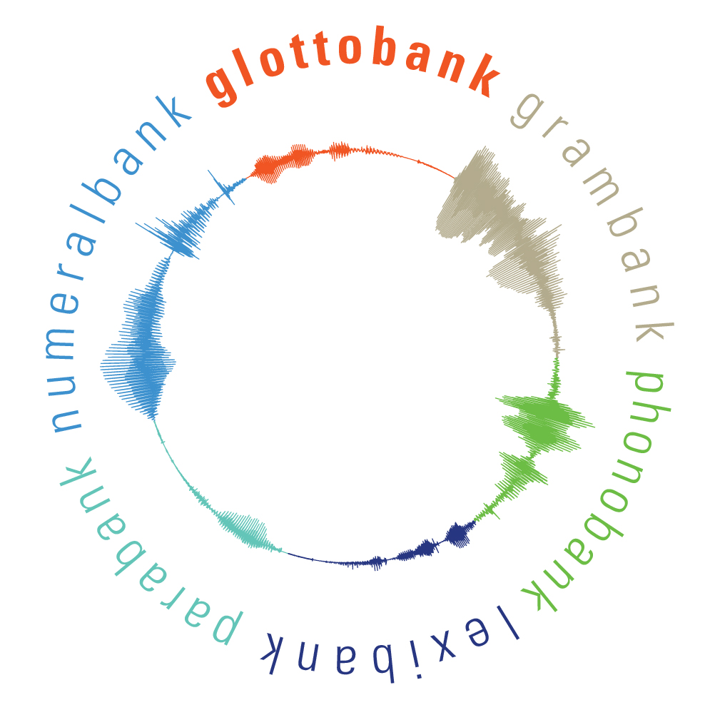

Data
Dryer & Haspelmath 2013; Skirgård in prep.
Notes:
I sampled my data from two databases:
1. WALS, the World Atlas of Language Structures online, edited by Matt Dryer and Martin Haspelmath, and
2. Grambank, a database in preparation at the MPI in Leipzig, currently led by Hedvig Skirgård

Slide 10
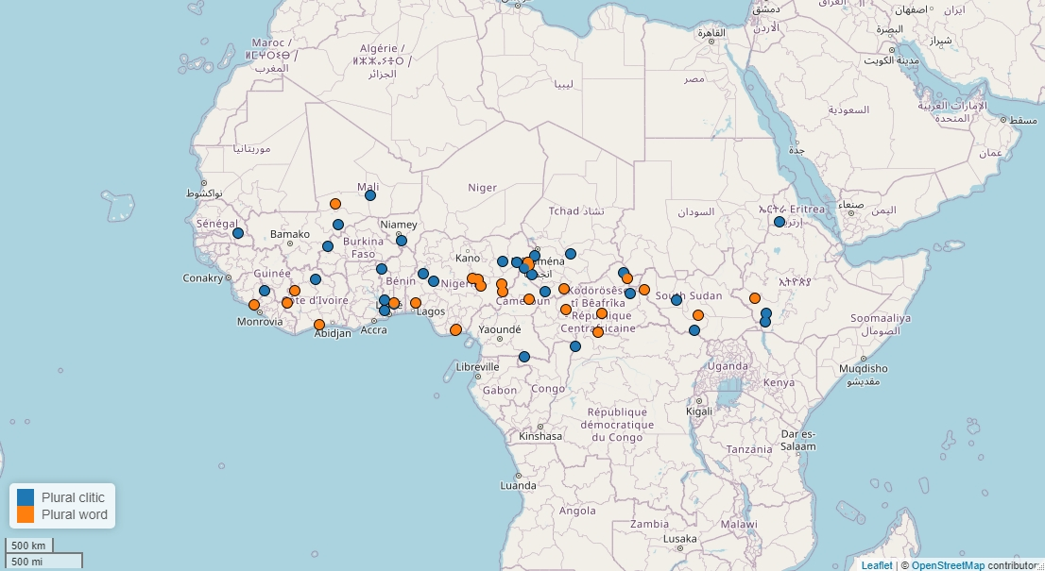
Plural words in WALS
No explicit definition
Clitics as ‘a type of plural word’
Only includes languages where plural words are the main plural markers
Dryer 2013
Notes:
WALS does not give an explicit definition of ‘plural word’, other than ‘an independent word with the meaning of a plural suffix’. It also calls plural clitics ‘a type of plural word. This is the distribution of plural words and plural clitics from WALS. The dots in blue are languages with plural clitics and the dots in orange are languages with plural words.
The ‘plural words’ are usually coded as such because they were written as separate words in a grammar.
WALS only includes those languages where plural words are the main plural markers. So languages where there are both plural affixes and plural words will often not be included as having plural words in WALS.

Slide 11
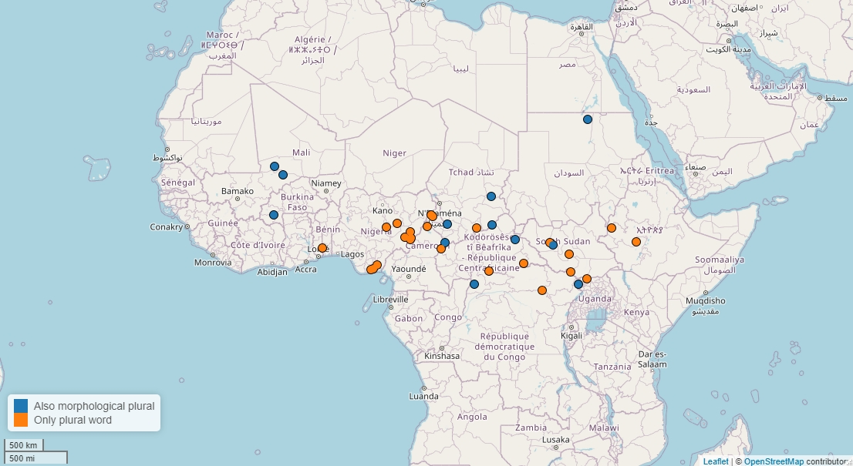
Plural words in Grambank
Phonologically free marker
Excludes clitics
Includes languages with both plural words and affixes
Skirgård in prep.
Notes:
Grambank defines plural words as phonologically free plural marker, that is, markers that don’t interact phonologically with neighboring items. Grambank excludes clitics, because those tend to interact with neighboring items. In practice, Grambank also often relies on orthography.
Grambank includes indicates which languages have both plural words and affixes. On the map, the orange dots represent languages that only have plural words. The blue dots represent languages that have both plural words and plural morphology.
Note that different coding procedures result in a different analysis of the spread of plural words.

Slide 12
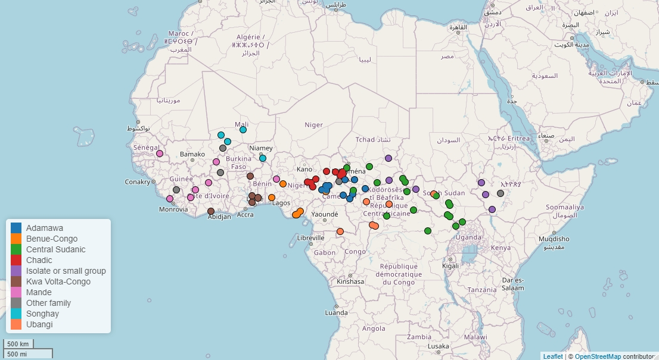
Combined data
Notes:
I combined the data from WALS and from Grambank. In total, after some cleaning, this gives us 80 languages with plural words. Plural words occur in a genealogically diverse set of languages. On the map, I color-coded each language for family to highlight their genealogical diversity. There are Mande, Songhay, Kwa and Benue-Congo languages in the Western Sudan. There are Chadic languages, Adamawa languages, Central Sudanic languages and Ubangi languages in the Central Sudan. And there are isolates and small families in the Central Sudan and in the Ethiopian Sphere.

Slide 13
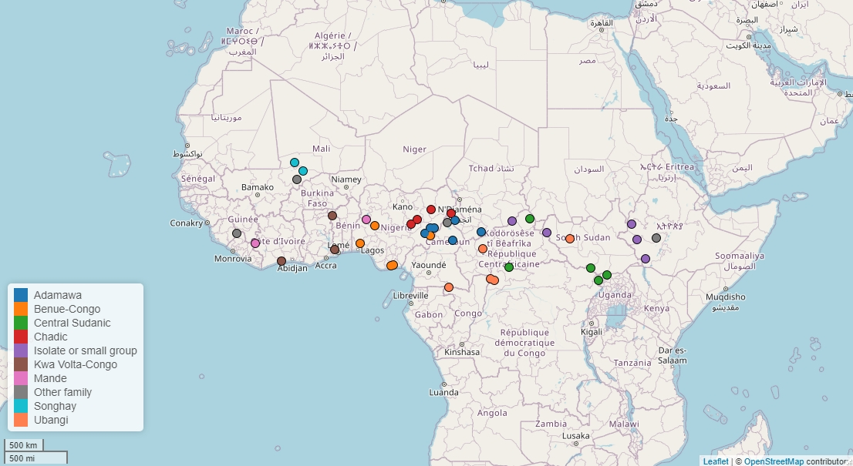
Sample
Notes:
I took an areally and genealogically balanced sample of these languages. The sample contains 41 languages. All families are represented except for 1 isolate. Tried to represent at least two subgroups from each family.
Based on some preliminary reading, I made a questionnaire of 17 questions. I then filled in the questionnaire for these 41 languages on the basis of the grammars I could find..

Slide 14
Properties of plural words
Properties from definitions
Word order properties
Occurrence restrictions/selectivity
Relationship with other grammatical categories
Notes:
I will present the main results of this questionnaire as 12 parameters divided into four sets.
The first set contains properties relevant to the different definitions of ‘plural word’.
The second set contains word order properties.
The third set contains restrictions on when plural words occur.
And the fourth set contains two parameters dealing with the relationship between plural words and other grammatical categories.

Slide 15
1. Different definitions
1a. Plural words are usually promiscuous (= they can occur with different root classes in the noun phrase).
Kam
  àwàn yō
  king PL
  àwàn ə́bɔ̄rī yō
  king big PL
  àwàn càr yō
  king three PL
Lesage 2020
Notes:
First, plural words are usually promiscuous. This means that they can occur with different root classes in the noun phrase. In this example from Kam, the plural marker can occur after a noun. If an adjective follows the noun, it can occur after the adjective. And if a numeral follows the noun, it can occur after the numeral. It’s not ‘bound’ to the noun, so to say.

Slide 16
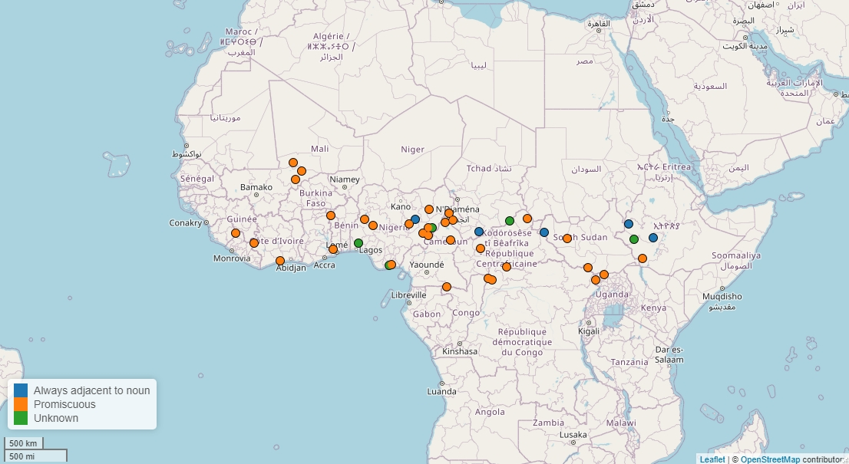
1. Different definitions
1a. Plural words are usually promiscuous (= they can occur with different root classes in the noun phrase).
Exceptions (14%)
e.g. Guruntum-Mbaaru (Chadic)
“zi … occurs immediately before the noun”
Haruna 2003
Notes:
This map shows that the overwhelming majority of plural words are promiscuous, indicated by the orange dots.
There are some exceptions, making up 14% of the data. In Guruntum-Mbaaru, for instance, the author says that the plural word always occurs immediately before the noun.

Slide 17
1. Different definitions
1a. Plural words are usually promiscuous.
Note potential problems in the Ethiopian sphere.
Notes:
If this criterion is taken as central to identifying plural words, we may have to revise its occurrence in the Ethiopian Sphere.

Slide 18
1. Different definitions
1a. Plural words are usually promiscuous (= they can move to different root classes in the noun phrase).
It’s difficult to judge languages where PL has a radically different position from all other modifiers (e.g. ADJ-N-PL).
Hozo (Blue Nile Mao)
pərsha t’oobi
horse PL
mət’i pərsha t’oobi
handsome horse PL
zə pərsha t’oobi
PROX.PL horse PL
Kassa 2014
Notes:
In some languages, it’s difficult to judge what non-promiscuity means. This goes for languages where the plural marker has a radically different position from all other nominal modifiers. In Hozo, for instance, a Blue Nile Mao language, the plural marker follows the noun but adjectives and demonstratives precede the noun.
Sure, the plural word is not promiscuous, but perhaps this is only because nothing else can follow the noun. There is no way to test whether it would move if we put a root after the noun.

Slide 19
1. Different definitions
1a. Plural words are usually promiscuous (= they can move to different root classes in the noun phrase).
1b. Plural words usually occur only once in the NP.
e.g. Anufo (Kwa)
nyìni níɛ kankàn=m
that animal small=PL
‘these small animals’
vs. e.g. Kunama (isolate)
ail-e ʊmm-e
cow-PL black-PL
‘black cow’
Smye 2004; Tucker and Bryan 1966
Notes:
The second property of plural words that sometime comes up in definitions is that they usually only occur once in the noun phrase. This property is intended to distinguish agreement affixes from clitics. For instance, the situation in Anufo, where the plural marker occurs once, contrasts with the situation in Kunama, where the adjective agrees with the noun in number using an identical plural suffix.

Slide 20

1. Different definitions
1a. Plural words are usually promiscuous.
Southern Kisi (Mel)
lɛ́ɛ́ŋ-là yùwɛ́í=láŋ=lâŋ
cutlass-PL old=PL=PROX.PL
1b. Plural words usually occur only once in the NP.
Mofu-Gudur (Chadic)
Optionally repeated in long phrases.
Childs 1995; Barreteau 1988
Notes:
Most plural words occur only once in the noun phrase, shown with orange dots on the map.
There are also exceptions, like Southern Kisi, where the plural clitic recurs in, on or as the proximal demonstrative.
Or like in Mofu-Gudur, where the plural word is optionally repeated in long noun phrases.

Slide 21
1. Different definitions
1a. Plural words are usually promiscuous (= they can move to different root classes in the noun phrase).
1b. Plural words usually occur only once in the NP.
1c. Plural words usually do not interact segmentally with their host.
Notes:
The final criterion authors tend to use is that plural words should not interact segmentally with their host.

Slide 22
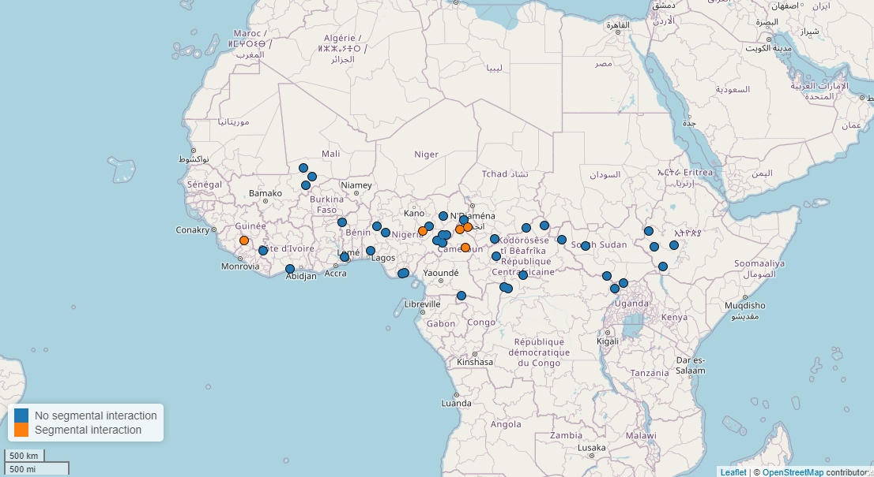
1. Different definitions
1a. Plural words are usually promiscuous.
1b. Plural words usually occur only once in the NP.
1c. Plural words usually do not interact segmentally with their host.
Exceptions (12%)
e.g. Mundang (Mbumic)
fàtʊ̀k=rā → fàtʊ̀ɣrā
wild:animal-PL ‘wild animals’
Elders 2000
Notes:
This is the case in most languages in the sample.
* There are some exceptions, however, such as Mundang, where the final consonant of a noun can be lenited before the plural clitic rā.

Slide 23
1. Different definitions
Separate occurrence?
Prosodic strength?
Tonal interaction between a marker and a host?
Notes:
There are other criteria that authors tend to use to distinguish words from clitics and affixes. Separate occurrence, for instance. But this was almost never investigated in the languages in the sample.
The same goes for prosodic strength: some authors use accentual arguments to distinguish between words and affixes. But this criterion almost never discussed in the languages in the sample.
Finally, I did not look at tonal interaction between markers and their host because this was difficult to straightforwardly apply across the languages in the sample.

Slide 24
2. Word order properties
2a. Overwhelmingly N PL order (like affixes)
If promiscuous
  2a. Occurs with adjectives in 86% of languages
  2b. Cannot occur with numeral in 86% of languages
  Can occur with demonstratives in 50% of languages
The status of a marker is always more complex than just a ‘clitic’ which attaches to any host.
Notes:
The next set of properties concerns the position a plural word may take in a noun phrase.
First, overwhelmingly, plural words in the sample occur after the noun. In this regard, they behave very much like affixes. I won’t say much more about that now.
What is more intersting, I think, is that, if plural words are promiscuous, languages show some variation regarding the hosts that can take a plural word.
In most languages, adjectives can host a plural word. 14% of promiscuous plural words cannot occur next to adjectives.
The opposite is true for numerals: 86% of languages do not allow adjacent numeral-plural word combinations.
Whether demonstratives can host plural words is a matter of much more variation.

Slide 25
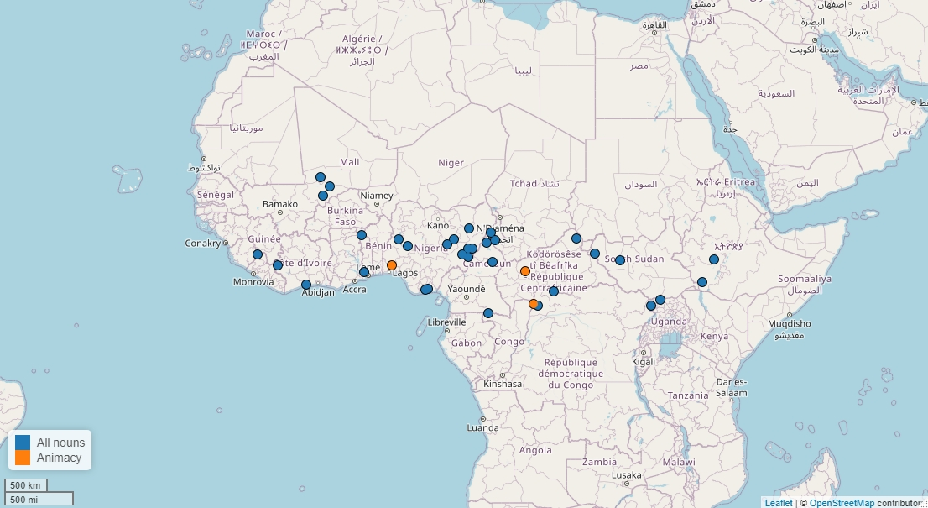
3. Few constraints on occurrence
3a. The typical plural word is not semantically selective.
Exceptions (8%)
e.g. Monzombo (Ubangi)
ō only occurs with animate nouns if the referent is indefinite
Boyi 1983

Slide 26
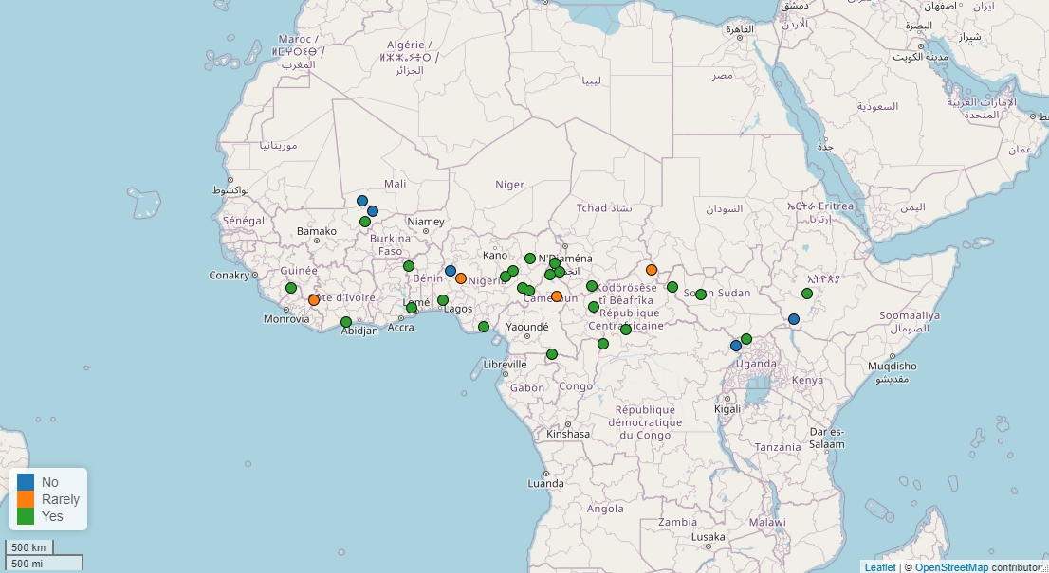
3. Few constraints on occurrence
3a. The typical plural word is not semantically selective.
Exceptions (15%)
e.g. Kwegu (Surmic)
*imiʃ=an gai ɗaa
buffalo=PL REL two
‘two buffaloes’
3b. The typical plural word can occur with numerals.
Hieda 1998

Slide 27
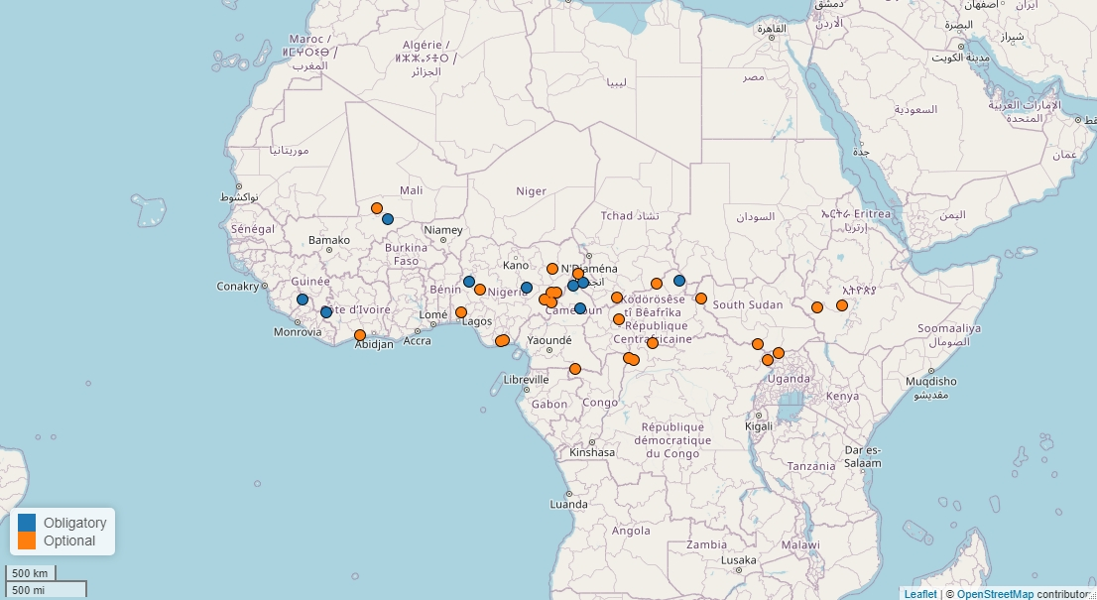
3. Few constraints on occurrence
3a. The typical plural word is not semantically selective.
3b. The typical plural word can occur with numerals.
Exceptions (26%)
e.g. Tondi Songway Kiini (Songhay)
=yów, indefinite plural appears to be obligatory in indefinite plural noun phrases without a numeral
3c. The typical plural word is optional. (vs. affixes)
Heath 2005

Slide 28
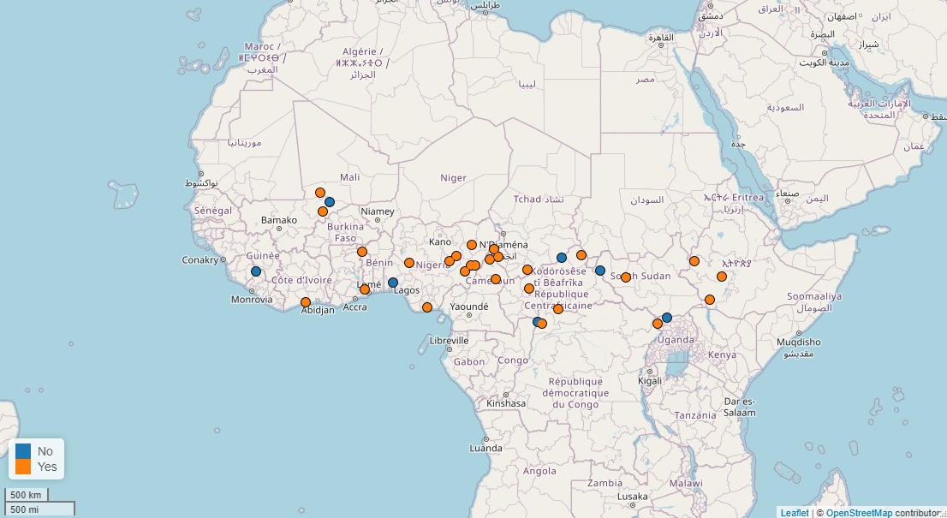
4. Relationship with other grammatical categories
4a. Most plural words are dedicated to marking plural. They don’t mark anything else.
Most exceptions mark definiteness
e.g. Kresh-Woro
igi lukpa
DEF.PL woman.PL
‘the(se) women’
Santandrea 1976
Notes:
The fourth set of features covers whether plural words also express other categories and etymology.
First, I checked which other meanings plural words express. And it turns out that most plural markers are dedicated to marking plural, nothing else. *
There are a few exceptions in the data. Most of these exceptions express definiteness, and Kresh-Woro in the frame is an example. This is not that surprising since there’s a well known association between definiteness and number marking in the typological literature.
Other exceptions include case marking, in Runga, a Maban language, and gender in Southern Kisi.

Slide 29
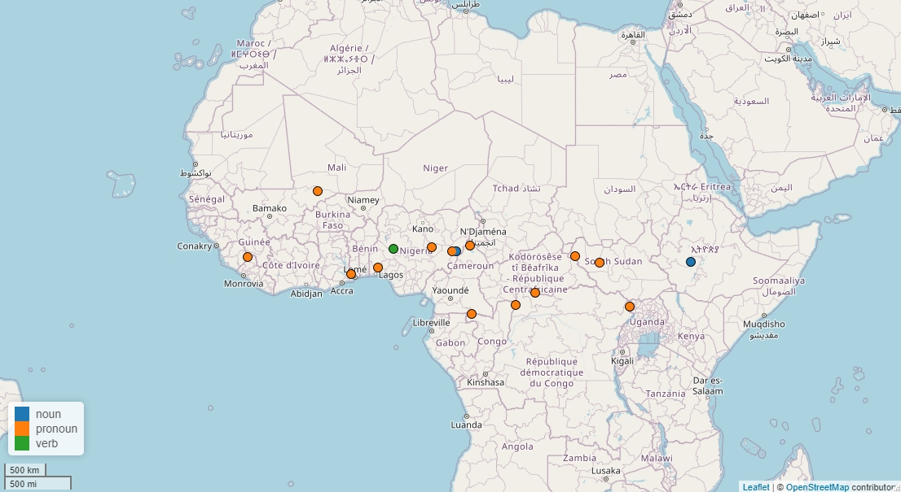
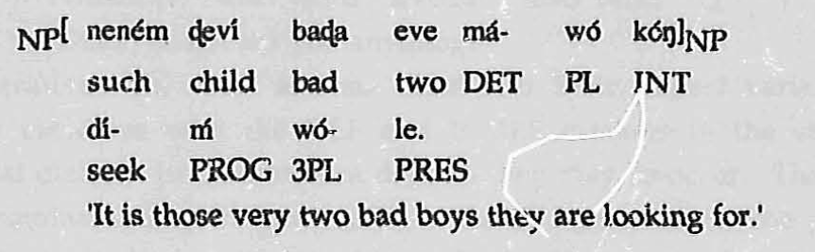




4. Relationship with other grammatical categories
4b. Where we have information on etymology, plural words tend to be etymologically related to 3PL pronouns.
e.g. Ewe (Kwa)
Ameka 1991
Notes:
Finally, I checked where plural words may come from. For most languages, it was difficult to get diachronic data. But for some, it was very clear that the plural marker was directly derived from a pronoun, usually the 3PL pronoun.
This example from Ewe shows both the plural marker wó and the pronoun wó occurring in the same clause.
Other sources found in the data are nouns and verbs.
That we find more pronouns than anything else may simply be because pronouns are probably more stable than other sources of plural markers such as nouns and verbs, which may disappear after the plural marker has grammaticalized. They are also some of the first forms that people collect in a language, even at a very early stage. So there’s simply more data on them.

Slide 30
The typical plural word
1a. Occurs with different root classes
1b. Occurs only once in a noun phrase
1c. Does not interact segmentally with its host
2a. Follows the noun
2b. Can be hosted by an adjective
2c. Cannot be hosted by a numeral
3a. Can occur with any noun
3b. Can occur with numerals
3c. Is optional
4a. Only expresses plurality
4b. Is grammaticalized from a pronoun
Notes:
To summarize, the typical plural word …

Slide 31
Discussion
1a. Occurs with different root classes
1b. Occurs only once in a noun phrase
1c. Does not interact segmentally with its host
No consistent definition, but some distinct parameters.
Different definitions do not seriously impact the areal profile.
But: are some affixes in fact plural words? (cf. Van de Velde 2005 on potential plural words in Bantu)
2a. Follows the noun
2b. Can be hosted by an adjective
2c. Cannot be hosted by a numeral
3a. Can occur with any noun
3b. Can occur with numerals
3c. Is optional
4a. Only expresses plurality
4b. Is grammaticalized from a pronoun
Notes:
The first three features are relevant to former definitions of plural words. They allowed us to look at how the dataset changes if we use different definitions.
They showed that none of the definitions completely overlaps and that there are subtle differences in which languages will count as plural words. But the overall picture remains the same, and none of the features divide the areas into clear sub-areas.
Note, however, that I only looked at markers that are already considered to be plural words. Chances are that, if we code the same features for a sample of markers traditionally identified as affixes, we will find that the distribution of each of these features is not limited to the area we already know.

Slide 32
Discussion
Some criteria are difficult to apply
  Across languages
    E.g. in a language where PL is the only pre-nominal modifier, we cannot test whether it is potentially promiscuous. So, is its ‘boundness’ merely a result of the position of the modifiers? Since there is no positive evidence of it being a clitic or an affix, should these be interpreted as simultaneously clitics and affixes? Or as a third type of marker?
  Within languages
    E.g. in Eton: “the plural word might be a proclitic as well, but the difference between words and proclitics is only visible in Eton if they carry a final high tone.” (Van de Velde 2005: 126). Do we have to make a choice between the two? Could we say that for some forms, the clitic-affix distinction is simply not relevant?
Notes:
I want to make an important note on the difficulty to apply these criteria, both within languages and across languages.
* The promiscuity criterion is difficult to interpret in languages where the plural marker is on the opposite side of the noun from all the other modifiers. If we cannot put anything before the noun but the plural marker, there’s no way to get positive evidence of its promiscuity. Its non-promiscuity could be interpreted as a triviality caused by the position of the modifiers. So it’s difficult to see how these marker should be coded, and whether there are good reasons to consider them to be affixes or clitics.
* Other criteria are even difficult to apply within languages. For Eton, for instance, Mark identifies a plural word that may be a plural word or may be a proclitic. But the form of the marker makes it impossible to test which it is.
We could wonder whether in these cases, we really have to make a choice between whether something is a clitic or an affix, or whether we should simply accept that the distinction is not relevant for some markers. And perhaps those markers can be interpreted as simultaneously affixes and clitics. Or as a separate form type.

Slide 33
Discussion
What is special about ‘plural words’ as compared to affixes? We don’t know yet.
The design space for plural markers is large. We should look beyond ‘wordhood’ and orthographic conventions. We can use more fine-grained parameters to compare markers.
We should be wary of uncertainty and acknowledge what we don’t know. Fine-grained parameters make it easier to handle this uncertainty. By salvaging all the bits of information we can get from a grammar.
Notes:
* I’ve given an overview of the properties of plural words. But before we code the same parameters for a sample of markers identified as affixes, we don’t really know what is so special about plural words.
* It’s clear that the design space for plural markers is rather large, and that simple wordhood judgments and orthography capture very little of this variation. But we can unbin the ‘word’ category into some finer grained parameters that are probably more useful to compare markers and capture areal variation.
* Finally, one of the reasons why orthography has been used for wordhood judgements is its convenience: we want data and they give us data. But I think we should be wary of the uncertainty of what orthography represents, and that we should acknowledge this uncertainty. I think the finer-grained parameters make it easier to handle this uncertainty because it allows us to salvage all the bits of information that we can get from a grammar without having to do a lot of guessing.

