Slide 1
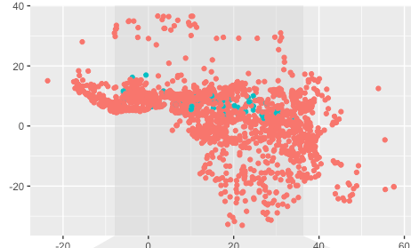
Areality & Borrowability
4.-6.11.21: IAAW Berlin; Diedrich Westermann-Workshop

Slide 2
Overview
Areality and borrowability: general remarks
  Thomason & Kaufman calculus
  Borrowability of pronouns
  Contact intensity and areal evidence
Logophoric pronouns
  Logophoricity features
  Logophoric 3.Sg.Sb
  3.Pl.Sb / 2.Sg.Sb
  Sources and source concepts
ICP
Conclusion
Notes:
Spreas of features / Spread of languages

Slide 3
The Thomason & Kaufman (1988) ‘calculus’
Transfer estimates
  Borrowability
  Contact intensity
Borrowing likelihood ~ Contact intensity ~ X := +/- transfer
Structural borrowing (low borrowability) is possible if contact intensity is high
Areal linguistic evidence from the Macro Sudan belt?
Notes:
Spreas of features / Spread of languages
Spread of features with languages
Likelihood of language contact
Likelihood of borrowing and contact intensity:
If we know one, we may estimate the other.
Areal evidence plays a crucial role in language contact theory
What may we learn from ponouns in the Macro Sudan belt?

Slide 4
Pronouns and borrowability
Morphological borrowing and borrowing scales
Pronouns (cited from Melissaropoulou & Ralli 2019):
nouns > adjectives > verbs > prepositions > coordinating conjunctions > quantifiers > determiners > free pronouns > clitic pronouns > sub- ordinating conjunctions
Muysken (1981)
(iv) Nouns, conjunctions > verbs > discourse markers > adjectives > interjections > adverbs > other particles, adpositions > numerals < pronouns > derivational affixes > inflectional affixes
Matras (2007)
Notes:
Morphological borrowing
Pronoun borrowing borrobabilty: medium to low?
Agreement anong Muysken and Matras, and more.
Doeas this fit to the evidence from the Macro Sudan belt?
Logophoric Pronouns: convergence involved? Convergence sub-zones? Only in zones with high contact intensity?

Slide 5
Pronouns and borrowability
TK ‘calculus‘ => overall high contact intensity in the Macro Sudan?
Borrowing scales and borrowing types
Gardani (2020)
  matter borrowing’ (MAT borrowing): formatives
  pattern borrowing’ (PAT borrowing): structural patterns
Conceptual Transfer (Heine & Kuteva 2005)
  Contact Induced grammaticalization I
  Replica grammaticalization II
Logophoric vs. ICP Pronouns
  Impact of borrowability
  Impact of contact intensity
  Impact of ‘error’
Notes:
According to th TK calculus: high defree of contact intensity overall.
Borrowing scales and borrowing types. Do scales depend on the type?
Matter borrowing. medium contact intensity?
Pattern borrowing. high conttact intensity?
Borrowing scales for conteptual transfers? Pragmatic or conceptual salience?
Is contact induced grammaticicalizationinvolved?
=> Contrast between Logophoric and ICP

Slide 6
Areal Linguistics
There is no geographical determinism; the linguistic borrowings are prime, and the geographical areas are only a reflection of these, with no significant causal force of their own. (Campbell (2006) cited in Güldemann (2018)
Areal typology as the study of geo-statistical properties of typological features/phenomena
Spatial non-randomness is a consequence of historicity and sociolinguistic mechanisms as causal forces
Not a theory but an empirical method:
  Non-Random distributions of a point process
  Evidence for (formerly excluded) structural transfers
Notes:
Typological properties and subtypes

Slide 7
Areal feature data exploration
„Areal linguistics in a more literal sense should be concerned more generally with the distribution of linguistic – or even more broadly, language-related –features across geographical space, and this interest should be independent of historical or any other explanations.“ (Güldemann 2018)
Areal features data exploration
  „Typologies“ -> Discrete feature matrix
  General descriptive statistics absolute and relative frequencies
  Feature covariation

Slide 8
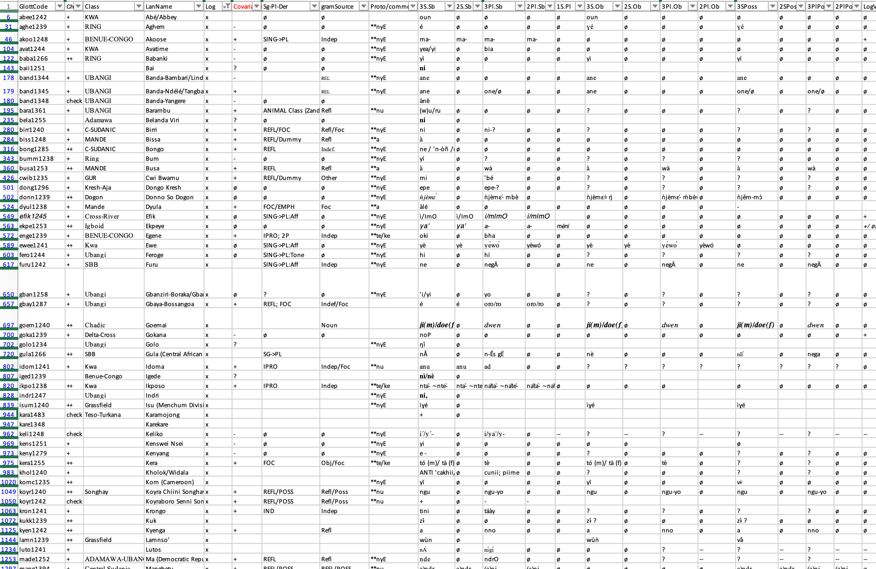
Logophoricity features
Typological features (Ameka 2017), Boyeldieu (2004), Güldemann (2003), Curnow (2002), Huang (2000), Culy (1994), von Roncador (1992)
Typological disposition
  Gender
  Portmanteau-TAM
  ‚Case“
Features
  Singular properties
  Types
Individual features

Slide 9
Logophoricity features
Paradigms:
  3, 2, 1 Person (no dual or incl./excl.)
  Sg. / Pl.
  S, O, Poss
  Affix
Conjoint reference
  Reported Speaker: RSLogP
  Addressee: AddLogP
Disjoint reference
  Anti-Logophoric

Slide 10
Logophoricity data and feature operationalization
Glottolog ‚Africa‘ macroarea
Log. literature and further grammatical descriptions: 100 out of 2360 ‘languages’
NAs and question marks:
  Language description (older sources)
  Thematical focus (binding theory)
Data interpolation?

Slide 11
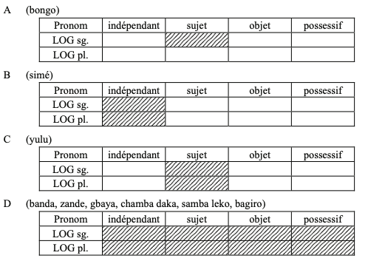
Data interpolation?
Boyeldieu (2004: 5)

Slide 12
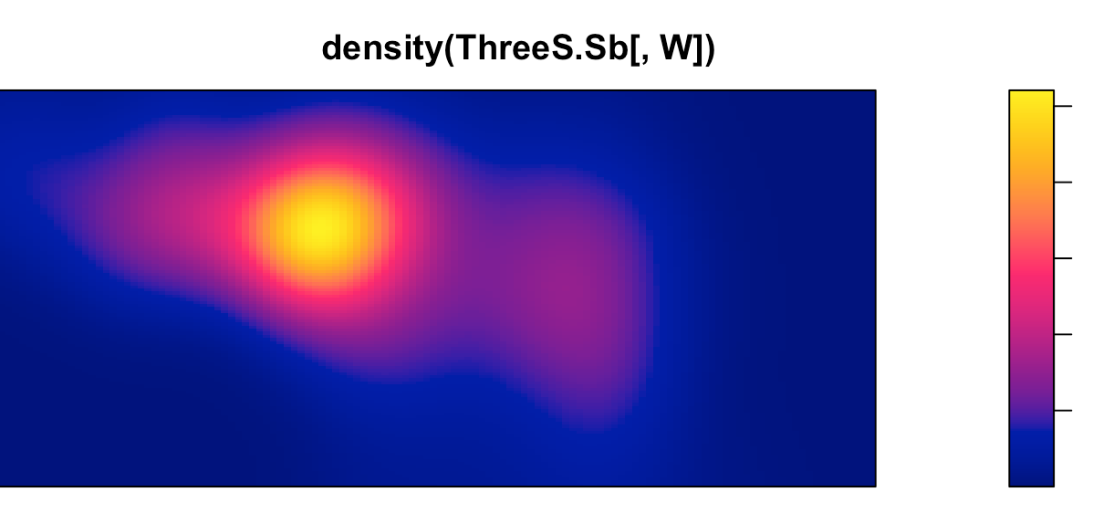
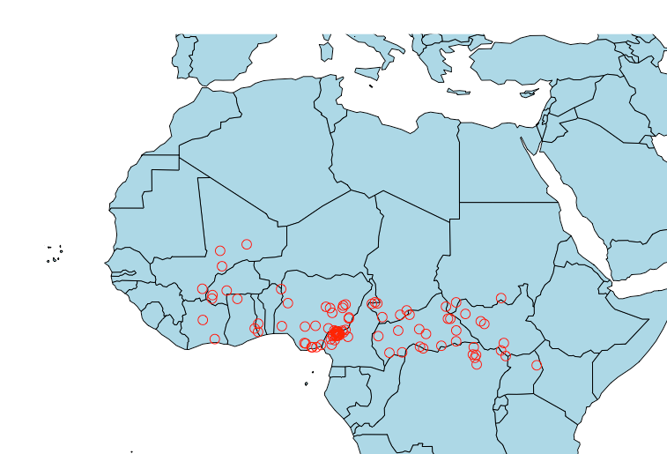
Logophoric 3.Sg.Sb
All but „aniti-log“ and suffix only (Gokana)
Macro-Sudan distribution
von Roncador (1992) comparative series
  (n)ye, (n)yi
  (n)u
  te, ke

Slide 13
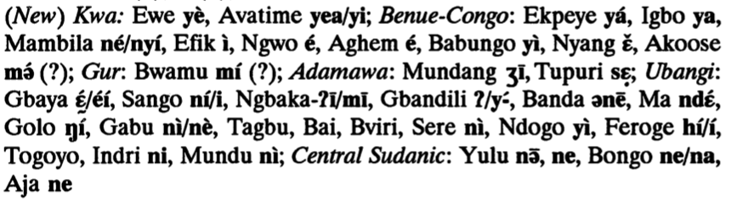
3.Sg.Sb
No coherent areal form patterns (->genealogical affiliation)

Slide 14
3.Pl.Sb 2.Sg.Sb
3Sg.>3Pl.Sg
„Core“ Macro-Sudan distribution?
3Pl.>2.Sg
3+2 neutralisation
Others

Slide 15
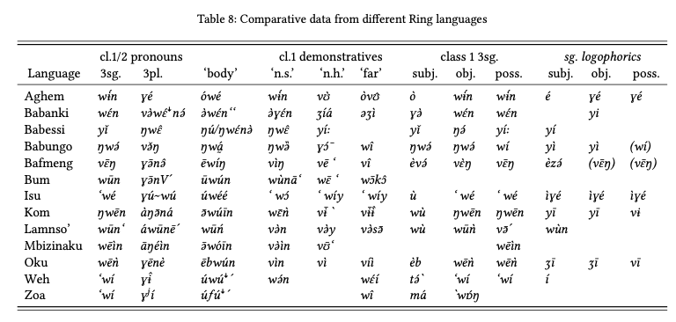
Similarities and grammaticalization
Hyman (2018: 208)

Slide 16
Sources and source concepts
„Functional connections to emphatics, which allow for logophoric marking in non-subject positions, are to be found in the second plus third person logophoric marking Systems of Idoma and Gbaya. The functional domain of the form in Gbaya outside speech reporting has been described as emphatic or reflexive. In several languages likewise, a reflexive possessive 'his own' is used also to mark logophoricity.“ von Roncador (1992)
„[…] les valeurs des logophoriques lacunaires sont alors normalement relayées par les formes de S3/P3 (sauf cas du bongo qui peut faire appel à une forme de réfléchi)“. (Boyeldieu 2004: 5)

Slide 17
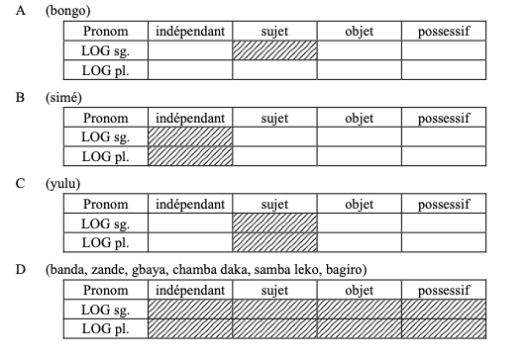
Sources and source concepts
„„[…] les valeurs des logophoriques lacunaires sont alors normalement relayées par les formes de S3/P3 (sauf cas du bongo qui peut faire appel à une forme de réfléchi)“. (Boyeldieu 2004: 5)

Slide 18
Sources and source concepts
It is possible that pronouns of set 1 originated in nouns since they behave like nouns with respect to their syntactic position.
In the case of logophoric A pronouns, there is some diachronic evidence that they actually derive from nouns (see Frajzyngier 1993: 118 for an analysis of cognate forms in Mupun). Hellwig (2003: 27)

Slide 19
Sources and source concepts
+/- Covariation
Independent Pronouns
Indefinite Pronouns
Reflexives (-> Focus)
„Retentions“
Other
=> Grammaticalization

Slide 20
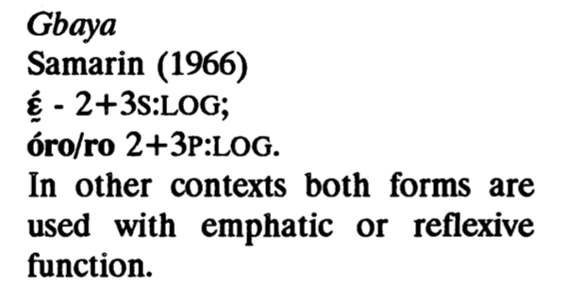
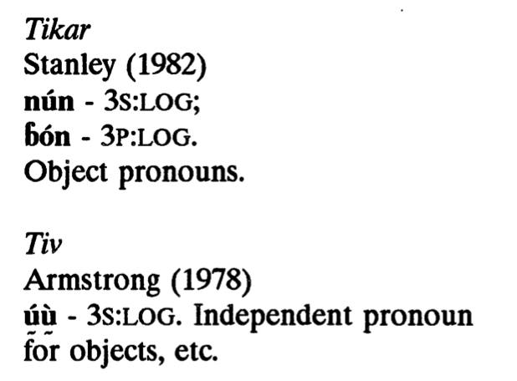
Sources and source concepts
Reflexives (-> Focus?) Indep.
(von Roncador 1992)
(von Roncador 1992)

Slide 21
ICP: morphological types
ICP+Logophoric

Slide 22
Conclusion
Sub-Areas for LogPs
  Plateau convergence zone
  Patterns with: center: -covariation, periphery: grammaticalization
Level of systemic integration (data quality)
TK calculus
  Logophoric: medium contact intensity + medium borrowability
  ICP: high contact intensity + low borrowability?
Conceptual transfers
  Multiple Sources in grammaticalization: but areal preferences?
  “Pure“ conceptual transfer: Chadic
  Coherent semantics for ICP

Slide 23
Outlook
Quantitative areal linguistics
Spatial point pattern statistics
Significant spatial point pattern correlations
  Estimating homogeneous intensity (Quadrat counts)
  Poisson Modelling
  Gibbs Models
Testing and simulation

