Slide 1

Gilles Authier
Prefixal gender and number marking in East Caucasian
African Seminar, Humboldt University
Berlin, 20 June 2023

Slide 2
WALS: plural suffixes vs plural prefixes

Slide 3
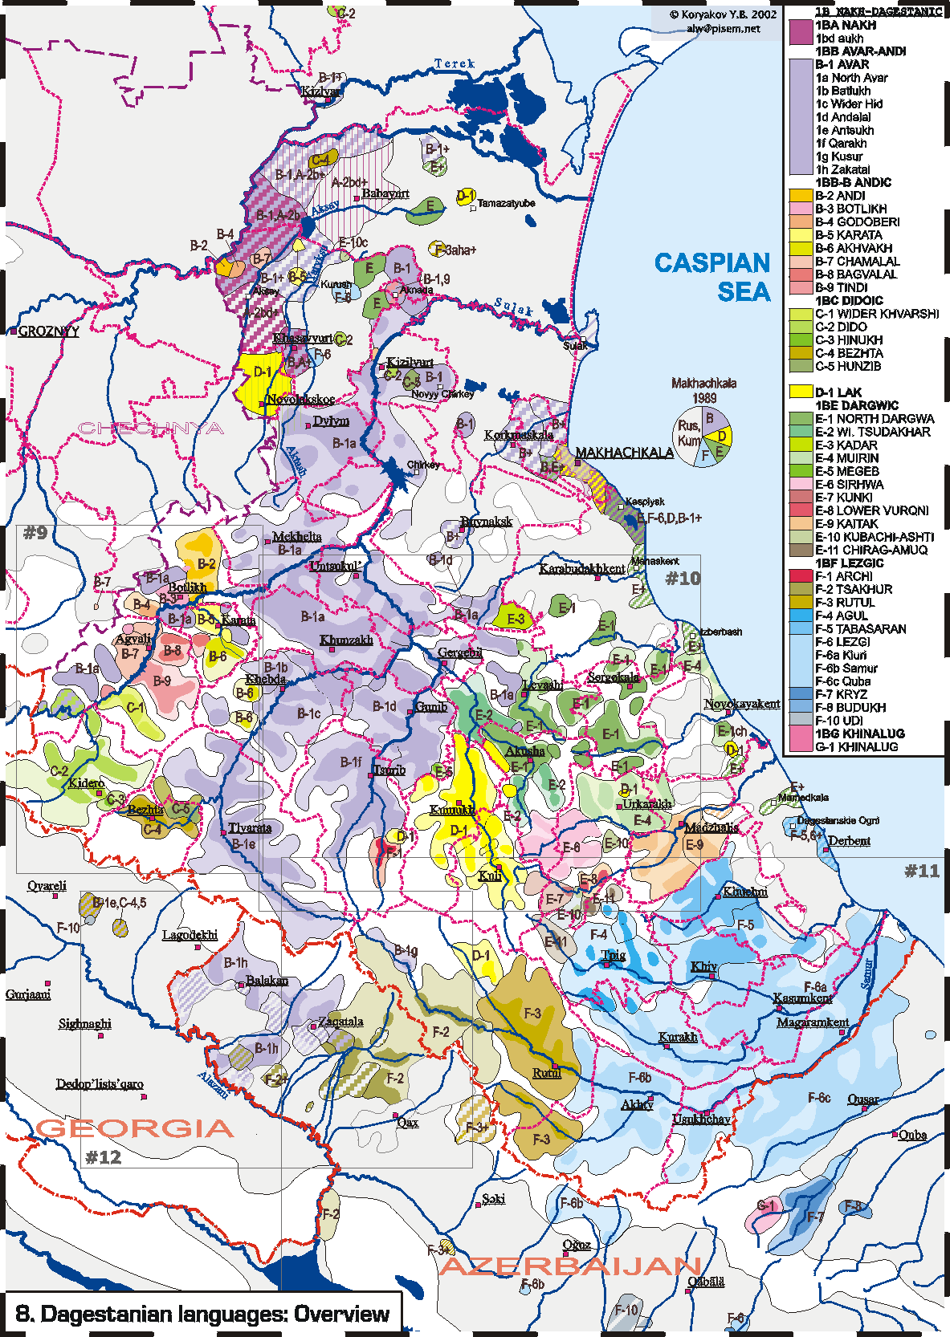
East Caucasian: 40 languages,
8 well-accepted branches
predominantly suffixal,
but most languages have
gender-number (verbal) agreement prefixes:
human masculine v-
human feminine r-
non human ‘animates’ b-
inanimates d-
Chechen
Andic
Avar
Tsezic
Dargic
Lak
Lezgic
K

Slide 4

Two singular vs plural agreement syncretisms
3d person plural marking
in all branches
SAP plural marking
in Nakh (W) and Dargic (E): retention
 | SG | PL
M | v- | b-
F | r- | b-
A | b- | d-
N | d- | d-
SG | PL
v- | d-
r- | d-
b- | d-
d- | d-

Slide 5
3d person vs SAP agreement in Dargic (& Nakh)
haˤltːi lebilra cuglan-te ka-b-eʁ-ib=qːele,
those all.HPL Tsugni.people-PL.NOM down-3HPL-go.PF-PRET=WHEN
ka-d-eʁ-ib=da.
down-1/2PL-go.PF-PRET=1
‘ When all Tsugni people moved to the lowlands, we also moved down.’

Slide 6
Agreement markers can be very transparent
= isomorphic, alliterating
ARCHI
buwa-mu b-ez ditːa<b>u χːʷalli a<b>u.
mother-ERG A-1SG(DAT) early<A> bread(A)(NOM) made<A>.PFV
‘Mother made bread for me early.’ (b = Animate non human)
This is not always the case !

Slide 7
Agreement markers can be very transparent
and the trigger noun often shows an alliterating onset:
b-eχu-ttu-b mulli-tti-k ditta-bu barq b-erq’ir.
A-long-ATTR-A mountain.OBL-SUPER-DIR quick-A sun(A) A-reach.IPF
‘On a high mountain, the sun arrives early.’
> Niger-Congo ‘overt gender’ type; J. Nichols ‘autogender’

Slide 8
Long recognized v-, r-, b- and d- onsets disproportion in dictionaries
 | ‘brother’ | ‘sister’ | ‘animal sibling’
Avar | vac: | jac: | bac:
Dargi | udzi | rudzi | budzi

Slide 9
the cognacy of gender morphology is often obscured:
branch-specific or areally determined consonant shifts:
M v → ø, j
F r → j
A b → v;
N d → r → j
root-particular nasalization: b → m; d → n),
=> language specific (locus determined) allomorphies.

Slide 10
Locus of agreement and allomorphy
LAK
allomorphs b/v:
baˁr č’ivi livč’-un b-ur.
pond(A) small.A A.grow-SEQ A-COP
‘The pond went down.’
d/r + root-particular nasalization: d → n:
neχ č’iri lirč’-un d-ur.
river(N) small.N N.grow-SEQ N-COP
‘The river went down.’

Slide 11
Initial B and D in dictionaries
 | ‘moon’, third gender | ‘heart’ fourth gender
Batsbi | but: | dok’
Avar | moc:’ | rak’w
Lak | barz | dak’
Dargi | bac: | urk’i
Kryz | vaz | jik’

Slide 12
Nouns marked for the third, ‘B’ animate gender in all languages
 | unique « active » THINGS |  | ANIMALS |  | Single BODY PARTS and activities
 | ‘moon’ | ‘sun’ | ‘wolf’ | ‘boar’ | ‘tongue’ | ‘nose’ | ‘tale’
Batsbi | but: | - | bʕorc’ | - | mot:’ | marɬŏ | moq
Avar | moc:’ | barq’ | bac’ | boƛon | mac:’ | meʕer | marha
Lak | barz | burq: | barc’ | burk’ | - | maj | maq
Dargi | bac: | barħi | bec’ | - | mez | - | -
Kryz | vaz | viraʁ | - | vak | mez | maʕal | maχw
Notes:
ANIMALS

Slide 13
Nouns marked for the fourth, ‘D’ gender in all languages
 | complex or mass BODY PARTS |  | mass or paired THINGS
 | ‘heart’ | ‘meat’ |  | ‘cloud’ |  | ‘axe’
Batsbi | dok’ | ditx |  | doxk’ |  | dik’
Akhwakh | rak’wa | riƛ:’i |  | - |  | -
Avar | rak’ | - |  | nak: |  | -
Lak | dak’ | dik’ |  | t:urlu |  | rik’
SDargi | urk’i | dig |  | dirixw |  | -
Lezgian | jik’ | jak |  | cif |  | jak’w
Kryz | (ji)k’ | jak |  | džif |  | jak’w

Slide 14
equipollent human gender contrasting nouns: four adjacent branches: probably areal innovation
 | ‘brother’ |  | ‘sister’
Chechen | voša |  | joša
Akhwakh | vaci |  | jaci
Avar | vac |  | jac:
Dargi | udzi |  | rudzi

Slide 15
non equipollent gender contrasting nouns non-adjacent branches: archaisms
 | ‘brother’ | ‘sister’
F overt gender, prefixal (Lak) | s:u | d-us: (r>d in Lak)
F overt gender, suffixal (Kryz, Lezgic) | šid | šid-ir
// unspecified gender (Tsez) | is | is

Slide 16
overt gender and case marking
Overt gender in the nominative (S/P) only:
S/P OBL (ERG, GEN)
Tsez ‘son’ M u-ži ž-a
Lak ‘moon’ A ba-rz z-urdu-l
Kryz ‘heart’ N ji -k’ k’-ij
Very irregular morphology - ‘weak suppletion’
but found across non-adjacent branches: archaisms
Suggests a state of affairs in which only S/P arguments would be flagged for their own gender. marked nominative ? definiteness?

Slide 17
Preliminary conclusions
Most nouns are not marked for their own gender, including in the most stable inherited vocabulary:
e.g. cognates for ‘water’ is of the fourth (N) gender, ‘fire’ is of the third (A) gender and this is never marked on the nouns for ‘water’ and ‘fire’ themself
But
fourth gender nouns often have a word initial dental,
in the third gender, nouns often have a word initial labial.
Hypothesis:
overt gender marking has to do with definiteness / specificity / number marking

Slide 18
Ø/ B alternation across Dargi lects for ‘blood’ :
 | ‘blood’
Akhwakh | hini
Avar | bi
Tsez | ijo
Lak | uˁ
Northern Dargi | ħe
Southern Dargi | / be
Lezgian | ivi
Kryz | i-radž
Khinalug | p’i

Slide 19
Frozen gender prefixes and the Lezgic tree
‘threshing-floor’
‘door’
Lezghian r-at
Tabasaran r-ac:
Agul r-at:
Rutul r-at
Tsakhur at:a
Archi c̣i
Udi eč:
Lezghian r-ak
Tabasaran r-ak:-
Agul r-ak:
Rutul r-ak
Tsakhur ak:a
Archi d-aƛ̣:

Slide 20
B / Ø alternation on singular / paired body parts
 | ‘eye’
Batsbi | bʕar-k’
Akhwakh | k’e-har / Anchiq har-k’e (k’e- ‘two’)
Avar | ber
Lak | ja
Dargi | (ħ)ul
Lezgian | vili
Kryz | ʕul

Slide 21
B- / Ø- and D- / Ø alternation: singulative and collective forms for bodyparts?
 | B- singulative? |  | D- collective?
 | (cattle) ‘head’ | ‘fingernail’ | ‘span’ | ‘liver/lung-s’
Batsbi | - | mʕajrĭ | - | dɦeɁ
Akhwakh |  | miƛo | reƛ:’en | riƛ’e:ƛ:i
Avar | bet’er | maƚ | roƛ:’ob | t’ul
Tsez |  | moˁƚu | t’om | -
Lak | bak’ | mix | - | t:ilik’
Dargi | bek’ | mekka | č’im | dulek’
Tsakhur | vuk’ul | - |  | -
Lezgian | k’il | kek | č’ib | leq’
Kryz | q’il | - | k’ep’ | -

Slide 22
B / D / Ø alternation on countable measure word
 | ‘day’ | ‘year’
Avar | q’o | son
Akhwakh |  | reše(n) | r<d
Kryz | jiʁ | san | j < r < d
Dargi | barħi | dus
Lezgian | juʁ, pl. ʁ-ar | jis, pl. s-ar | j < r < d

Slide 23
The main problem
Many obviously cognate nouns have
a labial onset, B/M i.e. third-gender prefix, in one branch or language
and a dental onset, D/N i.e. fourth-gender prefix, in others,
with no subgrouping evidence

Slide 24
Lexeme distinguishing gender alternation
 | ‘day’ | ‘sun’
Avar | q’o | barq’
Dargi | barħi = | barħi
Lezgian | juʁ, pl. ʁ-ar | raʁ
Kryz | jiʁ | viraʁ

Slide 25
M / N alternation on nasalised roots no apparent subgrouping except for Nakh
 | ‘louse’ | ‘honey’ | ‘bedclothes’
Batsbi | mac’ | moc’ | mot:
Akhwakh | nac:’i | unc:’i | rešva
Avar | nac:’ | hoc:’o | bosen
Tsez | noci | nuci | muži
Lak | nac’ | nic’ | -
SDargi | nez | vaza | -
Lezgian | net | virt | mes
Kryz | - | jit | mes
Khinalug | nimc’ | nüc’ | -

Slide 26
Lexeme distinguishing gender alternation
 | ‘tear(s)’ | = ! ‘broth’
Batsbi | natʾqʾajri | -
Akhwakh | maq’a | -
Avar | maʕu | -
Tsez | mo | (Bezhta janq’o)
Lak | maq’ | naq’
Dargi | nurʁbe (regular plural of!) | nerʁ
Lezgian | - | diq’

Slide 27
other M / N = B / D alternation on nasalised roots no apparent subgrouping except for Nakh and Lezgic
 |  | ‘dream’ | ‘nettle’
Batsbi |  | nab | nit:’
Akhwakh |  | miƛ:’e | mic:’i
Avar |  | maƛ:’u
Tsez |  | moƛu
Lak |  | mak’ | meč’
SDargi |  | muger | mic:i
Lezgian |  | nik’
Kryz |  | neq’ | medž
Udi |  | nep’ | meč’

Slide 28
Typological (morphology/semantics) conclusions
reconstructed types of number marking (in the nominative (S/P) case)
singularia tantum, consistent b-: ‘moon’, ‘sun’, ‘tongue’, ‘nose’
mass/pair nouns, consistent d-: ‘heart’, ‘cloud’, ‘axe’, ‘meat’, ‘tears/broth’
singular/pair, b- or d- / Ø: ‘eye’, ‘liver/lungs’
mass or discrete nouns, b- or d- : ‘honey’, ‘lice’, ‘sheets’, ‘nettle’, ‘dream’

Slide 29
General conclusion
A submerged inflectional feature
reconstructible for the proto-language,
opposed to the current state of affairs in attested languages:
typological shift
driven by long-standing contact with purely suffixing languages (Turkic)

