Slide 1
Location in Ngen
Tatiana Korol
May 2024, Berlin

Slide 2
Outline
Basic information
Locative postpositions
Locative nouns
Deictic adverbs
Questions for discussion
Results

Slide 3
Basic information
Niger-Congo
Southeastern Mande
Southern Mande
Beng
Ngen
Gban
Mande
…
…
…
Mwan
Wan
Dan
Tura
Yaure
…

Slide 4
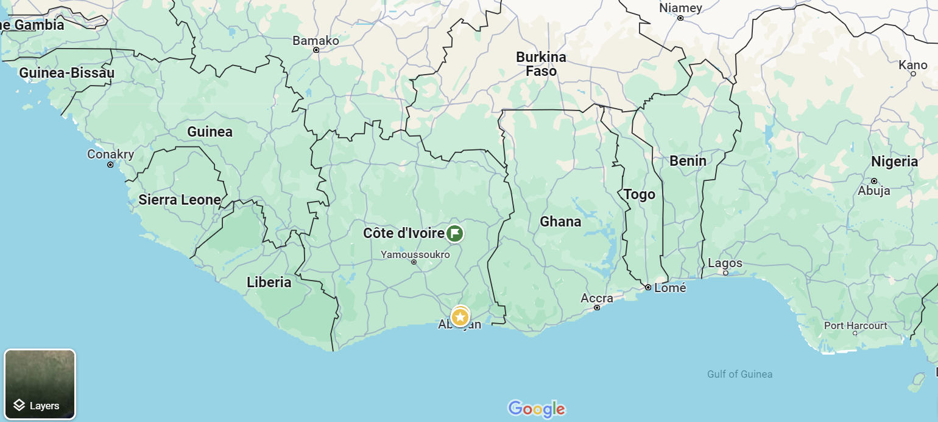
Basic information
Currently, about 1,000 people speak Ngen language in the Prikro prefecture in northeastern Côte d'Ivoire.
Ngen is endangered.

Slide 5
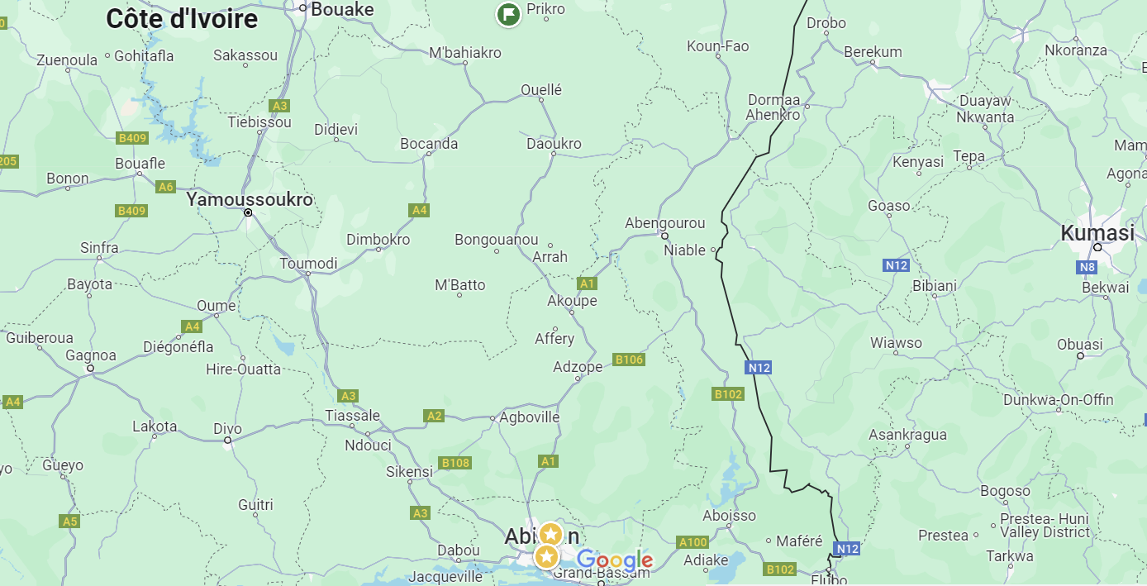
Basic information
Currently, about 1,000 people speak Ngen language in the Prikro prefecture in northeastern Côte d'Ivoire.
Ngen is endangered.

Slide 6
Main typological characteristics
3 level tones + downdrift
strict Subject-Auxilary-Object-Verb-X (other components) word order
dependent noun precedes head noun in possessive constructions: N_{GEN} N
numerals follow the nouns: N NUM
no alienability contrast in possessive constructions (not typical for Mande)
postpositional phrases, but not noun phrases, commonly occur after the finite verb; postpositions also differ from nouns in that they cannot combine with a definite marker or modifiers such as adjectives
Notes:
Position with respect to the finite verb can be used in Ngen as the basic syntactic test for distinguishing between noun phrases and postpositional

Slide 7
Allative/Ablative/Locative
Locative phrases refer to a localization only. The semantic role of the localization, also known as its orientation (e.g. as the goal or the source of motion), is not marked in the locative phrase and has to be inferred from the verb modified by the locative phrase. (Creissels, 2003)
1. | Àlɩ́ | nú-nā | bùɛ̀ | lò | (bì)
 | A. | come-PRF | forest | in | (there)
‘Ali came to the forest.’ (Allative)
2. | Àlɩ́ | à | bɔ̄ | bùɛ̀ | lò | (bì)
 | A. | 3SG | come.back | forest | in | (there)
‘Ali has returned from the forest.’ (Ablative)
3. | Àlɩ́ | bé | bùɛ̀ | lò | (bì)
 | A. | COP/aux | forest | in | (there)
‘Ali is in the forest.’ (Locative)
Notes:
This is due to the fact that the verbs of motion in such languages are divided strictly into 'verbs of purpose' and 'verbs of the source of motion', so that they remove the homonymy of meanings.

Slide 8
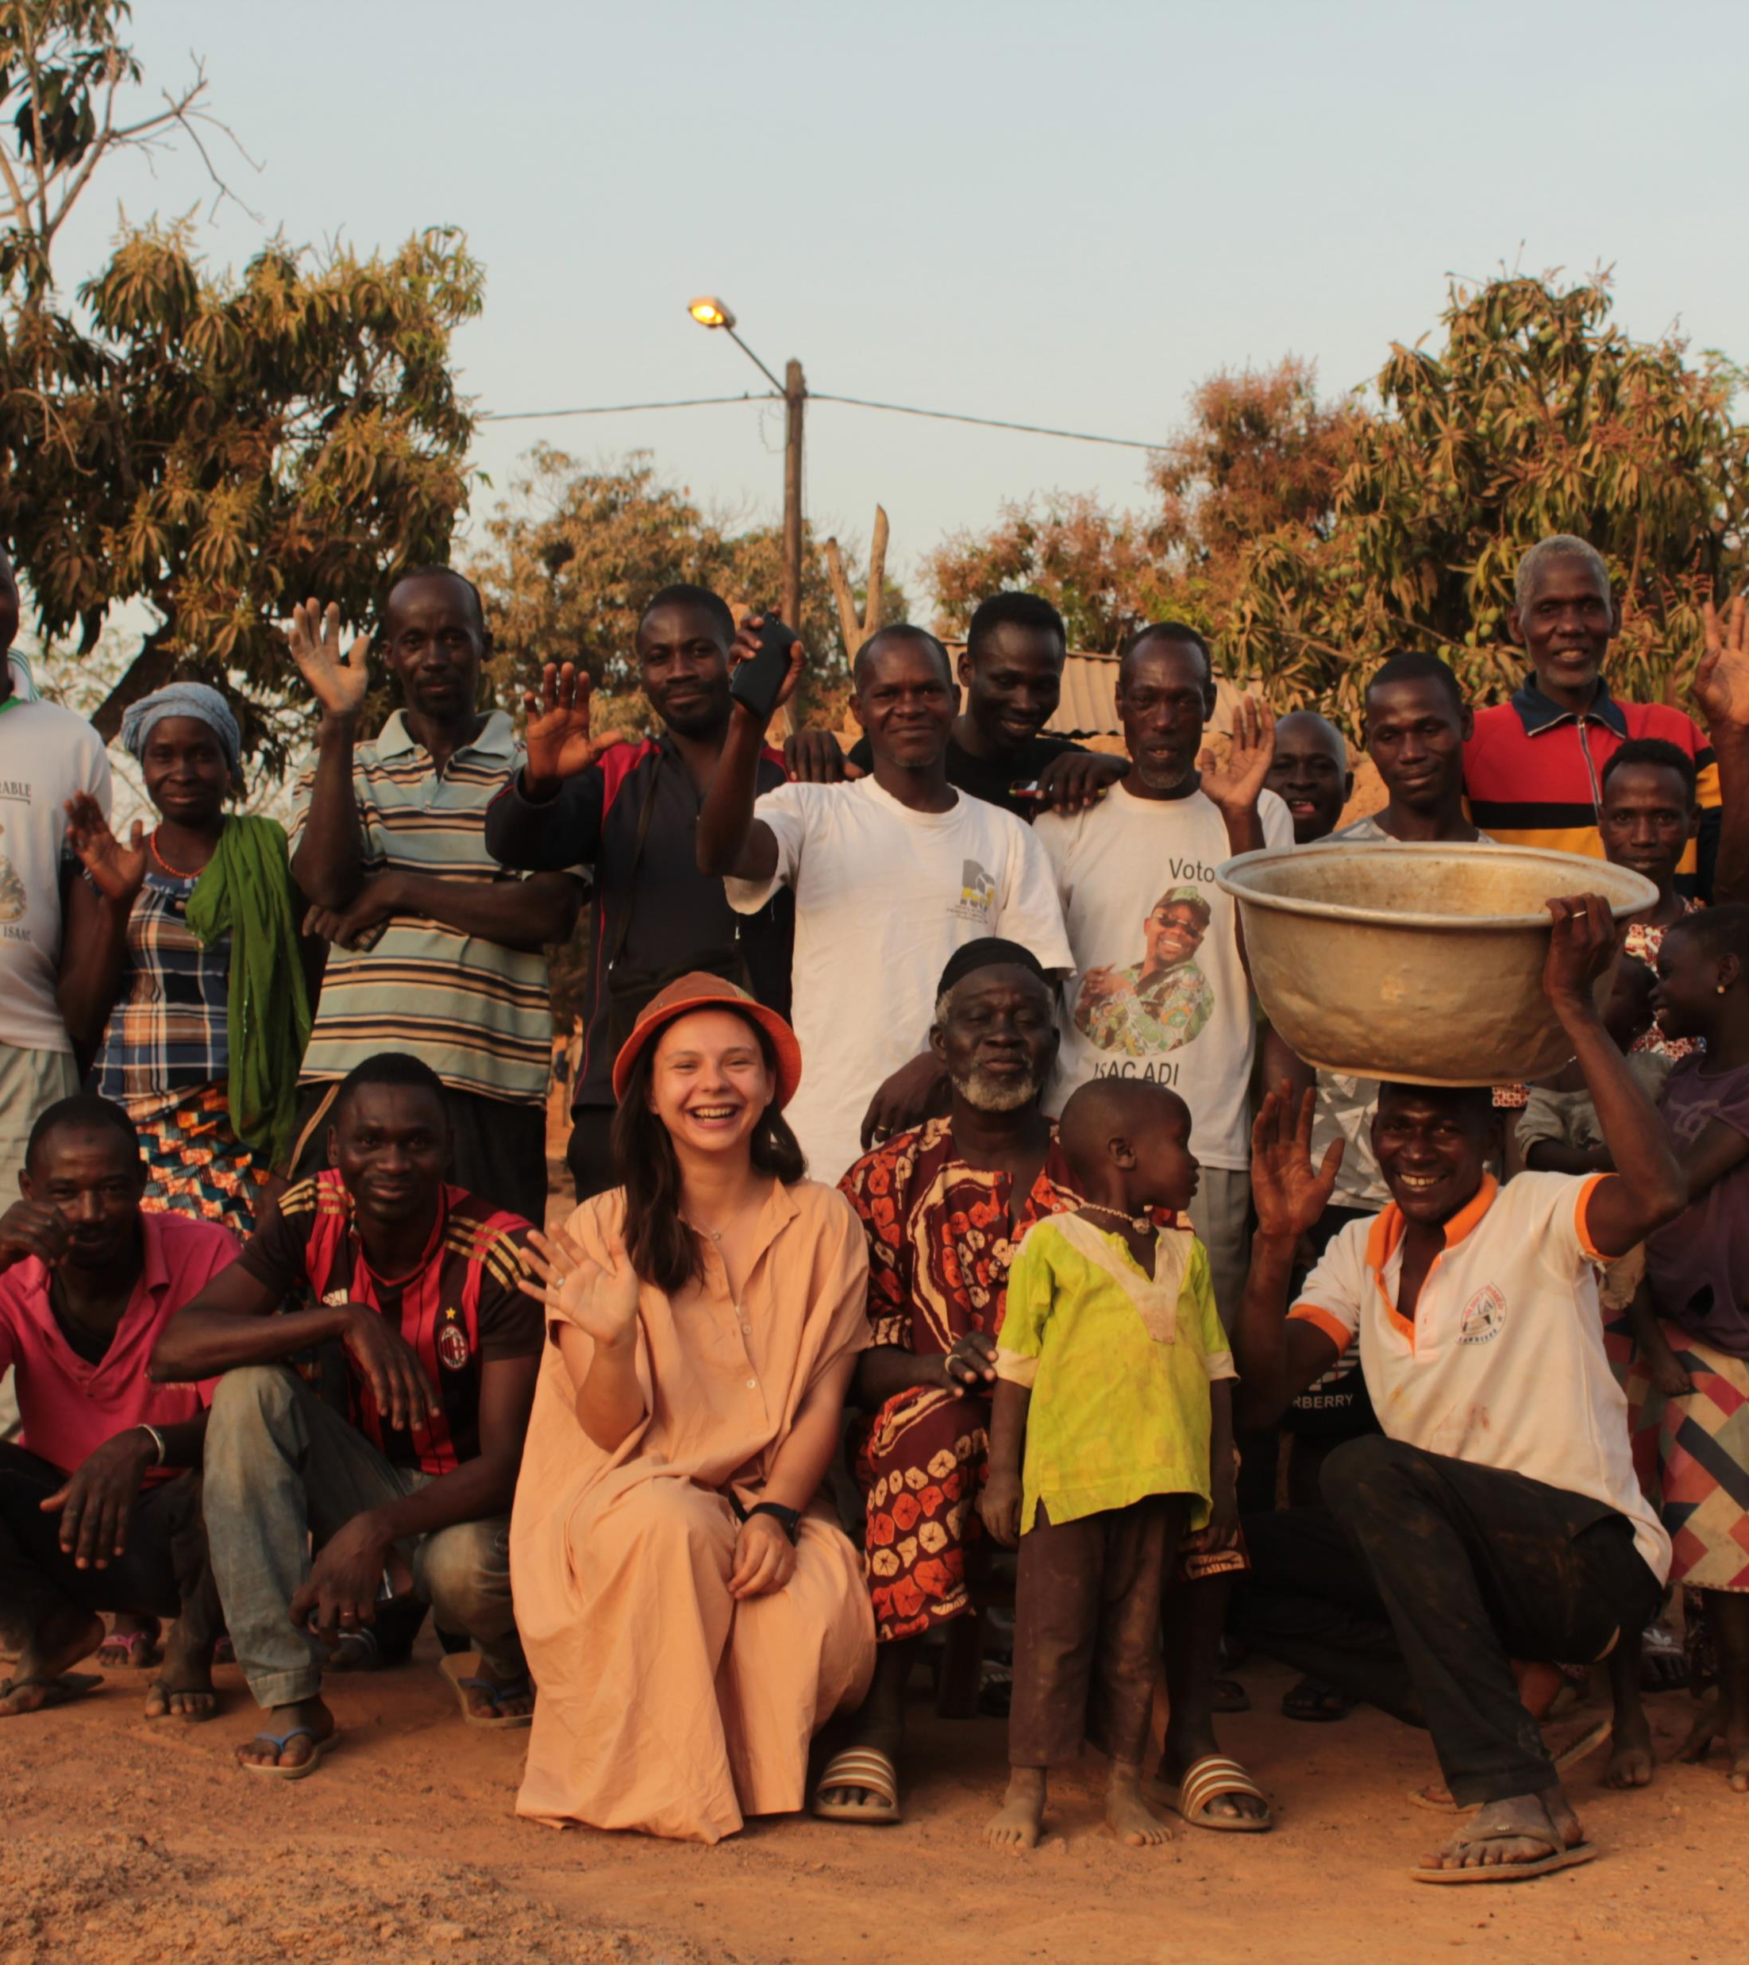
Basic information
This work is based on a corpus of narratives (~35 minutes) and elicitations collected from 2019 to 2023
Examples from narratives are labelled (tx)
Elicited examples are unmarked
Examples without tonal marks require additional validation
Data was collected from four language consultants: Soualio Ouattara, Ali Issuf, Ali Amara and Kuadjo Yacouba
All consultants speak not only Ngen, but also Jula and Baule

Slide 9
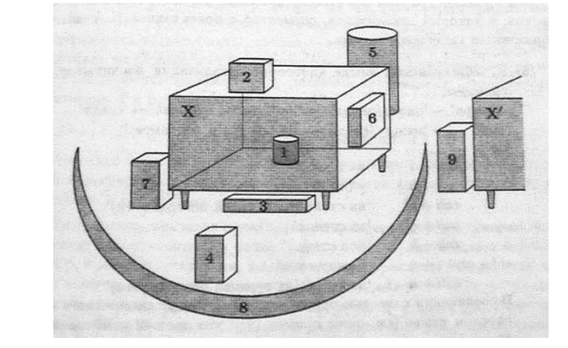
Locative postpositions
Pic. 1. Schematic representation of the main possible localizations. (Melchuk 2004: 53).

Slide 10
Localisation 1
An object is located inside of another object, a container, that is perhaps open or abstract.
4. | á | māgolɛ́ | bē | sákí | lò
 | 3SG | mango | COP.EX | bag | DEF<in
‘ Mango is in the bag.’
5. | wà | dá-nà | yí | lò
 | 3PL | fall-RES | water | DEF<in
‘ They fell into the water.’
6. | wéŋ́gbèŋ | sɔ̄ŋ | yé | cí | lō | lɛ́
 | word | five | FOC | book | DEF<in | FOC
‘ There are 5 words in the book.’
Etymology:
wò < wɔ̀ ‘neck’
Notes:
typical spatial adposition localizes an object MANGO or an event (the Figure) with respect to a reference object BAG (or the Ground).

Slide 11
Localisation 2
An object is located on the surface of another object.
7. | àcɛ́cɛ́ | dō | à | kálá-nā | tābālì | là
 | buterfly | one | 3SG | sit-PRF | table | on
‘There's a butterfly on the table.’
Note:
Suffix lā is used to mark the progressive aspect on verbs.
See ex. 12.

Slide 12
Localisation 3
An object is located underneath another object.
8. | jānūmā | lɛ̀ | bé | tābālí | lɛ̀ | lólà
 | cat | DEF | COP.EX | table | DEF | under
‘The cat is under the table.’

Slide 13
Localisation 4
An object is placed in front of another object.
9. | pɔ̄ | dō | bé | ŋ́ | gānā
 | thing | one | COP.EX | 1SG | in.front.of
‘There's something in front of me.’

Slide 14
Localisation 5
An object is located behind another object.
10. | pɔ̀ɔ́ | lɛ̄ | bé | yínɛ̀nɛ̀ | cɛ̀lɛ́
 | field | DEF | COP.EX | water.flow | behind
‘There's a field across the river.’
11. | dō | bé | cɛ́ | lɛ́ | cɛ̀lɛ́ | bì
 | one | COP.EX | house/wall | DEF | behind | there
‘There's someone behind the wall.’
Etymology:
cɛ̀lɛ́ < kpēlɛ́ ‘back’

Slide 15
Localisation 6
An object is located on the side surface of another object.
12. | Gɔ̄ŋ̄ | nɛ̀ | kālā | cɛ̀ | lɛ̀ | zì | è | bé | līŋ̄ | nɛ̀ | gbɛ̄-lā
 | man | FOC | sit | house | DEF | side | 3SG | aux | woman | DEF | wait-PRG
‘A boy is sitting outside the house waiting for a woman.’
13. | mé | gbàŋ̀ | nɛ̀ | zì
 | 1SG<aux | village | DEF | side
‘I'm on the edge of the village.’

Slide 16
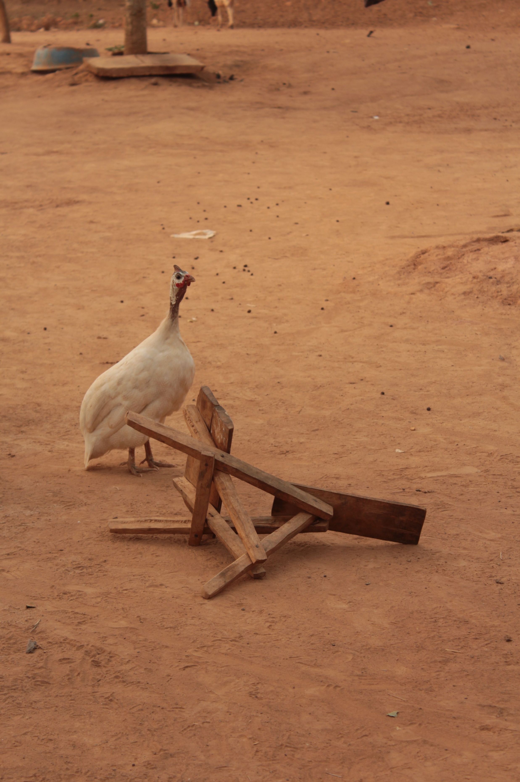
Localisation 7
An object is located next to another object, but does not touch it.
14. | gà̰ŋ | bɛ̀lɛ̀ŋ̀ | wò | bé | ŋ̄ | cɛ́ | lɛ̀ | srɔ̄ŋ | gbɔ̀
 | guinea-fowl | many | PL | COP.EX | 1SG | house | DEF | close | place/here
‘ There are a lot of guinea fowls near my house.’

Slide 17
Localisation 8
An object is placed around an object.
15. | wà | kùkù | pē-nā | pálá | lɛ̀ | zì
 | 3PL | fence | make-PRF | house | DEF | around
‘ They put up a fence around the house.’

Slide 18
Localisation 9
The object is located between two objects.
Not collected at the moment

Slide 19
Locative nouns

Slide 20
Locative nouns
Is a small subclass (pɔ̄ɔ́ 'field', gbāŋí 'village', pálá 'home, house' and toponyms) of general nouns.
They can occupy the position of the subject with the article:
18. | pɔ̀ɔ́ | lɛ̄ | bē | yínɛ̀nɛ̀ | cɛ̀lɛ́ | (bī)
 | field | DEF | COP.EX | river | behind | there
‘The field is behind the river.’

Slide 21
Locative nouns
Is a small subclass (pɔ̄ɔ́ 'field', gbàŋ̀ì 'village', pálá 'home, house' and toponyms) of general nouns.
They can be pluralised:
16. | Līŋ̄ | è | bé | pɔɔ
 | woman | 3SG | COP.EX | field
‘There is a woman in the field.’
17. | Līŋ̄ | nù | bé | pɔɔ | nù
 | woman | PL | COP.EX | field | PL
‘There are women in the fields.’

Slide 22
Locative nouns
They are not used with postpositions, but they are combined with deictic adverbs.
19. | ŋ́ | nú | sórō | gbàŋī | bī
 | 1SG | come | arrive | village | there
* | ŋ́ | nú | sórō | gbàŋī | lò | bī
 | 1SG | come | arrive | village | in | there
‘I arrived to the village.’
*‘I arrived to the village.’
20. | bā | bé | gbā̰ŋí | bī
 | 1PL | COP.EX | village | there
* | bā | bé | gbā̰ŋí | lò | bī
 | 1PL | COP.EX | village | in | there
‘We are in the village.’
*‘We are in the village.’
Notes:
Примеры выше иллюстрируют то, что локативные существительные не допускают после себя послелогов, вероятно, их форма уже включается в себя послелог, который не отделяется на синхронном уровне.

Slide 23
Locative nouns
Sometimes they change their morphological form with determinative
21. | mā | dɔ́mà | sá̰ | jārá | wò | bé | gbàŋ̀ | kō | wò
 | 1SG<aux | know | that | lion | 3PL/-PL | COP.EX | village | this | in
‘ I didn't know there are lions in this village.’
22. | mā | dɔ́mà | sá̰ | jārá | wò | bé | *gbāŋ-í | kō | wò
 | 1SG<aux | know | that | lion | 3PL/-PL | COP.EX | village.LOC | this | in
*I didn't know there are lions in this village.

Slide 24
Locative nouns
Each Ngen verb has exactly one semantic slot for a location (contrasting with verbs of European languages that can have multiple locative modifiers that correspond e.g. to the source and the goal of motion, as in the English The Smith family left Vienna for Paris).
In Ngen, if a verb is modified with more than one locative phrase, they always describe the same location:
23. | ā | nū-nā | pálá | Àbìjān | nɔ̀
 | 3SG | come-PRF | home | Abidjan | here
‘He came home to Abidjan.’

Slide 25
Deictic adverbs

Slide 26
Deictic adverbs
Ngen | gbɛ̀ | nɔ̀ | bī | gbɔ̀
French | ici1’, place’ | ici2 | là1 | là2 place’
meaning | here, close to the Speaker | here, close to the Listener | there, close to Speaker, far from the Listener | there, far from both participants

Slide 27
Adverbal contexts
24. | sóŋ́ | bé | bī
 | tooth | COP | there
26.a | dé | ŋ̄ | cɛ̀lɛ̀ | (bī)?
 | who | 1SG | back | there
‘A tooth is there.’ (tx)
‘ - Who is behing me (there)?’
26.b | gɔ̄gbɛ́lā | lɛ̄ | lɛ̀!
 | friend | DEF | COP.ID
25. | à | bɔ̀ | bī
 | 3SG | quit | there
‘ - The friend!’
‘He left that place.’

Slide 28
Deictic adverbs
Combined with locative nouns
27. | bā | bé | gbāŋí | bī
 | 1PL | COP.EX | village.LOC | there
‘We are in the village’
Combined with toponyms
28. | à | nù-nà | pálá | Àbìjān | nɔ̀
 | 3SG | come-PRF | home | Abidjan | here
‘He came home to Abidjan.’
Combined with postpositions
29. | Yáá | yí | tɛ̄ŋ | nò | kāā | ŋ̄ | srɔ̄ | nɔ̀ | lɔ̀
 | Then | 2SG | rfl | come | sit | 1SG | close | here | excl
‘And you also, come here to sit down near me!’ (tx)

Slide 29
Nominal contexts
These markers that typically occur in adverbial contexts are also found in nominal ones
30. | à | bī | ye
 | 3SG | there | see
31. | ŋ́ | lɔ̀ | bī | wa
 | 1SG | mouth<in | there | look
‘I saw that place.’
‘ Look into my mouth!’ (tx)

Slide 30
Genetive constructions in Ngen
dependent noun precedes head noun in possessive constructions: N_{GEN} N
32. | bùlùnāŋ̄ | pɔ̄
 | witch | thing
‘ Witch’s thing.’

Slide 31
Question 1
33. | gbāŋí | bī | klìɲàŋ̀
 | village | there | sand
34. | būɛ̀ | pɔ̄
 | forest | thing
‘sand from village’
‘A thing from forest’
* | gbāŋí | lò | bī | klìɲàŋ̀
 | village | DEF>in | there | sand
35. | būɛ̀ | lò | pɔ̄
 | forest | DEF>in | thing
*‘sand from village’
‘ A thing from forest’
36. | būɛ̀ | lò | bī | pɔ̄
 | forest | in | there | thing
‘sand from the forest’ or ‘sand, that came from the forest.’
Notes:
Genetive constructions with deictic ?adverbs? Is it really an adverb?
be adverbial noun phrases, pointing to the relation of an object to a particular time or place?

Slide 32
Question 2
29.a | dé | ŋ̄ | cɛ̀lɛ̀ | (bì)?
 | who | 1SG | back | there
Why there is no copula?
‘ - Who is behing me (there)?’
29.b | gɔ̄gbɛ́lā | lɛ̄ | lɛ̀!
 | friend | DEF | COP.ID
‘ - The friend!’

Slide 33
Question 3
37. | ŋ̀ | báŋ́-nù | wò | pālāŋ̄ | sárá
 | 1SG | sheep-PL | in | two | take
What is the syntactic structure here?
‘From sheeps I take two.’

Slide 34
Results
The presentation gives an overview of Ngen postpositions
A group of locative nouns that are used in the predicative position without postpositions was extracted from group of general nouns.
Tests for syntactic compatibility of postpositions, locative nouns and deictic markers were carried out.

Slide 35
À mìlì
‘ Thank you!’

Slide 36
References
Creissels D. 2003. Encoding the distinction between localization, the source of motion and the direction of motion: a typological study // Proc. of Colloque international Space in languages: linguistic systems and cognitive categories, Ecole Normale Supérieure d'Ulm, Paris, France, 7-8 février 2003.
Melchuk I. А. 2004. General morphology. {Obschaya morphologiya} Т. II. М

