Slide 2
Contact and inheritance in the development of lateral obstruents in Southern Bantu languages
department of languages and cultures
african languages and cultures
Hilde Gunnink – KBA Riezlern meeting – 18-20 July 2022

Slide 3
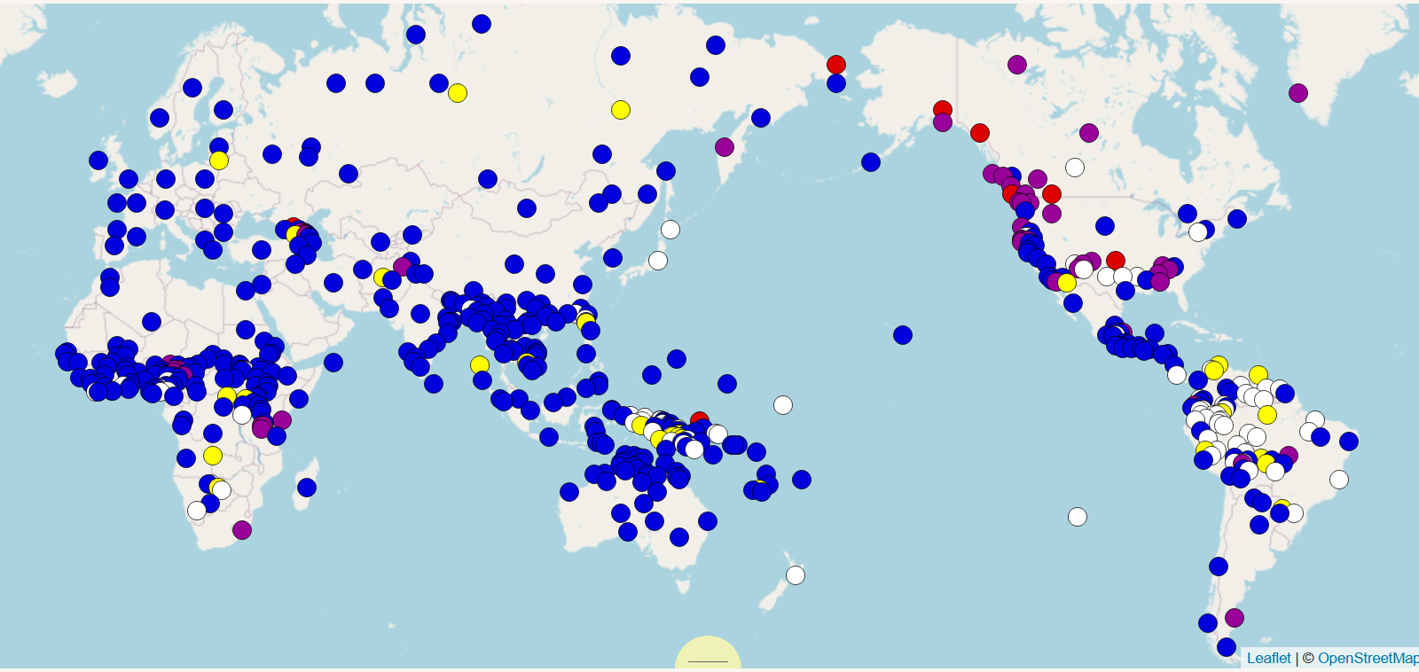
Laterals
Lateral approximants /l, ɭ, ʎ/: crosslinguistically common, especially alveolar /l/
Lateral obstruents:
Fricative /ɬ, ɮ/
Affricate /tɬ, dɮ, tɬ’, tɬh, kʟ, kʟ’, kʟh/
https://wals.info/feature/8A#2/19.3/153.1 (red / purple = presence of lateral obstruents)

Slide 4
Lateral obstruents in Bantu
Eastern Africa:
Inner Mbugu (G221)
Dawida (E74a)
…
Southern Africa:
Nguni (S40)
Tsonga (S50)
Sotho (S30)

Slide 5
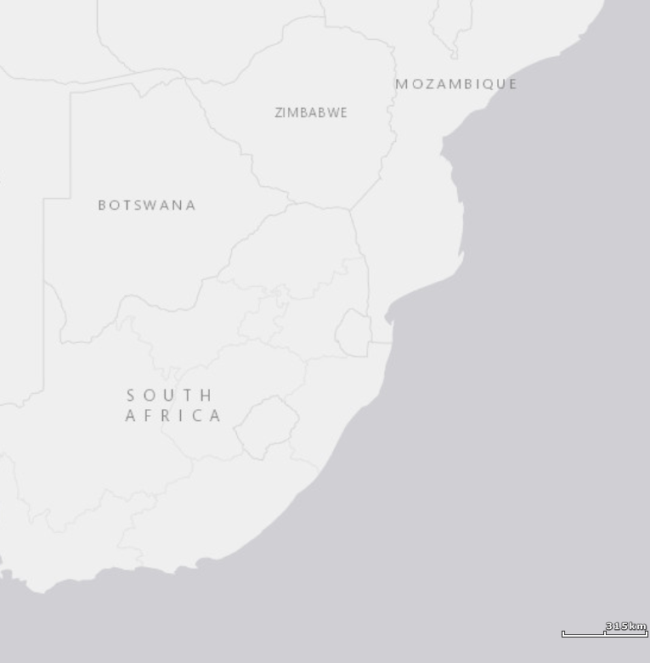
Southern bantu
Shona (S10): Zezuru, Ndau, Karanga, Karanga…
Venda (S20): Venda (S21)
Sotho (S30): Tswana (S31), Northern Sotho (S32), Southern Sotho (S33)…
Nguni (S40): Xhosa (S41), Zulu (S42)…
Tsonga (S50): Tsonga (S53), Tswa (S51), Ronga (S54)
Copi (S60): Copi (S61), Tonga (S62)
Shona
Venda
Sotho
Tsonga
Copi
Nguni

Slide 6
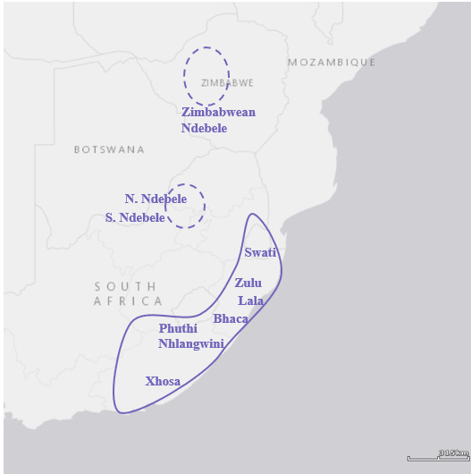
Lateral obstruents in Nguni (s40)
e.g. Xhosa
Lateral fricatives: /ɬ, ɮ/
ɬala ‘to stay’, ɮala ‘to play’
Lateral affricates: /ntɬ’, ndɮ/
intɬ’alo ‘dwelling’, amandɮa ‘power’
e.g. Zulu
Lateral fricatives: /ɬ, ɮ/
Lateral affricates: /ntɬ’, ndɮ/
Velar lateral affricate: /kʟ’, nkʟ’/
kʟ’weɓa ‘to scratch’, nkʟ’inkʟ’iza ‘breathe with difficulty’

Slide 7
Lateral obstruents in Nguni (S40)
Alveolar lateral fricatives and affricates: in all Nguni languages
Velar lateral affricates:
in Zulu, Swati
Possibly in Zim. Ndebele, Northern Ndebele, Bhaca
Absent in Xhosa, Southern Ndebele, Phuthi

Slide 8
Lateral obstruents in Sotho (S30)
e.g. Tswana
Lateral affricates /tɬ’, tɬh/
tɬala ‘famine’, tɬhapi ‘fish’
no voiced laterals, no lateral fricatives
e.g. Southern Sotho
Lateral fricative /ɬ/
ɬaba ‘stab’
Lateral affricates /tɬ’, tɬh/
tɬ’uŋ ‘in the house’, tɬhonepho ‘politeness’

Slide 9
Lateral obstruents in Sotho (S30)
Pai/Pulana/Kutswe (Eastern Sotho): velar lateral affricates instead of / in addition to alveolar lateral affricates/fricatives
Pulana: /kʟ’/
Pai: /ɬ, kʟ’/
Kutswe: /tɬh, kʟ’/

Slide 10
Lateral obstruents in Sotho (S30)
Kgalagadi (S311), Lobedu (S32b), North Tswana (S31c): dental stops correspond to lateral obstruents elsewhere
e.g. Kgalagadi t̪ou, Lobedu d̪ou ‘elephant’
vs. Tswana tlou ‘elephant’
dental stops instead of lateral obstruents also in Venda (S21): nd̪ou ‘elephant’

Slide 11
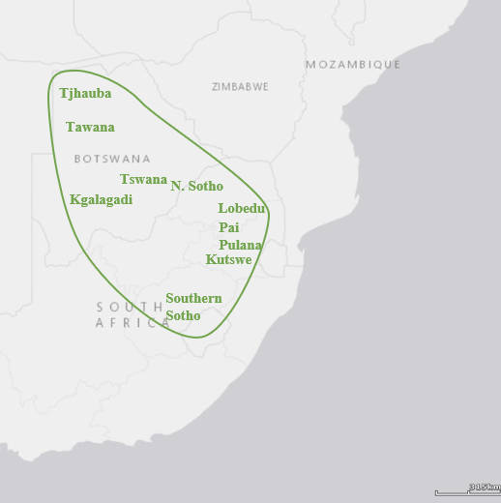
Lateral obstruents in Sotho (S30)
Sotho (S30):
Alveolar lateral obstruents in Tswana, S. Sotho, N. Sotho
Velar lateral obstruents (with or without alveolar ones) in Pai, Pulana, Kutswe
No lateral obstruents (but dental plosives instead) in North Tswana, Kgalagadi, Lobedu

Slide 12
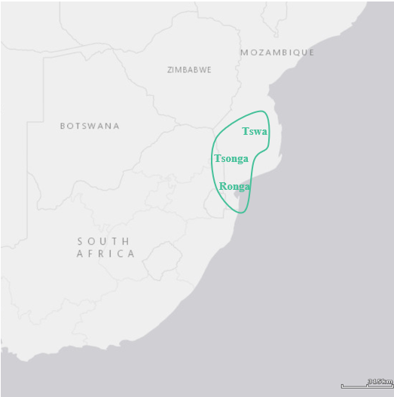
Lateral obstruents in tsonga (S50)
Tsonga (S50):
Alveolar lateral fricatives and affricates
e.g. Tsonga (S53) ɬ, tɬ, tɬh, ntɬ, ntɬh, dɮ, ndɮ
No velar lateral affricates, except in Tswa (S51)?
Larger than Nguni: lateral affricates are not restricted to post-nasal contexts
Larger than Sotho: also voiced lateral obstruents

Slide 13
Lateral obstruents in khoisan
ǂHoan (/ǂ’Amkoe, Kx’a, Botswana): velar ejective lateral affricate /kʟ’/ (Sands 2007: 212)
however, other sources transcribe /kχ’/ > dialectal/idiolectal difference?
Gǀui/Gǁana (Khoe-Kwadi, Botswana): in some varieties /kχ’/ is realized as /kʟ’/ (Nakagawa 2006: 112-113)
ǁXegwi (Tuu, South Africa): velar/alveolar? lateral affricates and (possibly) fricatives (Lanham and Hallowes 1956; Honken 2020; Sands 2007)
extensive Bantu influence on ǁXegwi
Sekele !Xung (Kx’a, Angola): /kʟ, gʟ/ (Traill and Vossen 1997: 37)
Kwadi (Khoe-Kwadi, Angola): /tɬ’, tɬh, (ɬ)/ (Güldemann 2013: 87), /kʟ, kʟ’/ (Fehn 2020a: 325-326)
Notes:
Fehn notes in a talk based on a wider array of sources than Guldemann that hl is probably a variant of tlh

Slide 14
Lateral obstruents in khoisan
Mostly velar lateral affricates (except ǁXegwi: Bantu influence?)
Lateral obstruents often occur as click replacements
Kwadi: ǁ > kʟ, ǁx’ > kʟ’ (Fehn 2020a: 325-326)
Sekele !Xung: ! > kʟ, g! > gʟ, gǁ > gʟ (Traill and Vossen 1997: 37)
ǁXegwi: ǂ, ǂ’ > tɬ’, nǂ > dɮ, ǂh > tɬh (Sands 2007: 214)

Slide 15
Diachronic development
(Some) alveolar lateral obstruents in Southern Bantu developed out of *c, *nc and *nj
*cèk ‘laugh’
> Zulu (Nguni) ɬeka, Tsonga ɬeka
*N-cooko ‘head’
> Xhosa (Nguni) ntɬoko, Tsonga nɬoko, Tswana (Sotho) tɬhoχo
*N-jada ‘hunger’
> Zulu (Nguni) indɮala > Tsonga ndɮala > Tswana tɬala

Slide 16
diachronic development
Velar lateral obstruents in Pai, Pulana, Kutswe (Eastern Sotho)
Pulana: *c, *nc, *nj > kʟ’
Pai: *c, *nc > ɬ
*nj > kʟ’
Kutswe: *c, *nc > tɬh
*nj > kʟ’
*N-jogu ‘elephant’ > Pai, Pulana, Kutswe i-kʟ’ou ‘elephant’
*cakun ‘chew’ > Kutswe tɬhak’una ‘chew’, Pai ɬatʃ’una ‘chew’, Pulana kʟ’ak’una ‘chew’

Slide 17
diachronic development
Origin of /kʟ/ in Nguni:
not in words with a recognizable Bantu etymology
As replacement of affricated or aspirated clicks in Khoe loans
Zulu i-kʟala ‘ox with a spot on the throat, man with a hairy throat’ < ǃOra ǃχ’ara ‘throat’
Zulu kʟaza ‘spit out, spurt out’ < ǃOra ǂχ’ara ‘spit out’
Zulu kʟela ‘stand in line’ < Khoekhoe ǃhari-b ‘line’
Zulu kʟakʟa, kʟekʟa ‘make incisions, pierce lobe of the ear’ < Khoekhoe ǃkha ‘stab, pierce’, ǃOra ǃha ‘pierce’, Proto-Khoe *ǃhae ‘pierce’
However, Khoe source words with affricated or aspirated clicks can also be borrowed as aspirated clicks:
Zulu i-ǀhibi ‘lake’ < Khoekhoe ǃkhubi ‘vlei’, ǃOra ǃχubi ‘pan, vlei’ (Gunnink 2022: 326)
Zulu um-!hele ‘crown’ < !Ora ǀhae, ǀhei ‘crown’ (Gunnink 2022: 328)
Zulu ǁhawula ‘grip, shake hand’ < Khoekhoe ǁkhami ‘grip’ (Gunnink 2022: 330)

Slide 18
diachronic development
Origin of /kʟ/ in Nguni:
some Zulu words with kʟ corresponding to Xhosa words with a click Zulu kʟaŋgalasa ‘scream’, Xhosa nǃ̥aŋgaza ‘scream’ Zulu nkʟi, kʟi ‘grip tightly’, Swati kʟinya ‘tie tightly’, Xhosa nǃ̥i ‘be tight’ (< Khoekhoe ǁii 'tie up very tightly’) Zulu kʟeza, Swati kleta ‘milk into mouth’, Xhosa (Hlubi) ǁeza ‘milk into mouth’ Zulu kʟibhizela ‘express derision’, Swati kʟibha ‘criticize publicly’, Xhosa gǁibha ‘criticize severely’ Zulu kʟabela ‘cut up’, Xhosa ǁabela ‘cut up’ (< Khoekhoe ǁhaa ‘chop’)

Slide 19
diachronic development
Origin of /kʟ/ in Nguni:
As a variant of the (central) velar affricate /kx/
Zulu kʟ corresponding to Xhosa kx Zulu kʟaza ‘spurt out; produce shrill sound’, Xhosa kxasa ‘sing with a shrill voice’ (< !Ora ǂkχ'ara ‘spit out’) Zulu kʟela ‘stand in line’, Xhosa kxela ‘stand in a queue’ (< Khoekhoe ǃhari.b ‘queue’) Zulu kʟazula, Swati kʟatula ‘tear, split’, Xhosa kxazula ‘tear’ (< Khoekhoe ǀkhau ‘tear’)
North Lala /kʟ/ corresponds to South Lala /kx/ North Lala kʟama ‘mark site’, South Lala kxama ‘mark site’
free variation between Zulu [kx] and [kʟ]
This same [kx ~ kʟ] variation was observed in certain Khoisan languages

Slide 20
diachronic development
Alveolar lateral obstruents as regular reflexes of *c and *j in Sotho, Nguni, Tsonga
Other reflexes of *c and *j in Southern Bantu:
Dental stops in Venda, Kgalagadi (Sotho), Lovedu (Sotho), North Tswana (Sotho)

Slide 21
diachronic development
Other reflexes of *c and *j in Southern Bantu:
Dental stops in Venda (S21), Kgalagadi (Sotho, S311), Lovedu (Sotho, S32b), North Tswana (S31c)
Situation in Copi (S60) requires further investigation
No lateral obstruents except in loans, no dental stops (?)
Preliminary data suggest sibilant reflexes
*N-jogu ‘elephant’ > Copi nzofu, Tonga njofu ‘elephant’
*N-jɪda ‘path’ > Copi ndzila, Tonga njila ‘path’
*cek ‘laugh’ > Chopi seka ‘laugh’
Zulu (Nguni) ntɬanzi ‘fish’, Copi ntsandzi, Tonga ndzandzi ‘fish’

Slide 22
diachronic development
Other reflexes of *c and *j in Southern Bantu:
Dental stops in Venda (S21), Kgalagadi (Sotho, S311), Lovedu (Sotho, S32b), North Tswana (S31c)
Situation in Copi (S60) requires further investigation
No lateral obstruents except in loans, no dental stops (?)
Preliminary data suggest sibilant reflexes
*N-jogu ‘elephant’ > Copi nzofu, Tonga njofu ‘elephant’
*N-jɪda ‘path’ > Copi ndzila, Tonga njila ‘path’
*cek ‘laugh’ > Chopi seka ‘laugh’
Zulu (Nguni) ntɬanzi ‘fish’, Copi ntsandzi, Tonga ndzandzi ‘fish’
Alveolar and postalveolar fricatives in Shona (S10)

Slide 23
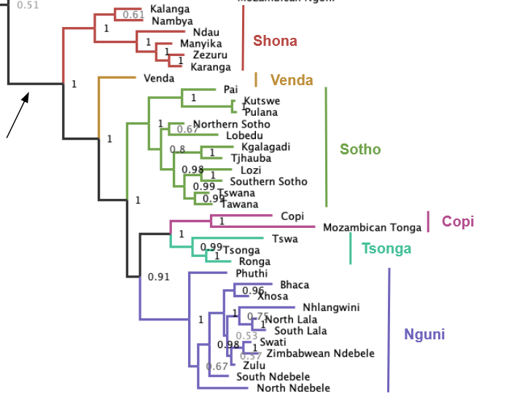
diachronic development
When did *c and *j change into lateral obstruents in Southern Bantu?
Alveolar lateral obstruents innovated in Proto-Nguni & Proto-Tsonga
No lateral obstruents in Proto-Nguni-Tsonga-Copi (unless Copi lost them or this clade does not exist after all)
Lateral obstruents in Tswana, N. Sotho and S. Sotho possibly due to Nguni contact

Slide 24
diachronic development
Why did *c and *j regularly change into lateral obstruents in certain Southern Bantu languages?
similar developments not attested elsewhere in Bantu
given the uncertain phonetic status of *c and *j, it is difficult to test whether this is a common development in other (non-Bantu) languages
Welsh: initial /l/ > /ɬ/
possible role of contact
with Cushitic:
Southern Cushitic languages spoken in Northern Tanzania make use of lateral obstruents
lateral obstruents also occur in Hadza and Sandawe > areal feature?
with Southern African Khoisan

Slide 25
contact
The role of Khoisan contact in the development of lateral obstruents in Southern Bantu
Other phonological influence on Southern Bantu from Khoisan in the shape of clicks
Explains areal bias of lateral obstruents in Bantu
However:
Lateral obstruents not that common in Khoisan
Khoisan languages mostly have lateral affricates, esp. velars, whereas Bantu languages have both affricates and fricatives, mostly alveolars
Lateral obstruents may result from click loss, but some Southern Bantu languages with lateral obstruents also have clicks

Slide 26
contact
Link between clicks and lateral obstruents:
Clicks can correspond to lateral obstruents:
Click loss has resulted in lateral obstruents in various Khoisan languages
Clicks in Southern Sotho (Sotho, S33) correspond to lateral obstruents in Tswana (Sotho, S31): S. Sotho !o!a ‘chat’, Tswana tɬotɬa ‘chat’
Some Hadza clicks apparently correspond to Cushitic lateral obstruents: Hadza [ǁaʔa] 'worry, concern’, Proto-West-Rift-Cushitic *tɬ’aʔ ‘stumble, be upset’
Some correspondences between lateral obstruents and clicks in Mpondo (Nguni) and Xhosa (Nguni): Mpondo um-ǀhakuva, Xhosa um-ɬakuva ‘castor oil plant, Mpondo u-ɬango, Xhosa u-ǀango ‘door’
Lateral obstruents are often (28/31) changed to dental clicks in Zulu hlonipha

Slide 27
contact
Is the development of lateral obstruents in Southern Bantu influenced by contact? If so, which lateral obstruents, which languages, which contact situations?
Probably yes for velar lateral affricates in Nguni
Less clear for lateral obstruent reflexes of Proto-Bantu palatal stops
Are Southern Bantu lateral obstruents in any way related to clicks?
How do lateral obstruents relate to clicks generally? Do lateral obstruents ever change into clicks? Is the co-occurrence of clicks and lateral obstruents in many languages a) statistically significant, and b) historically meaningful?
Are Southern Bantu lateral obstruents in any way related to lateral obstruents found in East African languages?
Are lateral obstruents an areal feature of East African languages? How did that linguistic area come about, and did it ever extend to Southern Africa?

