Slide 1
Induced Cultural Shift: The Case of the Gǀui and the Gǁana.
Kems Monaka and Naomi Moswete
University of Botswana
20th July 2022. Riezlern, Austria

Slide 2
Background
San communities which have since time immemorial resided in the Central Kalahari Game Reserve (CKGR) are the Gǀui and the Gǁana.
Pelican & Maruyame (2015) report that the Gǀui and the Gǁana in the central Kalahari region “were given special treatment, because they were viewed as a unique hunter-gatherer community with minimal contact with the outside world.”
It was because of these particular San communities that the British protectorate government established the CKGR in 1961

Slide 3
Background
The reserve was established to protect wildlife and the traditional hunting-gathering lifestyle of the local San people (Silberbauer, 1965).
After independence in 1966, Botswana established the Bushman Development Programme (BDP) in 1974 which focused on San communities as a special ethnic group that needed special assistance, especially in regard to draught and hunger relief.

Slide 4
Background
The Bushman Development Programme (BDP) was subsequently renamed Remote Area Development Programme (RADP) (1978) and was still a drought and hunger relief programme targeting mainly the San but included other impoverished rural and remote populations.
However, with RADP the focus was not ethnicity but remoteness and socioeconomic marginalization (Government of Botswana, n.d.).

Slide 5
Background
It was under RADP that the Gǀui and the Gǁana were encouraged to relocate from their ancestral lands, and the actual relocation started in 1997.
The relocation was to ‘accessible’ locations called settlements.
Some of the CKGR residents felt the relocation was blackmail in the guise of amenities (Saugestd, 2001)

Slide 6
Background
These hunter-gatherer communities were encouraged to adopt pastoral and arable farming: to rear goats, farm, work for wages, sell handicrafts, and continue hunting and gathering (Tanaka, 1987), in an effort to have the San communities develop alongsi.de mainstream society.
It was in the settlements that these nomadic autochthonous groups of people began to adopt a sedentary lifestyle (Cassidy et al. (2001).
The socio-economic effects of life in settlements are regretted by Chebanne and Glon (2017)

Slide 7
Indigenousness, nation-building and democracy
Some of the ideologies that were at the heart of Botswana government’s effort in dealing with San communities in the CKGR and others in the country included.
  The definition of indigenousness and ethnicity
  Nation-building and the concept of Democracy on the basis of national ethnic homogeneity
  Botswana, Motswana, Setswana viewed as the idea identity for the country.

Slide 8
Indigenousness
Botswana adhered to the contention that all the various groups of people within its borders, Khoesan, Bantu and Indo European, were equally indigenous.
Claims by NGOs and various pressure groups (FPK, WIMSA, IWGIA etc) that argued for recognition of the San as the ‘indigenous people’ who had rights to practice their traditional way of life in the land of their ancestors were not accepted by the Botswana government (RETENG REPORT, 2007).

Slide 9
Indigenousness
That meant that San peoples needed to be integrated into mainstream society (Bennett, 2002)
Their livelihoods needed be brought up to the standard of other ‘indigenous’ groups of people (Nyati-Ramahobo, 1999)
And that could be achieved through the RADP (Saugestad, 2001; Cassidy et al. (2001); Mazonde, 2002).

Slide 10
Nation building and Democracy
At independence, the new leaders of Botswana adopted policies that promoted “a common national identity” as an approach to building a united nation (Mulimbi & Dryden-Petersen 2018:152).
Nation-building required that all groups of people within the borders of the country who are citizens be identified as Batswana (Hays, 2004).

Slide 11
Nation building and Democracy
Pelican & Maruyama (2015) further report that “as a ‘frontline state’ in the fight against apartheid South Africa, the Botswanan government consciously adopted a ‘non-racial democracy’ and denied separate development based on differential treatment along racial or ethnic lines (Government of Botswana, n.d., Takada, 2016).
Botswana Government viewed diversity as an inconvenience (Saugestad, 2001).
Ideas of homogeneity and seen as surceding quality of life (Nyati-Ramahobo, 1999)

Slide 12
Nation building and Democracy
Nation-building and democracy meant that San communities are seen as part of “a common national identity” (Mulimbi & Dryden-Petersen, 2018, p.152), and needed to ‘develop’ along mainstream society (cf. Cassidy et al., 2001).
Wherever the San were found, they were subsumed under the Setswana group of that territory (Maoznde, 2001)

Slide 13
Development: Amenities
The Gǀui and the Gǁana in the Central Kalahari Game Reserve (CKGR) were therefore relocated to settlements equipped with developmental amenities: health facilities, feeding programs, drinking water, sports and recreation facilities, shelter, sanitation services, pensions for the elderly, residential plots, land for arable and pastoral farming, etc. (Motshabi, 2006; cf. Botswana Government, 2014, Pelican & Maruyama, 2015))
Location of residence within settlements was by choice (Ikeya, 2001), but this was also criticized by Saugestad (2001)

Slide 14
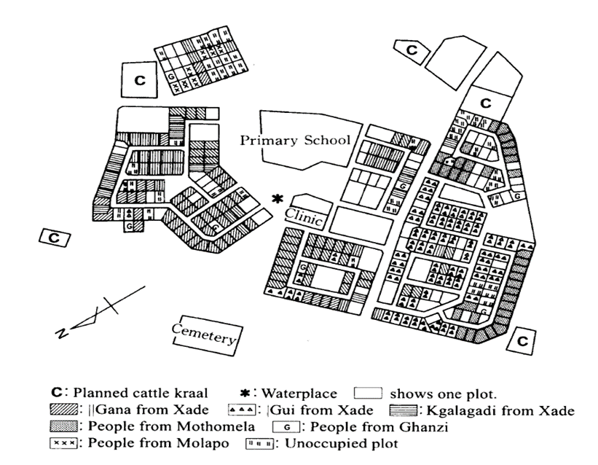
Development:
Arrangement of residential plots
(Cf. Ikeya, 2001)

Slide 15
Observed cultural shift
Disruption of nomadic residential groups
Traditional residential groups of the Gǀui and the Gǁana in the CKGR typically consisted of 10-20 nomadic hunter-gatherer families, also called camps, and fluid and temporal (Tanaka, 2016).
In contrast, the Gǀui and the Gǁana were densely packed together in the settlements, which was an experience they never had.
For examples, in New Xade (Kx’oensakene), population estimates ranged from 1,100 in 2000 to 1,500 in 2003 (Maruyame, 2016).

Slide 16
Observed cultural shift
Disruption of nomadic residential groups
The traditional residential groups in the CKGR were nomadic, fluid and temporal. Seasonal change of food resources determined the duration and size of residential groups, and kinship bonds and other relationships determined membership(Tanaka, 2016).
In the resettlements, (e.g., New Xade (Kx’oensakene), nuclear families were allocated fixed residential plots within a grid. Allocation was made in the order of arrival and did not take into consideration existing social relationships in the CKGR which were the backbone of residential groups (Ikeya, 2001, Maruyama, 2016)

Slide 17
Observed cultural shift
Disruption of nomadic residential groups
New social arrangement meant that residential groups were disrupted together with the traditional way of life that they drove.
Traditionally, they were a basic unit that shared living spaced, hunting grounds and food.
The new social order put strain on food resources, and produced idle adults (Chebanne and Glon, 2017)

Slide 18
Observed Cultural Shift: Resilience
Creation of mobile dwellings in the bush
Some of the San people moved to the surrounding bush where they live in small-scale mobile hunter-forager groups who also practiced agropastoralism on a small scale. Maruyama (2016, p. 177) reports that “Since 2003, more than 30 bush dwellings have continued to exist to date” and that these bush dwellings “have emerged as the new residences.”
They are mobile in the sense that the locations shift every once in a while “in search of natural resources or good neighbours (Ibid., p. 182)

Slide 19
Observed Cultural Shift: Resilience
Arrangement of houses in the settlement vs the bush
Plots/houses/huts in the settlements were arranged in rows as opposed to the traditional circular, and spaced-out arrangement.
Arrangement of the bush dwellings (New Xade/Kx’oesakene attempted to recover traditional arrangement pattern.
Gǁana homesteads are moved eastward towards the CKGR, and the Gǀui homesteads are moved southward towards the Hanahai valley (Chebanne and Glon, 2017).

Slide 20
Observed Cultural Shift: Resilience
Arrangement of plots/house/huts in rows in settlements = described “disorder” and “creates social conflict between people living in neighbouring plots” (Maruyame, 2016, p. 180).
Although the sedentary life was imposed on the Gǀui and Gǁana, they have been resilient in their attempt to recapture to some extent their nomadic residential existence through establishment of mobile bush dwellings.
The 2006 High Court ruling as leveraged some resilience in that some of the San were allowed to go back to the Reserve.

Slide 21
Observed Cultural Shift: Ecology
The CKGR provide the Gǀui and the Gǁana with ample natural space to develop and exercise ecological knowledge which was pivotal in hunting and foraging.
It encompassed
knowledge of specific trees used as landmarks
an understanding of woodlands and basins as environmental nodes that provide valuable resources
a conceptualization of dry valleys composed of sequences of woodlands or basins, which are used as routes for nomadic movement (Takada, 2016, pp. 149-150).

Slide 22
Observed Cultural Shift: Ecology
This ecological knowledge as also been adversely affected by relocation from an environment that engineered and supported it (cf. Takada, 2016).
The loss of traditional means of production aggravated loss of life-skills and added to the idle life of the community whose recourse is just Government food rations. (Glon and Chebanne, 20212 a & b).

Slide 23
RADP an instrument of assimilation
A refusal to acknowledge peculiarities that characterise groups within the borders of Botswana, and the determination to describe all citizens as Batswana = an assimilationist approach that seeks to suppress other ethnic groups into the dominant Tswana group.
The leaders of independent Botswana envisaged one nation under one flag and speaking one language (Nyati-Ramahobo 2004).
E.g In his address to the nation, Sir Seretse Khama, the first president, stated that his party pursued “a gradual but sure evolution of a nation state” (Nyati-Ramahobo 2002).

Slide 24
RADP an instrument of assimilation
Thus, the true vision of the leaders of the country is still on track, where non-Tswana groups in the country are planned to evolve into Batswana people under one flag, who speak Setswana language and practice Setswana culture.
The vision is to render “the total being of the non-Tswana invisible” (Nyati-Ramahobo 2004:6).
The illusions of homogeneity and unity are still perpetuated on national visions and development programmes (Chebanne, 2016).

Slide 25
Conclusion
The removal of indigenous San people from their ancestral lands is destructive to their indigenous knowledge systems, cultures and livelihoods.
San in settlements left with no life-skills.
Relocating them to areas that are destructive to their ethnic identity amounts to annihilation of such communities since it leads to loss of their language, their ethnic identity, and their culture as well as their survival strategies (Chebanne & Glon, 2017)

Slide 26
Conclusion
Nation-building and democracy strategies adopted by Botswana is at the heart of the problem, most assuredly making the uniqueness of peoples invisible and seeking to assimilate them into powerful groups (Werbner, 2004).

Slide 27
The End
Thank You!

