Slide 1
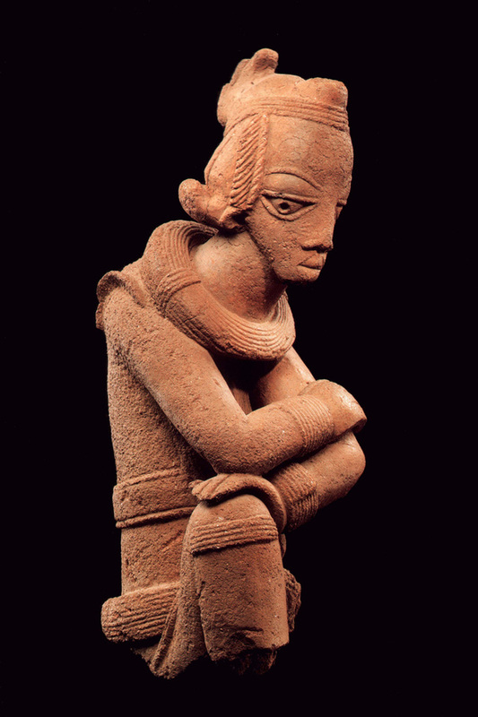
Words for ‘iron’ in Nigeria
Tracing the Spread and Borrowing of Technical Vocabulary
Jakob Lesage, HU Berlin (jakob.lesage@gmail.com)
Afrikalinguistisches Kolloquium HU Berlin
02.05.2023

Slide 2
Introduction

Slide 3
No discipline has uncovered the history and spread of early ironworking in Africa.
Since the middle of the 20th century, scholars were drawn to linguistics for clues.

Slide 4
Vansina 2006: a mix of three approaches
Geographical distribution of a reflex indicates age (but not always).
Semantic divergence within the reflex indicates age (but not always).
Implicit: Reconstruction indicates when and where a word originated.
Vansina (2006) does not dedicate much discussion to methodology

Slide 5
An example: °tale and °bolo

Slide 6
Weaknesses of the approach?
Reliance on intuition.
Should we rather quantify discontinuity and semantic drift to make it more replicable?
General approach: build a coherent picture that takes into account what we already know from archaeology. But subordinating linguistic evidence to that of other disciplines risks confirmation bias.

Slide 7
Is this the right approach?
What is interdisciplinarity? Should we let each discipline speak for itself before we integrate them?
This would imply abandoning the assumption that there will be traces in languages just because there are archaeological clues for early iron working.
The assumption becomes a question rather than a given: can words for ‘iron’ tell us something about the history of ironworking?

Slide 8
Three words-and-things perspectives

Slide 9
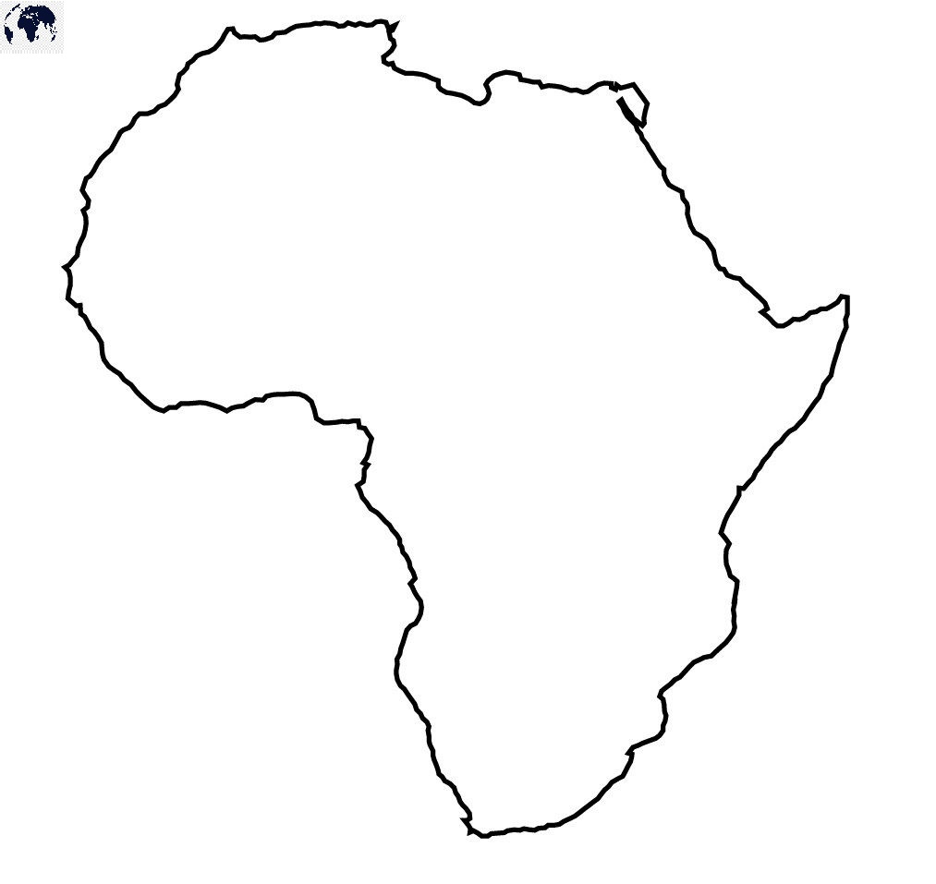
Three words-and-things perspectives
What forms express ‘iron’, where?
What meanings does °bòlò express, where?
Where and how did °bòlò come to mean ‘iron’?
e.g. Bostoen 2005
1
Forms
Meanings
sharp
inyi
beat
war
bòlò
soy
thing
cuma
3
2
3
°bòlò
‘iron’
2
1
Proto-*

Slide 10
The onomasiological perspective

Slide 11
The onomasiological perspective
The onomasiological approach asks which forms express a given concept, then classifies them into ‘cognate sets’.
  Concept = constant variable
  Forms = observed variable
Necessary starting point. Yields initial hypotheses.

Slide 12
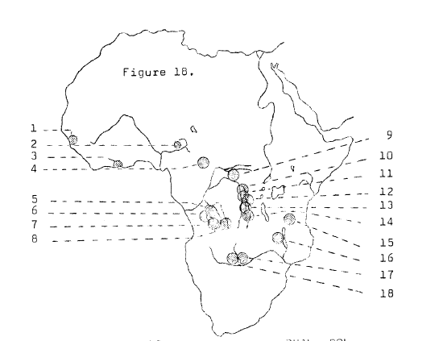
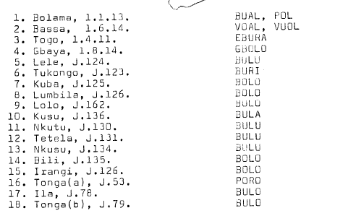
Example: Blakney 1963

Slide 13
Advantages and disadvantages
+
-
Fairly quick and easy
Not much expertise required
Necessary first step
Yields possible hypotheses
No reconstruction → subjective judgements
Missing data has a big impact
In early studies: only focus on big ‘cognate sets’

Slide 14
Elaboration of the method

Slide 15
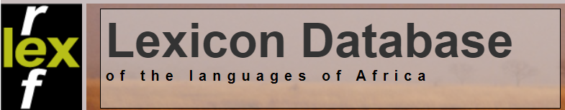


Elaboration: data processing
More data: also look at small cognate sets, which say something about variation.
Better trees help to judge chance
correspondences.
Automatic cognate suggestions.

Slide 16
Elaboration: analysis
Compare the spread of cognate sets with the spread of language families. Overlay cognate sets onto family trees.
  This helps us to detect where reconstruction is more likely.
  And where a lot of borrowing may have happened.
Quantify and compare the diversity of ‘iron’ cognate sets to those of other concepts. Does ‘iron’ follow the same pattern as other vocabulary?

Slide 17
Nigeria as a case study

Slide 18
Data collection
+ anything else I could find
More procedures:
Confidence coding of the data (e.g. old sources)
‘Cognate’ coding, with ‘conservative’ judgments vs. ‘greedy’ judgments
Separate ‘primary’ words from non-secondary ones – filtering out duplicates and low confidence forms

Slide 19
Approach 1: identify cognate sets
Cognate sets
Families

Slide 20
Approach 2: cognate sets across families
‘Reconstructibility’
‘Borrowability’

Slide 21
Approach 3: comparison with ‘fire’

Slide 22
Discussion

Slide 23
Discussion
Words for ‘iron’ are very diverse in Nigeria (cf. Lothe 1952; Blench 2006).
This diversity is still meaningful
  When we quantify it
  When we compare its interaction with genealogical and lexical diversity

Slide 24
Discussion: typology of areas
Reconstruction potential
 | Borrowability
Younger words?
In-group interaction only?
Knowledge ‘passed on’ + complex technological interaction between communities?
Diffusion primarily through (less intense?) interaction (trade?)

Slide 25
Discussion: comparison with basic vocabulary
Can independently corroborate hypotheses about borrowing and inheritance.
Can help us frame lexical stability with ‘iron’ in the light of other lexical changes.

Slide 26
Conclusion

Slide 27
Conclusion
Scholars sometimes prioritize triangulating findings over careful intra-disciplinary methods and linking archaeology with languages.
Interdisciplinary work should prioritize attention to individual disciplines, such as generating hypotheses purely from linguistic data.
Comparing these hypotheses with data from other disciplines, such as archaeology, can open up a dialogue between disciplines and reveal a more complex picture of technological dispersal than simple ‘borrowing’.

