Slide 1
Kalahari Basin Area Workshop
Humbolt University of Berlin
Held at Riezlern 17 – 21 July 2022)

Slide 2
The San have attitudes also: an overview of inter-Khoisan ethnic relationships and attitudes
Andy Chebanne
University of Botswana

Slide 3
Abstract …
It is now widely accepted that Khoisan people have inhabited the Kalahari Basin for many thousand years. Although they belong to different language groups, there is evidence that while they maintained distinct ethnic speech communities, they interacted over the centuries.
They also maintain different cultures; others were livestock keepers; while others maintained hunter-gathering life-stye, or both. However, it is not evident what social attitudes they presented towards each other.

Slide 4
… Abstract
Over the years, the researcher has made observations and collected evidence of inter-ethnic attitudes among the Khoisan of Botswana.
This paper discusses these attitudes, and will submit that these communities have social and cultural differences that they show towards each other in certain social contexts.
Contact situations with non-Khoe and San neighbours might have also contributed to this situation.

Slide 5
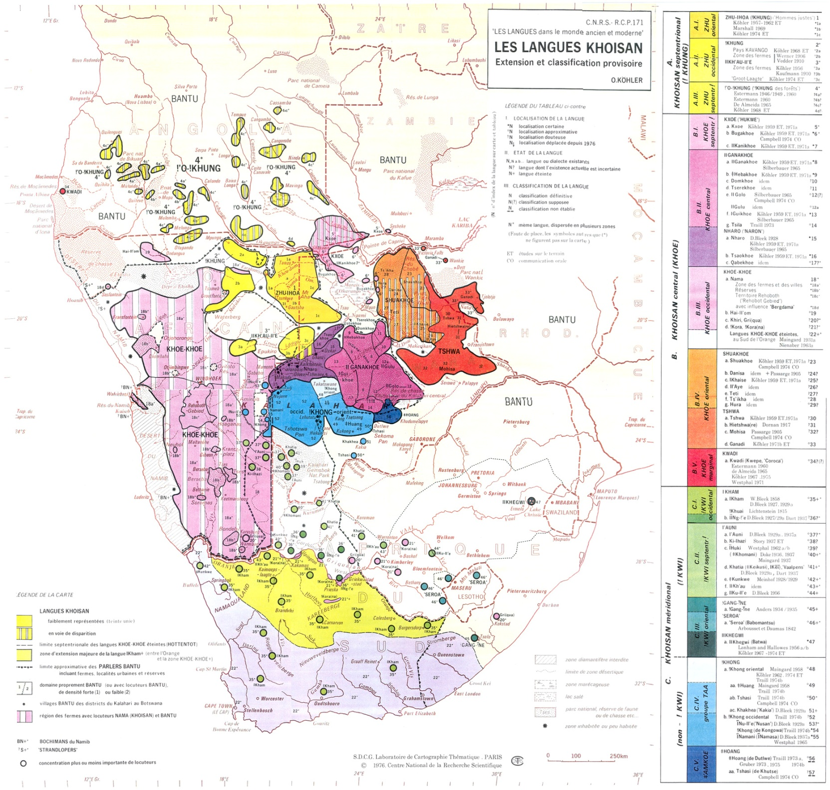
The Khoisan Historically and geographically

Slide 6
Background to the Issues …
The People they call “Basarwa”
In Botswana, speakers of Khoisan languages are called “Basarwa”. The term “Basarwa” to designate Khoisan speech communities appears in early ethnographers and anthropologists writings (Dornan, 1917) to denote what was variably called “Bushmen” and later Khoisan (Schapera, 1930).
The terms “San”, “Bushmen” and “Basarwa” have been used to refer to people with a long history of hunting and gathering in southern Africa (Weinberg, 1997). As Vossen (1998:18) observes, “Sarwa” is a cover term…so we do not know which particular “Sarwa” group or dialect is referred in each case”.

Slide 7
…background …
This term ‘Basarwa’ could be deduced from the phonology of the Setswana language, in which the -rwa should be considered a phonological evolution from the Bantu –Twa, meaning ‘pygmy’ or hunter-gatherer.
This –twa is also found in the designation of the cardinal point of south in Setswana, “bo-rwa”.
It can therefore be further deduced that there was an intermediary stage when there was “Ba-Rwa”, Southerners, and later, “Ba-sa-Rwa”, ‘people of the despicable manners of the Southerners’.

Slide 8
…background
This would then not make “Basarwa” a term that can be rehabilitated for Khoisan as it has the semantic value of the ‘Bushmen’ or the “uncultured”. The Sa-Rwa would therefore be a derogatory designation of what was the “–Twa” among Sotho-Tswana.
This could explain the continued negative social attitudes towards the Khoisan.
Jeffreys wrote an article entitled ‘The Batwa: Who Are They?” He suggested that the term Batwa implies ‘foreigner’ or stranger. The term ‘Batwa’ can also, Jeffreys argued, be used to imply ‘alien’ or ‘inferior’ (Jeffreys 1953: 45)

Slide 9
Introduction…
While nothing much is known of Khoisan languages speaking communities’ ancient history (cf. Denbow1986), their location in Southern Africa, shown by archaeological effects and coupled with some ancient rock art paintings (cf. Dowson & Lewis-Williams, 1994:5) makes them a southern Africa ethnic and cultural entity. Their linguistic classification shows that in Southern Africa, there are at leas two language families within the Khoisan.

Slide 10
…Introduction
Ancient ethnic and linguistic contact situations have been postulated (du Plessis, 2009:225). Modern Africa history is replete with accounts of their interaction with other Africans, but little about among themselves.
This history is also presented from a contact perspective, that is, in relation to the socio-historical and socio-economic activities that other African and non-African groups initiated in their interaction with the Khoisan speech communities (cf. Brenzinger et al., 1991).

Slide 11
Their lack of collective self-reference…
Currently there is no self-reference that is universally preferred by various indigenous groups of the Khoisan of southern Africa (Saugestad, 2001). In Namibia, for instance, Bushmen is used to refer to collectively various former foraging and it was not until 1996 that “San” began to be used in official circles (Saugestad, 2001).
For several years South Africa used the term Bushmen, but in the post-apartheid era, the term San was favoured, as seen by the establishment of the South African San Institute (SASI) in 1996.

Slide 12
… Their lack of collective self-reference
Generally therefore, the use of the term “Bushmen” in Southern Africa’s is no longer regarded part of correct discourse, it is interpreted by as having derogatory connotations. In Botswana, the term “Basarwa” was adopted officially (Batibo, 1998).
Therefore the current use of conventional generic term, ‘Khoisan’ equates to what some regional countries call “Basarwa” (cf. Cassidy et al (2001: 1) with reference to people coming from hunter-gatherer life-style, and are not a single community, linguistically and ethnically (Traill, 1986)).

Slide 13
Social Attitudes: Definitions …
In the reading of research on ethnicity, it is not possible to come to a common definition of ethnic attitude and identity.
In sociology and psychology behaviours, mainly negative, towards a different ethnic group constitute ethnic attitudes.
These behaviours are motivated by perceived differences, social problems associated with the their group, and competition for resources or power.
A feeling of belonging to and positive attitude towards one’s group constitute ethic identify, and is the basis of the construction of opposite feelings towards other groups.
Theories on self-identity and self-categorizations pursue group behaviours to try to understand factors that motivate egroup attitudes towards other groups

Slide 14
Aims of the discussion
To report on the geography and contact situations of the San communities;
Present their current social situations and relationships.
Discuss their social and sociolinguistics attitudes.
Characterize their inter-ethnic relationships.
Assess their socio-linguistics situations in view of the broader languages dynamics in Botswana.
Recommend on how positive attitudes and relationships could be built and sustained

Slide 15
Research Questions
Among the groups that are called :Basarwa”, how do you identify yourself?
How do you identify and relate to the “Basarwa”; group that you live with?
Do you like the other “Basrwa” group? And what are the issues that arise in your relationship?
Can you marry or be married in the other “Basarwa” group?
Can you speak anther “Basarwa” group language?
Can you give reasons why the other “Basarwa” group presents problems to you.

Slide 16
Questions soliciting social attitudes
Are you a “Mosarswa”?
What is your ethnicity within the Basarwa” identity? /
Do you have other Basarwa” in your village. Area?
How does your ethnic group relate to the these other “” Basarwa?
Which language do you use to speak to each other?
Who should make an effort to learn the other person’s language?
Can your group marry from the other group?
When you relate to “non-Basarwa, who is closer to them?

Slide 17
Sources of Data
Field research /Interviews
Observations
Historical accounts
Khoisan anthropological research
Linguistic research
Sociolinguistic research
Botswana Government reports

Slide 18
Research method
Observations
Oral questions
No determined sample size
Snowballing?
Essentially qualitative
Ethical issues sorted out first.

Slide 19
Theories on Ethnic Attitudes …
In the theory of Valk and Karu-Kletter (2001), ethnic identity involves ethnic differentiation and in-group preference
The in-group attitudes are characterize by hostility.
The relationship between ethnocentrisms (in-group bias)and ethnic attitudes may depend on group status and attitude modality.
A perceived threat, strength or advantage of another group influence or determine the nature of attitudes towards the group.

Slide 20
… Theories on Ethnic Attitudes
In Dustmann and Preston (2001) attitudes of one group (mainly the powerful or majority) constate social exclusion and social hostility.
Phinney et al. (2007) social psychology theories suggest that negative attitudes typical if not inevitable in inter-group attitudes.
Bratt (2002) propose the contact hypothesis and decategorization and the social identity theories as the comprehensive approaches to the discussion of social attitudes.

Slide 21
Sources of Social Attitudes
Government attitude:-
Haynes (n.d.:86) noted,
"Wild" Bushmen were encouraged to domesticate by active government
policy; and during severe droughts many roaming Bushmen found themselves camping at traditional water refuges in competition with cattle ranchers.
The Bushmen had to be forcibly trained in new habits, given new foods to eat, and taught new ideas, such as wage‐laboring, that irreversibly made them underclass participants in the revised economies of the colonial era.
In the late 1800s and early 1900s, African farmers and herders compelled “Bushmen” to herd cattle and work in the fields for no pay, in return for living space, some food, and water.
The Bushmen did not seem capable of protesting, and no government tried to emancipate them (quoted from Hitchcock et al., 2015: 5).

Slide 22
Social contact situations …
Except for Nama, there are no many other Khoisan languages that have survived contact situations for a long time.
It has also been noted in Chebanne (2008) that in Khoisan languages inter-ethnic contact, Khoe languages prevail over Non-Khoe such as the Ju (Northern San).
It is also possible that internal to the Khoisan speech communities, the sociolinguistics dynamics favored some groups, especially pastoralists, such as the Khoekhoe (Nama) and fishermen (the Kavango Khoe).
In this situation it was most likely that the Khoekhoe language was passed on to Khoisan speech communities that were non-Khoe.

Slide 23
… Social contact situations
Contact situations:-
But in this unknown history and sociolinguistics dynamics it is also possible that the Khoe speakers adopted and developed phonological and grammatical features of their neighbors (cf. Du Plessis, 2009; Louw (1979)).
Whichever way the situation is viewed, the extensive spread of Khoe languages speakers may be explained from these probable sociolinguistic assumptions which are that these languages were spoken by culturally and economically powerful people.

Slide 24
Brutality against the Khoisan …
The brutality of the people San called “potoko |ua Khoe”, the bone breakers.
We had almost reached the bank of the principal feeder of the Sua, called the Nata, where salt may be most readily procured, and where the Matabele are sent by their rulers every year to collect it.
The Bamangwato king was aware of the marauding habits of these parties, but did nothing to control them, although they perpetually disarm any Bamangwato they may meet, and delight in breaking the legs of the Masarwas (Holub 1881: 61). (quoted in Hitchcock et al., 2015: 4);

Slide 25
… Brutality against the Khoisan
Bryden (1893: 142) said that the San in 1890 were "in a state of absolute slavery and of hopeless degradation.” He went on to point out,
Woe betide him if the hunting season has been bad, or if the wild beasts have made havoc with flock and herd. He and his family must answer for it, in such a case, with heavy stripes, not seldom, indeed, a brutal death isthe penalty. Even his children and women folk are not his own, but may be and are seized and carried away into domestic servitude or concubinage (Bryden 1893: 143). (qioted in Hitchcock et al., 2015: 4).

Slide 26
THE KHOISAN HAVE ATTITUDES ALSO
Towards other Khoisan they have social attitudes also:
  These attitudes may range from accommodation to conflict (Vierich, 1996).
  Historically it has been reported that they would avoid each other to minimize conflict or completion for land and natural resources (Traill, 2000).
  Conflicts could also exist within a community, and splits would occur leading to movement far from conflict (Taylor, 2001).
Relocations and resettlements present numerous social challenges and may exacerbate conflicts (Chebanne & Monaka, 2005; Chebanne, 2007).

Slide 27
Khoisan Inter-attitudes …
Territoriality of the San:-
“Bushmen” in this country generally have their own well‑defined districts in which they hunt, and it would be bad form for a Metsibotlhoko Bushman to hunt in the Sebanene District. They do not like leaving their districts at all, and nothing as a rule will tempt them to do so. If a native wishes to form a cattle post, he sends the cattle to the Bushmen, not the Bushmen to the cattle (Hodson 1912: 228-228).

Slide 28
… Khoisan Inter-attitudes
Ethnic demographics in Inter-San contact:-
Population size of an ethnic group is important in contact situations. The group with more people dominates a smaller group (ex. G|ui in Khekhenye; G||ana in Xade and New Xade; Naro in Ghanzi Township, Cua in Kweneng North-East)
Language Development:-
Linguistic groups whose languages are developing develop positive identity but minimize other groups.

Slide 29
The Sasi and the Cua …
The Sasi belong to the Southern San and their language can be considered a variant of ǂHoan (Collins & Gruber 2015). They are found in northern Kgatleng and southern Ngwato Districts at Poloka, Mokgenee (Central District), Artesia, Dikgonnye, Khurutse, and Kogmodiatshaba (Kgetleng). In these localities, they lived as dependents of royal families of Bakwena and Bakgatla.
The Cua belong to the Eastern Kalahari Khoe (Chebanne, 2014) and may be considered an eastern extension of the Gǁana. They are found in Eastern Kweneng District (Sojwe, Shadishadi, Leologane, Lephephe, Mokgenene, Poloka (Central District), Dikgonnye and Kgomodiatshaba (Kgatleng District).

Slide 30
… The Sasi and Cua
While the Sasi and Cua are aware of each other, .and are found in the mentioned settlements, they avoid each other by maintaining clearly delimited settlement patterns. They will not occupy the same part of the settlement.
Sasi call the Cua “Bushmen” (Basarwa),and the Cua call the Sasi “Bakgatla” or “Bakwena” or just servants of these Tswana groups, and therefore not part of “Basarwa”.
Both groups are averse to inter-marriage but gladly accept marriage into Batswana families.

Slide 31
The Shorilatholo Cua and ǂHoan
The ǂHoan belong to Southern San just like the Sasi. Very few speakers have been documented (Collins and Gruber 2015) and are found in the northern Kweneng District in the settlements of Shorilatholo, Khudumelapye, Salajwe, Tshwane, and Dutllwe.
The Cua, an extension of the Gǁana, belong to the Eastern Kalahari Khoe group of languages (Chebanne 2014). They are fairly spread in northern Kweneng and Southern Central District.
In the northern District Cua are found in Kaudwane, Salajwe, Shorilatholo, Diphoduhudu, Ngwari, Boatlaname, Sojwe, Shadishadi, Leologane and Lephephe. They are therefore demographically sizeable.

Slide 32
… The Shorilatholo Cua and ǂHoan
Cua and ǂHoan mutually exclude each other, that is they marry their own, they do not inter-marry, but they would be married by Bakgalagari. One Mokgalagari lady is married by a ǂHoan.
ǂHoan are closer to Bakalagari and readily adopt a Shekgalagari language;
Cua adopt Sekwena and take the attitude of Bakwena towards the ǂHoan and the Bakgalagari.

Slide 33
The ǂHoan and Gǀui in Dutlwe and the Surroundings
ǂHoan are found in very small numbers in Dutlwe, Tshwane, Khekhenye and Takatokwane;
Gǀui or Khute as they are called by Bakgalagari are in majority;
The ǂHoan are sometimes referred as Tshasi, mistakenly so because the word refers to the Eastern ǃXoon;

Slide 34
… The ǂHoan and Gǀui in Dutlwe and the Surroundings
The ǂHoan and the Gǀui are considered both “Basarwa”. Bakgallagri can take their wives, but the “Baswara” may not take Bakgalagari wives;
The ǂHoan and the Gǀui accept each other as subalterns to the Bakgagalari in Dutlwe and the surrounding;
ǂHoan men have married Gǀui women, but they said it was possible that they could mutually marry.
When they face similar fate, their relationships are more positive.

Slide 35
Gǁana and Gǀui …
Gǁana and Gǀui speak mutually intelligible languages, and indication that they have coexisted for many hundreds years.
Their geography reported by Traill (1986) (Do the Kho have a place in the Sun?) is a separation by the Hanahai Valley – the Gǁana to the north and the Gǀui to the south.
From interviews, Gǁana and Gǀui believe they are nonetheless different, linguistically and culturally.
However, Gǁana and Gǀui also believe that they can sufficiently understand each other because they are aware of each other’ s speech differences.
The Gǀui feel the Gǁana have different social habits: they want positions, they are competing, they are greedy for social amenities.

Slide 36
… Gǁana and Gǀui
The Gǁana think the Gǀui are over-protective of their women; jealous, and want to live away from others; they exclude themselves.
The Gǁana also believe the Gǀui like to oppose them even on minor issues.
The Gǁana do not understand why the Gǀui treat them like “ Non-Basarwa”.
Asked why when they move their yards frm the New Xade Centre, the Gǁana ove eat and north, and the and Gǀui moving south or west, they both said that is the direction of their homeland.
Gǁana believe the Naro and other Khoe are their brothers, but the Gǀui believe the Naro are different.
There are therefore a lot of perceptions and false impressions in the social relationships between the Gǁana and Gǀui.

Slide 37
The Buga and the ǁAni
The Buga and the ǁAni and are the Okavango Khoe or Kxoe according to some research.
Geographically, The Buga are sand people – mainly hunting in the forest, and the ǁAni are river people, mainly fishing with the Bantu Kavango people.
I recent interviews, related to development of materials for literacy, the Buga felt that ǁAni speech was not pure, that is, it was influenced by the Kavango Bantu.
The Buga believe they are the real speakers of Khwedam.

Slide 38
The Makgadikgadi Khoe: Shua, Tcire-tcire, Ts’ ixa, Gǁoro, and Danisi (Danasani)
The Makgadikgadi (Nata, Manxotae, Gweta, Pphiduhudu, anabe, Mea, Zoroga) Khoe: Shua, Tcire-tcire, Ts’ ixa, and Danisi (Danasani) constitute a melting pot of the different Khoe speeches.
They have a higher mutual respect , and state that they are not in any competetion with other Khoe groups.
They believe they have a fair mutual intelligibility among themselves.
Their main regret is that Bantu have intermarried a ot with them and this has caused language and culture shift.

Slide 39
Reasons for San Social Attitudes
New settlements with development facilities
Co-existence with other population groups.
Among themselves they know their boundaries for natural resources and respect social relationships.
San groups that have stayed closer to Bantu groups are view with some misgivings.
In San and San contact situations, men marrying into the other group demonstrate their social power or status.
Mutual respect and reciprocal marriages are signs of good neighbourliness.

Slide 40
The San and the Others
According to research San live as herdsmen and laborers (Barnard 1992: 3; Cassidy et al., 2001:1-3; Chebanne, 2008:97) and mainly for other ethnic groups.
In Botswana, this situation has put these groups under the socio-economic and socio-cultural control by other groups (Batibo 2008).
The following quotation illustrates some of the consequential situations that these Khoisan groups have experienced in the recent history of regional countries.

Slide 41
Consequences of Servitude Relationship
The “Bushmen” relationship to other inhabitants of the subcontinent, both black and white, has always been difficult and tragic.
“Bushmen” were exterminated by both white and black settlers, who often regarded then as little more than vermin: at best, they were exploited as slave labour.
In the process, the Bushman population as a whole was decimated, and entire groups eradicated…(Riaan de Villiers, preface of Paul Weinberg 1997:7).

Slide 42
… servitude relationships
This inter-ethnic relation situation is also corroborated by the oral history that Osaki (2001) collected among the ǀGui and the ǁGana of the Central Kalahari Game Reserve.
The Tswana people (society) included the Kgalagadi tribe and the Bushmen, who lost their own land in the slave class….The Bushmen were put in the lowest class even under the Kgalagadi.
It should be pointed out that the root of various problems Bushmen are facing these days is traced to the traditional class-based social structure of the Tswana (Osaki, 2001: 34).

Slide 43
Accommodating Imperialistic tendencies
The San have for a long time accommodated or accepted imperialistic domination and loss of identity to their dominators.as their current situation is characterized by institutionalized assimilation, relocation, and language and culture loss (Chebanne; 2008).
They are subsumed under the ethnolinguistic identities of other groups (Suagestard, 2001; Maaznde, 2002).

Slide 44
Imperialistic tendencies and domination
It is the manner in which Bushmen tend to accommodate themselves to their conditions, whether the conditions entail environmental limitations and opportunities or social ones. Adaptations to social changes can be relatively permanent, or more commonly (at least until recently), temporary ones (Barnard, 1988: 12).
In contact situations among the ethno-linguistic communities that share similar culture and linguistic affinity harmonious co-existence is possible, but with pastoralists and other language groups, the Khoisan may retain their ethnicity and language for some time.
Social policy of Botswana still marginalizes the Khoisan (Chebanne, 2020).

Slide 45
Recommendations on Sustaining Positive Social Attitudes
The Khwedom Association that agitates and fight for social and economic rights for all Khoe languages is a good example of what may be done to unify San communities.
Collaboration among San associations should be encouraged.
Harmonization of related languages in orthography development would demonstrate their similarity.
Preparation of common resources (dictionaries, cultural compilation and documentation, and education initiatives will strengthen their resilience and hope for a better future.
Recognizing their ethnic groups as distinct entities with land resources.
Botswana social policy must change to favour the Khoisan

Slide 46
References…
Barnard, A. 1992. Hunters and Herders of Southern Africa: A Comparative Ethnography of the Khoisan Peoples. Cambridge: Cambridge University Press.
Barnard, A. 1988. Cultural Identity, Ethnicity and Marginalization among the Busmen of Southern Africa. In Rainer Vossen (ed.) New Perspectives on the Study of Khoisan, Quellen zur Khoisan-Forschung. Helmut Buske Verlag Hamburg.: pp, 9 – 27
Batibo, H.M. 1997. The Fate of Minority Languages in Botswana. Smieja, B. and M. Tasch (Eds.). 1997. Human Contact through Language and Linguistics: 243-252. Frankfurt: Peter Lang.
Chebanne, A. 2008. A Sociolinguistic Perspective of the Indigenous Communities of Botswana. African Study Monographs 29(3): 93-118. Kyoto: Centre for South East Asia
Denbow, J.R. 1986. “A New look at late pre-history of the Kalahari”. In: Journal of African History. Vol. 27: 3-28.
Du Plessis, M. 2009. A Unity Hypothesis for the Southern African Khoesan Languages. PhD Thesis, University of Cape Town.
Güldemann, T. & R. Vossen. 2000. Khoisan. In Khoisan Studies, ed. H. Bern & D. Nurse, 99 – 122. Cambridge, UK: Cambridge University Pres.
Hitchcock, RK. 1982 The Ethnoarchaeology of Sedentism: Mobility Strategies and Site Structure among Foraging and Food Producing Populations in the Eastern Kalahari Desert, Botswana. PhD dissertation, University of New Mexico, Albuquerque. New Mexico.
Hodson, AW 1912 Trekking the Great Thirst: Travel and Sport in the Kalahari Desert. London: T. Fisher Unwin.
Köhler, O.R.A. 1981. Les langues khoisan. Perrot, J. (Ed.). 1981. Les langues dans le monde ancien et moderne. Volume 1: Les langues de l'afrique subsaharienne — Pidgins et créoles: 455-615. Paris: Éditions du C.N.R.S.
Louw, J.A. 1979. “A preliminary survey of Khoi and San influence in Zulu” In a Traill (ed), Khoisan Linguistics Studies. 8:8-21.

Slide 47
…References
Mokhtar, G. (edit.)1990. General History of Africa (abridged Edition): II Ancient Civilizations of Africa. A James Currey. California. UNESCO Publication
Schapera, Isaac. 1930. The Khoisan Peoples of South Africa: Bushmen and Hottentots. London: Rutledge & Kegan Paul.
Shillington, K. 1989 (revised edition, 1995). History of Africa. London: Macmillan
Traill, A. 1986. Do the Khoi have a Place in the San? New Data on Khoisan Linguistic Relationship. Sprache und Geschichte im Afrika 7: 407-430.
Villiers, R. 1997. The Bushman – a Profile. In, , Weinberg, P. 1997. In Search of the Sun. The Porcupine Press, Johannesburg, South Africa
Vossen, R. (1997) “What click sounds got to do in Bantu: Reconstructing the history of language contacts in Southern Africa. In B. Smieja and M. Tasch (eds). Human Contact through Language and Linguistics. 353-368. Frankfurt: Peter Lang.
Vossen, R. 1988. Studying the Linguistic and Ethno-History of the Khoe-Speaking (Central Khoi­san) Peoples of Botswana. Botswana Notes and Records 16: 16-35.
Weinberg, P. 1997. In Search of the San. The Porcupine Press, Johannesburg, South Africa
Westphal, E.O.J. 1956. The Non-Bantu Languages of Southern Africa. Supplement to Tucker, A.N. and M.A. Bryan. 1956. The Non-Bantu Languages of North-eastern Africa: 158-173. London: Oxford University Press for the International African Institute.
Westphal, E.O.J. 1971. The Click Languages of Southern and Eastern Africa. Sebeok, Thomas A. (Ed.). 1971. Current Trends in Linguistics, Volume 7: 367-420. Linguistics in Sub-Saharan Africa. The Hague: Mouton.

